Slide 1
Part 3 – Binary outcome, difference in proportions between groups

Slide 2
In this Section
Focus on binary outcome variable
Find differences between the groups (is the proportion of the disease higher in one group than in another??)
Relative risk
Odds ratio
χ²-test
Logistic regression

Slide 3
Organize categorical data
2 x 2 table
 | Disease Yes/+ | Disease No/− | Total
Exposure Yes/+ | a | b | (a+b)
Exposure No/− | c | d | (c+d)
Total | (a+c) | (b+d) | (a+b+c+d) = N

Slide 4
Example
 | Diabetes + | Diabetes − | Totalt
Smoke + | a=14 | b=976 | 990
Smoke − | c=19 | d=777 | 796
Totalt | 33 | 1753 | 1786

Slide 5
Risk
The Risk is the probability of an event
Risk of the disease in each group:
Probability (exposed) = a/(a+b)
Probability (not exposed) = c/(c+d)
Relative risk of disease, exposed vs. not exposed:
RR = a/(a+b) / c/(c+d) = a(c+d) / c(a+b)

Slide 6
Risk
 | Diabetes + | Diabetes − | Totalt
Smoke + | a=14 | b=976 | 990
Smoke − | c=19 | d=777 | 796
Totalt | 33 | 1753 | 1786
The Risk is the probability of an event
Risk of the disease in each group:
Probability (exposed) = a/(a+b) = 14/990 = 0.0141
Probability (not exposed) = c/(c+d) = 19/796 = 0.0239
Relative risk of disease, exposed vs. not exposed:
RR = a/(a+b) / c/(c+d) = a(c+d) / c(a+b) =0.0141/0.0239 = 0.592

Slide 7
Odds
Odds is the likelihood of an event divided by the likelihood of a non-event
Odds of the disease in each group:
Odds (exposed)=a/(a+b) / b(a+b) = a/b
Odds (not exposed)=c/(c+d) / d(c+d) = c/d
Odds of the disease,
exposed vs. not exposed:
OR = (a/b)/(c/d) = a*d/b*c

Slide 8
Odds
 | Diabetes + | Diabetes − | Totalt
Smoke + | a=14 | b=976 | 990
Smoke − | c=19 | d=777 | 796
Totalt | 33 | 1753 | 1786
Odds is the likelihood of an event divided by the likelihood of a non-event
Odds of the disease in each group:
Odds (exposed)=a/(a+b) / b(a+b) = a/b = 14/976 = 0.0143
Odds (not exposed)=c/(c+d) / d(c+d) = c/d = 19/777 = 0.0245
Odds of the disease,
exposed vs. not exposed:
OR = (a/b)/(c/d) = a*d/b*c = 0.0143/0.0245 = 0.587

Slide 9
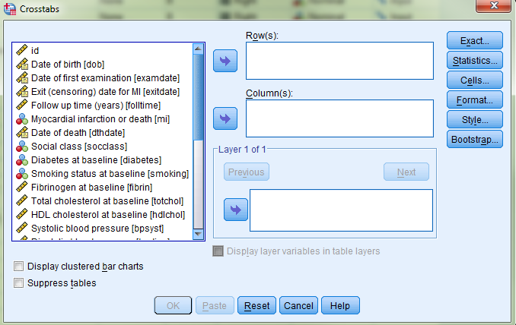
Compare proportions in groups
Calculating RR and OR in SPSS can be quite challenging
Go to «Analyze> Descriptive statistics> Crosstabs»

Slide 10
Compare proportions in groups
The outcome should go in the column and the exposure in the row,
The outcome we are interested in must be coded with the lowest value
The exposure we are interested in must be coded with the lowest value
It can be necessary to recode the variables

Slide 11
Exercise 3a
Find a possible connection between being a smoker (the variable «smoking») and myocardial infarction (the variable «mi») by calculating RR and OR
Hint: Re-code smoking first

Slide 12
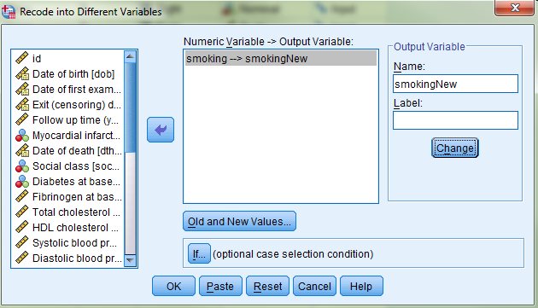
Exercise 3a: Solution
Re-code «smoking» to «smokingNew» with two categories.

Slide 13
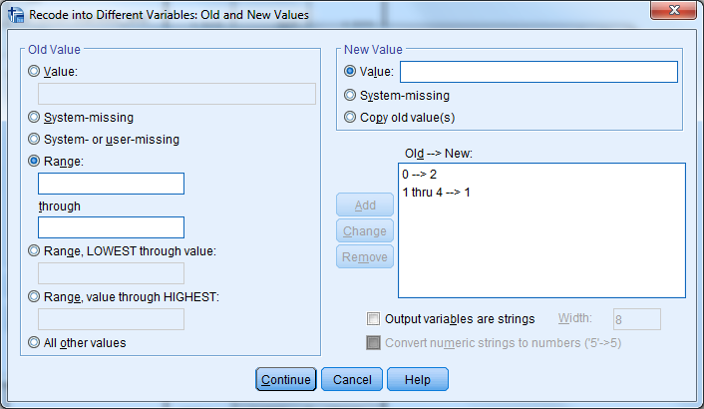
Exercise 3a: Solution
Re-code «smoking» to «smokingNew» with two categories.
Remember: The category we are interested in (those who have smoked) should have the lowest value.

Slide 14
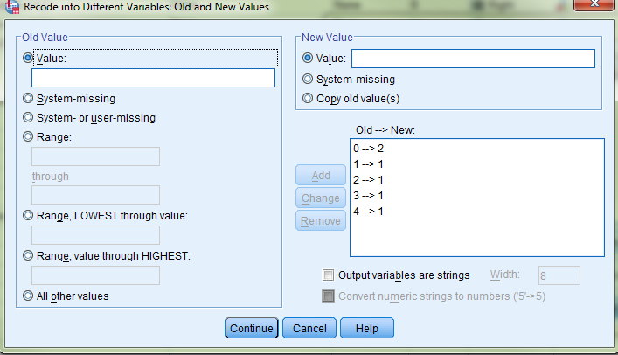
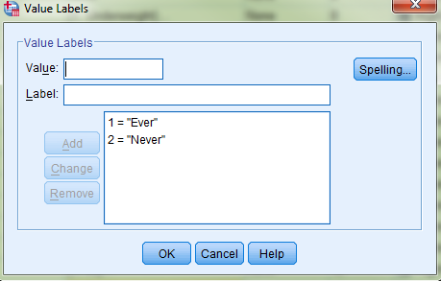
Exercise 3a: Solution
Re-code «smoking» to «smokingNew» with two categories.
Remember: The category we are interested in (those who have smoked) should have the lowest value
Add «Value Lables».
Also MI should be re-coded
«mi» → «miNew»
Add Value Labels (Yes / No)

Slide 15
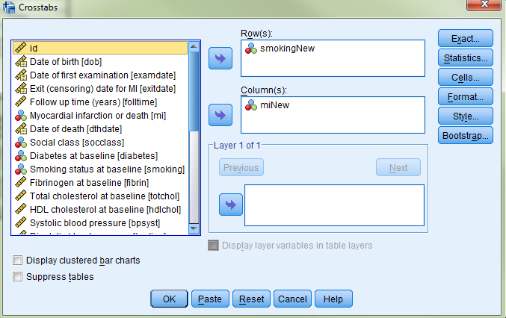
Exercise 3a: Solution
Go to «Analyze >Descriptive Statistics >Crosstabs».
«smokingNew» as rows «miNew» as columns

Slide 16
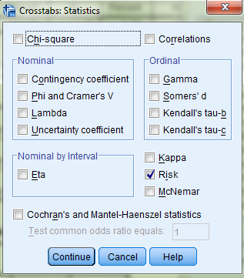
Exercise 3a: Solution
Go to «Analyze >Descriptive Statistics >Crosstabs».
«smokingNew» as rows «miNew» as columns
Click «Statistics», and select «Risk». Then «Continue»

Slide 17
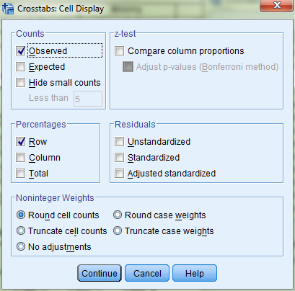
Exercise 3a: Solution
Go to «Analyze >Descriptive Statistics >Crosstabs».
«smokingNew» as rows «miNew» as columns
Click «Statistics», and select «Risk». Then «Continue»
Click «Cells», select «Observed» in «Counts», «Row» in «Percentages». Then «Continue».

Slide 18
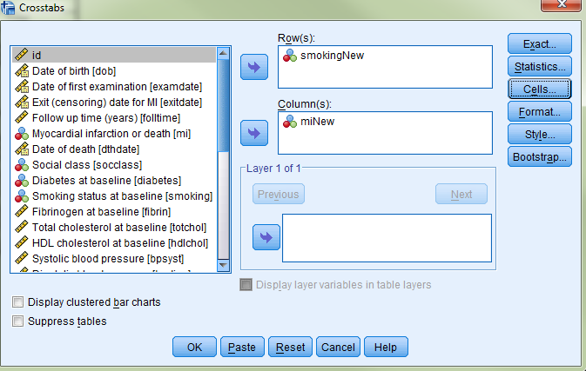
Exercise 3a: Solution
Go to «Analyze >Descriptive Statistics >Crosstabs».
«smokingNew» as rows «miNew» as columns
Click «Statistics», and select «Risk». Then «Continue»
Click «Cells», select «Observed» in «Counts», «Row» in «Percentages». Then «Continue».
Click «OK» in the original dialog box.

Slide 19
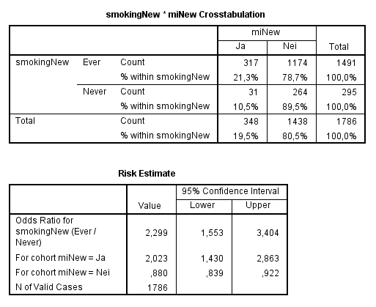
Exercise 3a: Solution
Interpreting output:
The odds are 2,3 times higher (95% CI: 1,6-3,4) for smokers, compared to non-smokers

Slide 20
Exercise 3a: Solution
Interpreting output:
The odds are 2,3 times higher (95% CI: 1,6-3,4) for smokers, compared to non-smokers
For comparison, the relative risk
(317/1491) / (31/295) = 2,02

Slide 21
RR and OR
RR og OR are useful tools to assess the effect of a binary exposure on a binary outcome
RR is easier to understand
OR sometimes is more useful
RR makes no sense in case-control studies, OR does
OR is used in logistic regression i logistisk regresjon
OR is always more extreme than RR
OR>RR>1
OR<RR<1
OR=RR=1
If the outcome is rare, then OR≈RR

Slide 22
χ²-test
If we are only interested in finding if there is a correlation between the row variable (exposure) and the column variable (outcome), without wanting to quantify the difference between the exposure groups, we can use a χ²-test.

Slide 23
χ²-test
If we are only interested in finding if there is a correlation between the row variable (exposure) and the column variable (outcome), without wanting to quantify the difference between the exposure groups, we can use a χ²-test.
Can have more than 2 categories in both variables.

Slide 24
χ²-test
Base Idea: comparing what we observe with what we would expect if we know that the variables are uncorrelated.
The expected numbers are obtained from the row and column totals in the table.
Compares the expected numbers with the observed numbers for each cell.
Variable coding is not influent for SPSS.

Slide 25
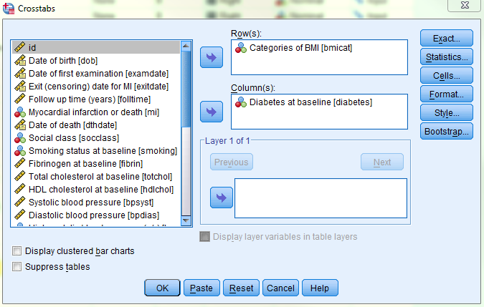
χ²-test
We want to find out if there is a connection between BMI categories and diabetes.
- «bmicat» (exposure) - «diabetes» (outcomes)

Slide 26
χ²-test
We want to find out if there is a connection between BMI categories and diabetes.
Go to «Analyze >Descriptive Statistics >Crosstabs» Add «bmicat» in «Rows», and «diabetes» in «Columns».

Slide 27
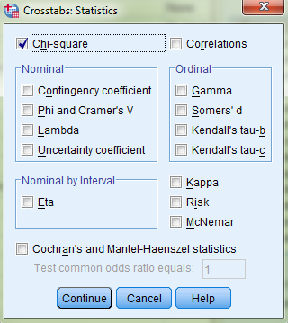
χ²-test
We want to find out if there is a connection between BMI categories and diabetes.
Go to «Analyze >Descriptive Statistics >Crosstabs».
Click «Statistics», and select «Chi-square», then «Continue»

Slide 28
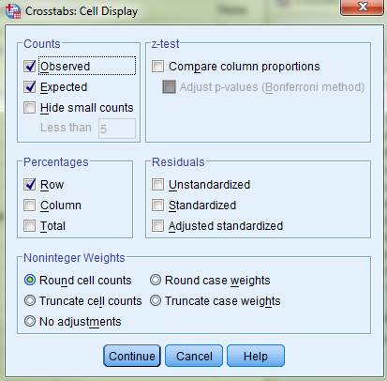
χ²-test
We want to find out if there is a connection between BMI categories and diabetes.
Go to «Analyze >Descriptive Statistics >Crosstabs».
Click «Statistics», and select «Chi-square», then «Continue»
Click «Cells», and select «Observed» and «Expected» under «Counts» and «Row» under «Percentages». Then «Continue»...

Slide 29
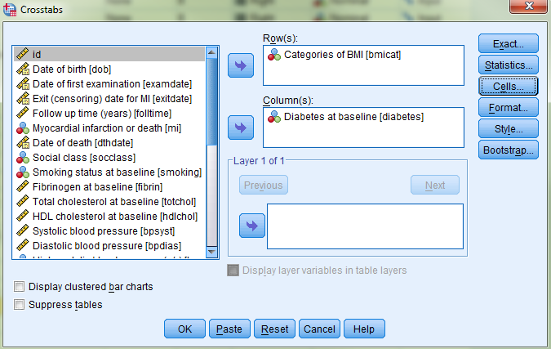
χ²-test
We want to find out if there is a connection between BMI categories and diabetes.
Go to «Analyze >Descriptive Statistics >Crosstabs».
Click «Statistics», and select «Chi-square», then «Continue»
Click «Cells», and select «Observed» and «Expected» under «Counts» and «Row» under «Percentages». Then «Continue» and «OK».

Slide 30
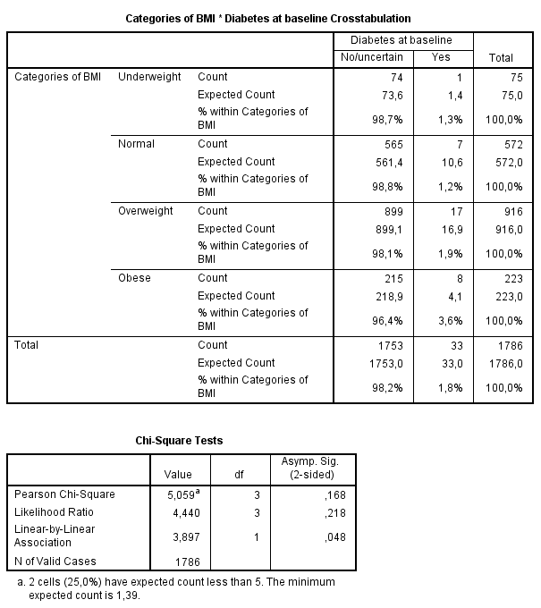
χ²-test
Interpreting output:
First table:
Observed counts.

Slide 31
χ²-test
Interpreting output:
First table:
Observed counts.
Expected counts (if there was no difference in the BMI categories).

Slide 32
χ²-test
Interpreting output:
First table:
Observed counts.
Expected counts (if there was no difference in the BMI categories).
The proportion with diabetes in each category.

Slide 33
χ²-test
Interpreting output:
First table:
Observed counts.
Expected counts (if there was no difference in the BMI categories).
The proportion with diabetes in each category.
The second table gives the result of the χ²-test.

Slide 34
χ²-test
Interpreting output:
First table:
Observed counts.
Expected counts (if there was no difference in the BMI categories).
The proportion with diabetes in each category.
The second table gives the result of the χ²-test. - BMI does not have an effect on Diabetes

Slide 35
χ²-test
To use the χ²-tes for a 2x2-table:
Total number of units in the table/study have to be above 40
OR
Total number of units must be between 20 and 40, and all expected values are greater than 5
To use the χ²-tes for a table bigger than 2x2:
Less than 20% of the expected values are lower than 5
AND
No expected values are less than 1

Slide 36
χ²-test

Slide 37
Logistic regression
Similar to linear regression, but with binary outcome.

Slide 38
Logistic regression
Similar to linear regression, but with binary outcome.
We can adjust for categorical variables (2+ categories).

Slide 39
Logistic regression
Similar to linear regression, but with binary outcome.
We can adjust for categorical variables (2+ categories).
We can adjust for continuous variables.

Slide 40
Logistic regression
Similar to linear regression, but with binary outcome.
We can adjust for categorical variables (2+ categories).
We can adjust for continuous variables.
But:
We calculate the logarithm of an odds ratio, rather than a continuous variable.

Slide 41
Logistic regression
Similar to linear regression, but with binary outcome.
We can adjust for categorical variables (2+ categories).
We can adjust for continuous variables.
But:
We calculate the logarithm of an odds ratio, rather than a continuous variable. Instead of

Slide 42
Logistic regression
Similar to linear regression, but with binary outcome.
We can adjust for categorical variables (2+ categories).
We can adjust for continuous variables.
But:
We calculate the logarithm of an odds ratio, rather than a continuous variable. Instead of p/(1-p) is the odds ratio of the outcome

Slide 43
Logistic regression
$$\log\left(\frac{p}{1−p}\right)=β_{0}+β_{1}x$$
If $x$ is a binary variable (for example smoking):
$x=1$ if smoker, og $x=0$ if not smoker.
The odds of smokers is $exp⁡(β_{0}+β_{1})$.
The odds of non smokers is $\exp\left(β_{0}\right)$
OR is: $\frac{\exp\left(β_{0}+β_{1}\right)}{\exp\left(β_{0}\right)}=\exp\left(β_{0}+β_{1}−β_{0}\right)=\exp\left(β_{1}\right)$.
The exponential of the coefficient, $\exp\left(β_{1}\right)$, is interpretable as an OR!

Slide 44
Logistic regression
$$\log\left(\frac{p}{1−p}\right)=β_{0}+β_{1}x$$
If $x$ is a binary variable (for example smoking):
$x=1$ if smoker, og $x=0$ if not smoker.
The odds of smokers is $exp⁡(β_{0}+β_{1})$.
The odds of non smokers is $\exp\left(β_{0}\right)$
OR is: $\frac{\exp\left(β_{0}+β_{1}\right)}{\exp\left(β_{0}\right)}=\exp\left(β_{0}+β_{1}−β_{0}\right)=\exp\left(β_{1}\right)$.
The exponential of the coefficient, $\exp\left(β_{1}\right)$, is interpretable as an OR!

Slide 45
Logistic regression
$$\log\left(\frac{p}{1−p}\right)=β_{0}+β_{1}x$$
If $x$ is a binary variable (for example smoking):
$x=1$ if smoker, og $x=0$ if not smoker.
The odds of smokers is $exp⁡(β_{0}+β_{1})$.
The odds of non smokers is $\exp\left(β_{0}\right)$
OR is: $\frac{\exp\left(β_{0}+β_{1}\right)}{\exp\left(β_{0}\right)}=\exp\left(β_{0}+β_{1}−β_{0}\right)=\exp\left(β_{1}\right)$.
The exponential of the coefficient, $\exp\left(β_{1}\right)$, is interpretable as an OR!

Slide 46
Logistic regression
$$\log\left(\frac{p}{1−p}\right)=β_{0}+β_{1}x$$
If $x$ is a binary variable (for example smoking):
$x=1$ if smoker, og $x=0$ if not smoker.
The odds of smokers is $exp⁡(β_{0}+β_{1})$.
The odds of non smokers is $\exp\left(β_{0}\right)$
OR is: $\frac{\exp\left(β_{0}+β_{1}\right)}{\exp\left(β_{0}\right)}=\exp\left(β_{0}+β_{1}−β_{0}\right)=\exp\left(β_{1}\right)$.
The exponential of the coefficient, $\exp\left(β_{1}\right)$, is interpretable as an OR!

Slide 47
Logistic regression
$$\log\left(\frac{p}{1−p}\right)=β_{0}+β_{1}x$$
If $x$ is a binary variable (for example smoking):
$x=1$ if smoker, og $x=0$ if not smoker.
The odds of smokers is $exp⁡(β_{0}+β_{1})$.
The odds of non smokers is $\exp\left(β_{0}\right)$
OR is: $\frac{\exp\left(β_{0}+β_{1}\right)}{\exp\left(β_{0}\right)}=\exp\left(β_{0}+β_{1}−β_{0}\right)=\exp\left(β_{1}\right)$.
The exponential of the coefficient, $\exp\left(β_{1}\right)$, is interpretable as an OR!

Slide 48
Logistic regression
SPSS:
Interprets the highest value of the (sick / not sick) as the one we are interested in.

Slide 49
Logistic regression
SPSS:
Interprets the highest value of the (sick / not sick) as the one we are interested in.
For the independent variable (exposure), we select the reference category (baseline) in the menu.

Slide 50
Logistic regression - example
Estimate logistic model for «diabetes», with «overvekt» as independent variable.
(overvekt =1, not overvekt =2)

Slide 51
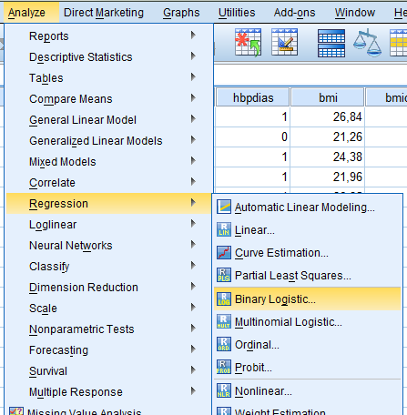
Logistic regression - example
Estimate logistic model for «diabetes», with «overvekt» as independent variable.
(overvekt =1, not overvekt =2)
Click «Analyze->Regression->Binary logistic».

Slide 52
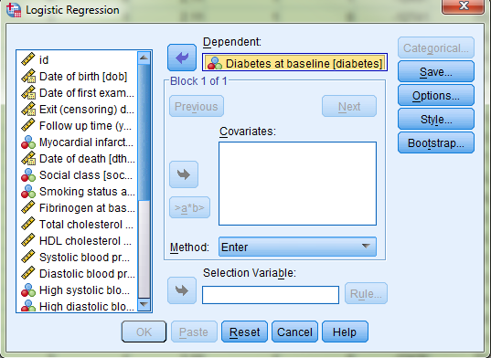
Logistic regression - example
Estimate logistic model for «diabetes», with «overvekt» as independent variable.
(overvekt =1, not overvekt =2)
Click «Analyze->Regression->Binary logistic».
Original diabetes variable (1=diabetes, and 0= no diabetes) as dependent variable (outcome variable).

Slide 53
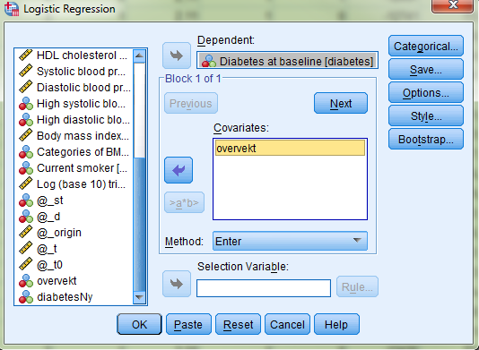
Logistic regression - example
Estimate logistic model for «diabetes», with «overvekt» as independent variable.
(overvekt =1, not overvekt =2)
Click «Analyze->Regression->Binary logistic».
Original diabetes variable (1=diabetes, and 0= no diabetes) as dependent variable (outcome variable).
Adds «overvekt» for «Covariates».

Slide 54
Logistic regression - example
Estimate logistic model for «diabetes», with «overvekt» as independent variable.
(overvekt =1, not overvekt =2)
Click «Analyze->Regression->Binary logistic».
Original diabetes variable (1=diabetes, and 0= no diabetes) as dependent variable (outcome variable).
Adds «overvekt» for «Covariates». Then, click «Categorial».

Slide 55
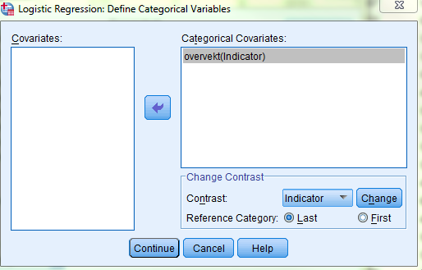
Logistic regression - example
Estimate logistic model for «diabetes», with «overvekt» as independent variable.
(overvekt =1, not overvekt =2)
Click «Analyze->Regression->Binary logistic».
Original diabetes variable (1=diabetes, and 0= no diabetes) as dependent variable (outcome variable).
Adds «overvekt» for «Covariates». Then, click «Categorial».
Move «overvekt» in «Categorical Covariates».

Slide 56
Logistic regression - example
Estimate logistic model for «diabetes», with «overvekt» as independent variable.
(overvekt =1, not overvekt =2)
Click «Analyze->Regression->Binary logistic».
Original diabetes variable (1=diabetes, and 0= no diabetes) as dependent variable (outcome variable).
Adds «overvekt» for «Covariates». Then, click «Categorial».
Move «overvekt» in «Categorical Covariates».
Select «Reference Category: Last» .
Then, «Continue».

Slide 57
Logistic regression - example
Estimate logistic model for «diabetes», with «overvekt» as independent variable.
(overvekt =1, not overvekt =2)
Click «Analyze->Regression->Binary logistic».
Original diabetes variable (1=diabetes, and 0= no diabetes) as dependent variable (outcome variable).
Adds «overvekt» for «Covariates». Then, click «Categorial».
Move «overvekt» in «Categorical Covariates».
Select «Reference Category: Last» .
Then, «Continue».
NB! If you want to change the reference category, remember to press «Change» before pressing «continue»!

Slide 58
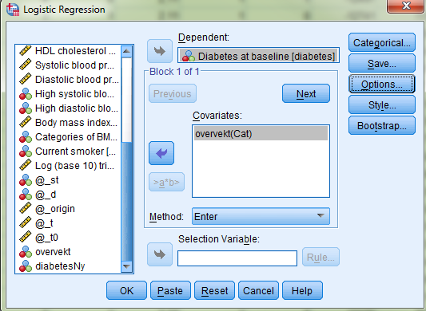
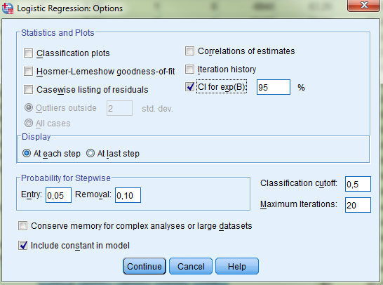
Logistic regression - example
Estimate logistic model for «diabetes», with «overvekt» as independent variable.
(overvekt =1, not overvekt =2)
Click «Analyze->Regression->Binary logistic».
Original diabetes variable (1=diabetes, and 0= no diabetes) as dependent variable (outcome variable).
Adds «overvekt» for «Covariates». Then, click «Categorial».
Move «overvekt» in «Categorical Covariates».
Select «Reference Category: Last» .
Then, «Continue».
Click «Options», then select:
«CI for exp(B): 95%»

Slide 59
Logistic regression - example
Estimate logistic model for «diabetes», with «overvekt» as independent variable.
(overvekt =1, not overvekt =2)
Click «Analyze->Regression->Binary logistic».
Original diabetes variable (1=diabetes, and 0= no diabetes) as dependent variable (outcome variable).
Adds «overvekt» for «Covariates». Then, click «Categorial».
Move «overvekt» in «Categorical Covariates».
Select «Reference Category: Last» .
Then, «Continue».
Click «Options», then select:
«CI for exp(B): 95%»
«Include constant in model»
Then, «Continue».

Slide 60
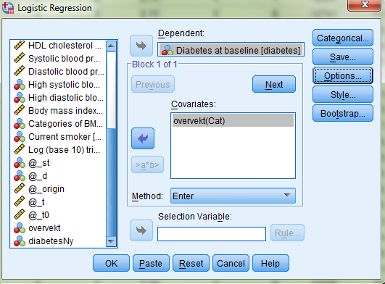
Logistic regression - example
Estimate logistic model for «diabetes», with «overvekt» as independent variable.
(overvekt =1, not overvekt =2)
Click «Analyze->Regression->Binary logistic».
Original diabetes variable (1=diabetes, and 0= no diabetes) as dependent variable (outcome variable).
Adds «overvekt» for «Covariates». Then, click «Categorial».
Move «overvekt» in «Categorical Covariates».
Select «Reference Category: Last» .
Then, «Continue».
Click «Options», then select:
«CI for exp(B): 95%»
«Include constant in model»
Then, «Continue».
Click «OK» in the original box.

Slide 61
Logistic regression - example
Interpreting output:
SPSS provides a lot of info
Start by checking that the numbers are correct

Slide 62
Logistic regression - example
Interpreting output:
SPSS provides a lot of info
Start by checking that the numbers are correct
The estimation of the model is in the last table!

Slide 63
Logistic regression - example
We see from the table that exp(B) is 1,8 (95% KI: 0,8 – 4,0).

Slide 64
Logistic regression - example
We see from the table that exp(B) is 1,8 (95% KI: 0,8 – 4,0).
Odd of having diabetes is 1,8 times bigger for overweight compared to non-overweight.

Slide 65
Logistic regression - example
We see from the table that exp(B) is 1,8 (95% KI: 0,8 – 4,0).
Odd of having diabetes is 1,8 times bigger for overweight compared to non-overweight.
NB! Not significant.

Slide 66
Logistic regression
We can have an independent variable (exposure) with multiple categories.

Slide 67
Logistic regression
We can have an independent variable (exposure) with multiple categories.
SPSS designs the «dummy-variabler» for us.

Slide 68
Logistic regression
We can have an independent variable (exposure) with multiple categories.
SPSS designs the «dummy-variabler» for us.
We choose the baseline (reference category).

Slide 69
Logistic regression
We can have an independent variable (exposure) with multiple categories.
SPSS designs the «dummy-variabler» for us.
We choose the baseline (reference category).
Calculate a coefficient for each category.

Slide 70
Logistic regression
We can have an independent variable (exposure) with multiple categories.
SPSS designs the «dummy-variabler» for us.
We choose the baseline (reference category).
Calculate a coefficient for each category.
is the OR compared to the baseline.

Slide 71
Logistic regression
We can have an independent variable (exposure) with multiple categories.
SPSS designs the «dummy-variabler» for us.
We choose the baseline (reference category).
Calculate a coefficient for each category.
is the OR compared to the baseline.
For a variable with 3 categories:

Slide 72
Logistic regression
We can have an independent variable (exposure) with multiple categories.
SPSS designs the «dummy-variabler» for us.
We choose the baseline (reference category).
Calculate a coefficient for each category.
is the OR compared to the baseline.
For a variable with 3 categories:
Is the OR of the 1st category compared to cat-0

Slide 73
Logistic regression
We can have an independent variable (exposure) with multiple categories.
SPSS designs the «dummy-variabler» for us.
We choose the baseline (reference category).
Calculate a coefficient for each category.
is the OR compared to the baseline.
For a variable with 3 categories:
Is the OR of the 2nd category compared to cat-0

Slide 74
Exercise 4b
Build a logistic regression model for myocardial infarction («mi»), with smoking as an independent variable.
Use the variable «smoking», which has 5 categories.
Select «Never smoked» (value 0) as reference category.

Slide 75
Exercise 4b: Solution
Logistic regression model for «mi», with «smoking» as independent variable.
«Analyze> Regression> Binary logistic»

Slide 76
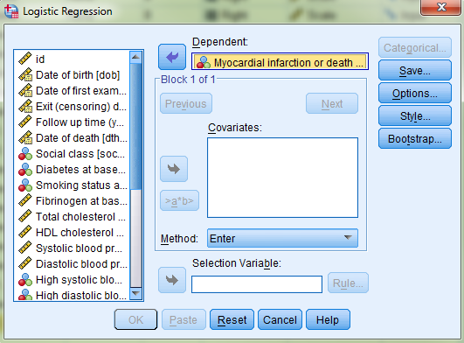
Exercise 4b: Solution
Logistic regression model for «mi», with «smoking» as independent variable.
«Analyze> Regression> Binary logistic»
The original variable as «Dependent».

Slide 77
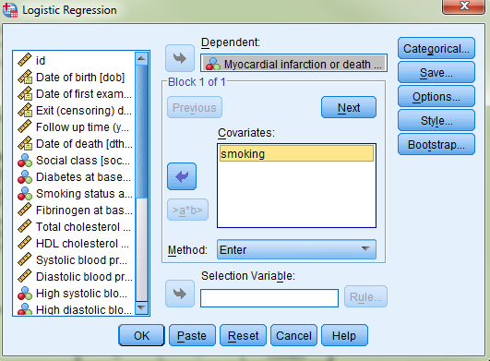
Exercise 4b: Solution
Logistic regression model for «mi», with «smoking» as independent variable.
«Analyze> Regression> Binary logistic»
The original variable as «Dependent».
Add «smoking» in «Covariates».

Slide 78
Exercise 4b: Solution
Logistic regression model for «mi», with «smoking» as independent variable.
«Analyze> Regression> Binary logistic»
The original variable as «Dependent».
Add «smoking» in «Covariates».
Then, click «Categorial».

Slide 79
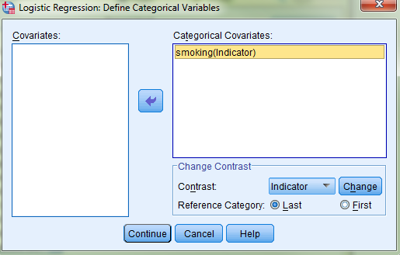
Exercise 4b: Solution
Logistic regression model for «mi», with «smoking» as independent variable.
«Analyze> Regression> Binary logistic»
The original variable as «Dependent».
Add «smoking» in «Covariates».
Then, click «Categorial».
- Put «smoking» in «Categorical Covariates»

Slide 80
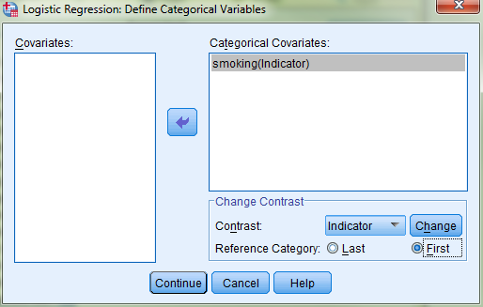
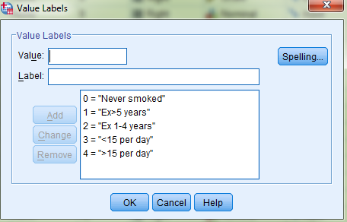
Exercise 4b: Solution
Logistic regression model for «mi», with «smoking» as independent variable.
«Analyze> Regression> Binary logistic»
The original variable as «Dependent».
Add «smoking» in «Covariates».
Then, click «Categorial».
- Put «smoking» in «Categorical Covariates»
- Remember: 0 = ‘Never smoked’
- Select «Reference Category: First» and click «Change».

Slide 81
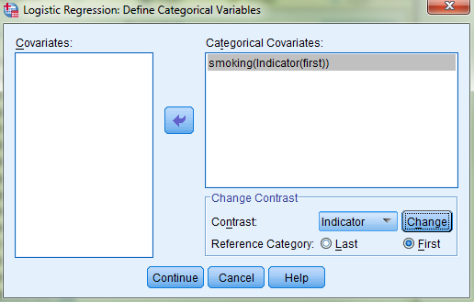
Exercise 4b: Solution
Logistic regression model for «mi», with «smoking» as independent variable.
«Analyze> Regression> Binary logistic»
The original variable as «Dependent».
Add «smoking» in «Covariates».
Then, click «Categorial».
- Put «smoking» in «Categorical Covariates»
- Remember: 0 = ‘Never smoked’
- Select «Reference Category: First» and click «Change».

Slide 82
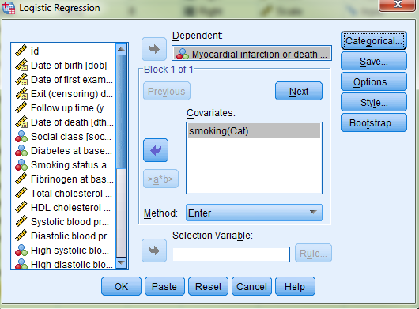
Exercise 4b: Solution
Logistic regression model for «mi», with «smoking» as independent variable.
«Analyze> Regression> Binary logistic»
The original variable as «Dependent».
Add «smoking» in «Covariates».
Then, click «Categorial».
- Put «smoking» in «Categorical Covariates»
- Remember: 0 = ‘Never smoked’
- Select «Reference Category: First» and click «Change».
Click «Options».

Slide 83
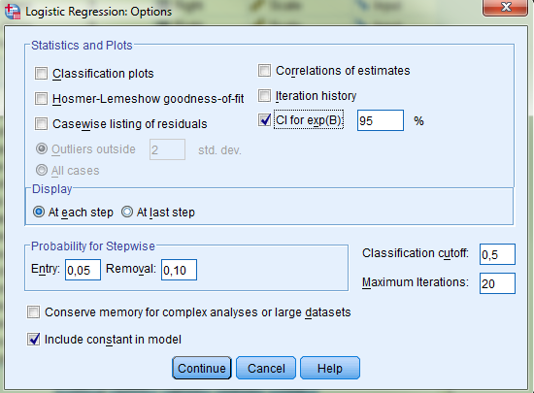
Exercise 4b: Solution
Logistic regression model for «mi», with «smoking» as independent variable.
«Analyze> Regression> Binary logistic»
The original variable as «Dependent».
Add «smoking» in «Covariates».
Then, click «Categorial».
- Put «smoking» in «Categorical Covariates»
- Remember: 0 = ‘Never smoked’
- Select «Reference Category: First» and click «Change».
Click «Options».
Check for «CI for exp(B): 95%».

Slide 84
Exercise 4b: Solution
Logistic regression model for «mi», with «smoking» as independent variable.
«Analyze> Regression> Binary logistic»
The original variable as «Dependent».
Add «smoking» in «Covariates».
Then, click «Categorial».
- Put «smoking» in «Categorical Covariates»
- Remember: 0 = ‘Never smoked’
- Select «Reference Category: First» and click «Change».
Click «Options».
Check for «CI for exp(B): 95%».
«Include constant in model» should be selected. Click «Continue».

Slide 85
Exercise 4b: Solution
Logistic regression model for «mi», with «smoking» as independent variable.
«Analyze> Regression> Binary logistic»
The original variable as «Dependent».
Add «smoking» in «Covariates».
Then, click «Categorial».
- Put «smoking» in «Categorical Covariates»
- Remember: 0 = ‘Never smoked’
- Select «Reference Category: First» and click «Change».
Click «Options».
Check for «CI for exp(B): 95%».
«Include constant in model» should be selected. Click «Continue».
Click «OK» in the original dialog box.

Slide 86
Exercise 4b: Solution
Interpreting output:

Slide 87
Exercise 4b: Solution
Interpreting output:
Make sure you have chosen a reasonable reference group!

Slide 88
Exercise 4b: Solution
Interpreting output:
OR with CI for each category compared to categoty 0.

Slide 89
Logistic regression
We can also have a continuous outcome

Slide 90
Logistic regression
We can also have a continuous outcome
the interpretation of will be:

Slide 91
Logistic regression
We can also have a continuous outcome
the interpretation of will be:
OR associated to the increase of one unit of the independent variable.

Slide 92
Logistic regression
We can also have a continuous outcome
the interpretation of will be:
OR associated to the increase of one unit of the independent variable.
If 𝑥₁ is weight in kg, exp(β₁) is the OR that compares an individual with a specific weight, with an individual weighing one kg less.
NOTE: OR is the same when comparing someone who weighs 2kg vs. 1kg, like 102kg vs. 101kg.

Slide 93
Exercise 4c
Estimate a logistic regression model for myocardial infarction («mi»), using the continuous BMI variable («bmi») as independent variable (exposure).

Slide 94
Exercise 4c: Solution
Logistic regression model for «mi», with «bmi» as independent variable.
«Analyze>Regression> Binary logistic»
.
.

Slide 95
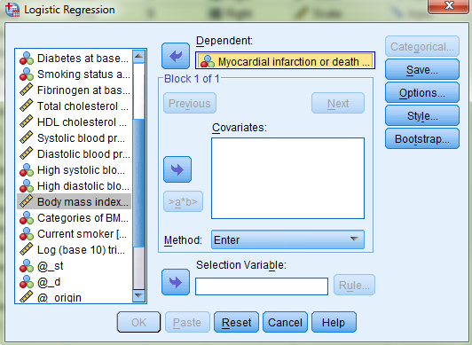
Exercise 4c: Solution
Logistic regression model for «mi», with «bmi» as independent variable.
«Analyze>Regression> Binary logistic»
The original variable as «Dependent».
.
.

Slide 96
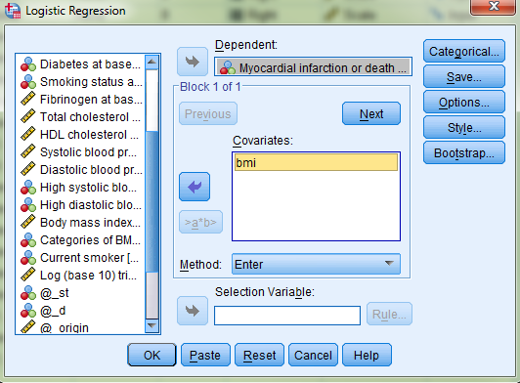
Exercise 4c: Solution
Logistic regression model for «mi», with «bmi» as independent variable.
«Analyze>Regression> Binary logistic»
The original variable as «Dependent».
Add «bmi» in «Covariates».
.
.

Slide 97
Exercise 4c: Solution
Logistic regression model for «mi», with «bmi» as independent variable.
«Analyze>Regression> Binary logistic»
The original variable as «Dependent».
Add «bmi» in «Covariates».
Click «Options».
.
.

Slide 98
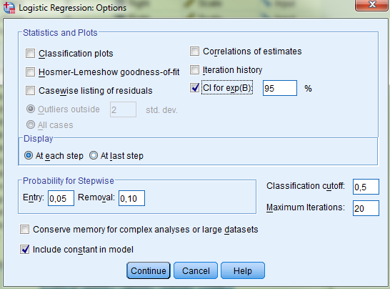
Exercise 4c: Solution
Logistic regression model for «mi», with «bmi» as independent variable.
«Analyze>Regression> Binary logistic»
The original variable as «Dependent».
Add «bmi» in «Covariates».
Click «Options».
Check for «CI for exp(B): 95%».
.
.

Slide 99
Exercise 4c: Solution
Logistic regression model for «mi», with «bmi» as independent variable.
«Analyze>Regression> Binary logistic»
The original variable as «Dependent».
Add «bmi» in «Covariates».
Click «Options».
Check for «CI for exp(B): 95%».
«Include constant in model» should be selected.
.

Slide 100
Exercise 4c: Solution
Logistic regression model for «mi», with «bmi» as independent variable.
«Analyze>Regression> Binary logistic»
The original variable as «Dependent».
Add «bmi» in «Covariates».
Click «Options».
Check for «CI for exp(B): 95%».
«Include constant in model» should be selected.
Click «Continue».

Slide 101
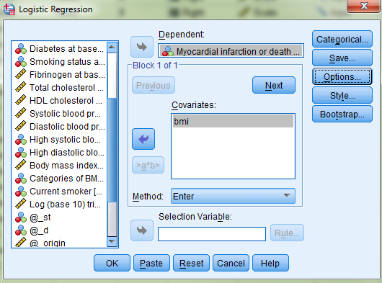
Exercise 4c: Solution
Logistic regression model for «mi», with «bmi» as independent variable.
«Analyze>Regression> Binary logistic»
The original variable as «Dependent».
Add «bmi» in «Covariates».
Click «Options».
Check for «CI for exp(B): 95%».
«Include constant in model» should be selected.
Click «Continue».
Click «OK» in the original box.

Slide 102
Exercise 4c: Solution
Interpreting output:
OR of 1.05 (95% CI) associated with one unit increase in BMI.

Slide 103
Exercise 4c: Solution
Interpreting output:
OR of 1.05 (95% CI) associated with one unit increase in BMI.
OR associated with an increase in BMI of 10: exp(10*0.051) = Exp(0.51) = 1.67

Slide 104
Summary
Compare differences of proportions of two groups.
RR or OR.
Easier way: use logistic regression in SPSS, even if you have only one independent variable with two levels
Compare the difference in proportions of more than two groups without quantifying the difference.
χ²-test.
Compare the difference in proportions of more than two groups, with the wish to quantify the difference.
Logistic regression.
Adjust for other variables.
Logistic regression.

