Slide 1
Introduction to SPSS (biostatistics) Oslo Center for Biostatistics and Epidemiology (OCBE)

Slide 2
Program
This course will be dived into 3 parts:
Part 1 Descriptive statistics and introduction to continuous outcome variables
Part 2 Continuous outcome variables (t-test, non-parametric tests, linear regression).
Part 3 Binary outcome variables (RR, OR, χ² test, logistic regression)

Slide 3
The course dataset
We will use data from the Caerphilly study.
Prospective heart disease study that was conducted 1979-1983 in Wales.
It recorded many different lifestyle markers and outcomes: BMI, blood pressure, cholesterol, smoking, diabetes and heart disease in 1786 men.

Slide 4
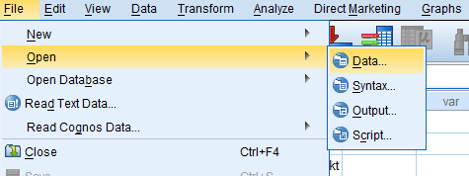
How to open an existing dataset
Click «File->Open->Data», and select the dataset.
Open the dataset «caerphilly_start.sav» (you should have received it). Download: https://wiki.uio.no/med/imb/ocbe/index.php/Introduction_to_SPSS

Slide 5
Types of data
Continuous data
Categorical data
Data that can be quantified or measured on a scale that can take an «infinite» number of values.
Examples: Height, BMI, Blood pressure, Age, etc.
Data that cannot necessarily be quantified.
Nominal (cannot be ordered).
Examples: Gender, Nationality, etc.
Ordinal (can be ”naturally” ordered).
Examples: Grades, education, pain scale, age groups, etc.
Binary data is also categorical (but with only two levels).
Examples: healty/sick, gender, smoker/non-smoker, etc.
Categorical data must be quantified to be used in a statistical analysis (SPSS can do it for us).
NOTE! In SPSS the type of data is called «measure».

Slide 6
Descriptive Statistics
In this section we will use SPSS to explore and describe data
Stastistics:
- Average
Median - Standard deviation
Visual plots:
- Boxplots
Histogram - Scatterplot

Slide 7
Descriptive Statistics summary and presentation of continuous variables
Number
Analyze > Descriptive Statistics > Descriptives
Simple description (mean, sd, min, max)
Analyze > Descriptive Statistics > Frequencies
Supplementary description (addition: percentiles)
Analyze > Descriptive Statistics > Explore
Supplementary description (addition: stratification + plot)
Grafic
Analyze > Descriptive Statistics > Explore
Graph> Legacy Dialogs > Boxplot
Scatter/Dot
Histogram

Slide 8
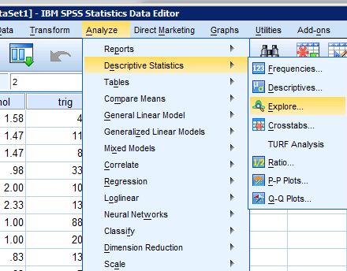
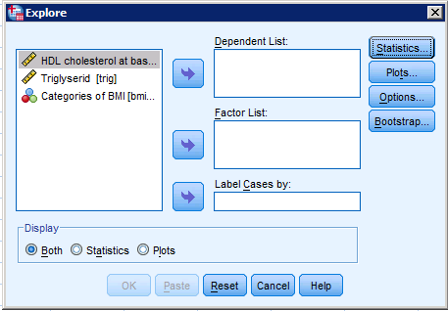
Descriptive Statistics
Go to «Analyze > Descriptive statistics > Explore»

Slide 9
Descriptive Statistics
Go to «Analyze > Descriptive statistics > Explore»
Drag the variables you want to analyze from the list on the right to «Dependent List»

Slide 10
Descriptive Statistics
Go to «Analyze > Descriptive statistics > Explore»
Drag the variables you want to analyze from the list on the right to «Dependent List»
Under «Statistics»

Slide 11
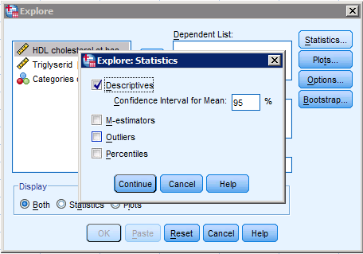
Descriptive Statistics
Go to «Analyze > Descriptive statistics > Explore»
Drag the variables you want to analyze from the list on the right to «Dependent List»
Under «Statistics»
In «Statistics» select only «Descriptives»

Slide 12
Descriptive Statistics
Go to «Analyze > Descriptive statistics > Explore»
Drag the variables you want to analyze from the list on the right to «Dependent List»
Under «Plots»

Slide 13
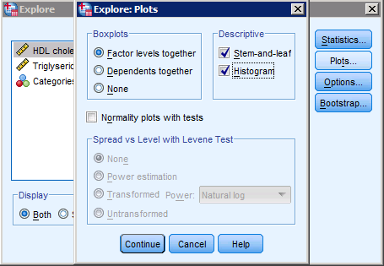
Descriptive Statistics
Go to «Analyze > Descriptive statistics > Explore»
Drag the variables you want to analyze from the list on the right to «Dependent List»
Under «Plots» flag:
Boxplots : «Factor…»
«Stem-and-leaf»
«Histogram»

Slide 14
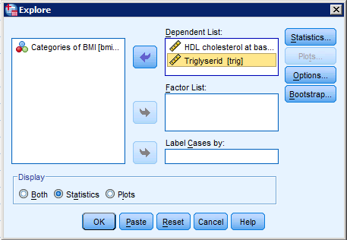
Descriptive Statistics
Go to «Analyze > Descriptive statistics > Explore»
Drag the variables you want to analyze from the list on the right to «Dependent List»
We just want statistics so select «Statistics» instead of «Both»

Slide 15
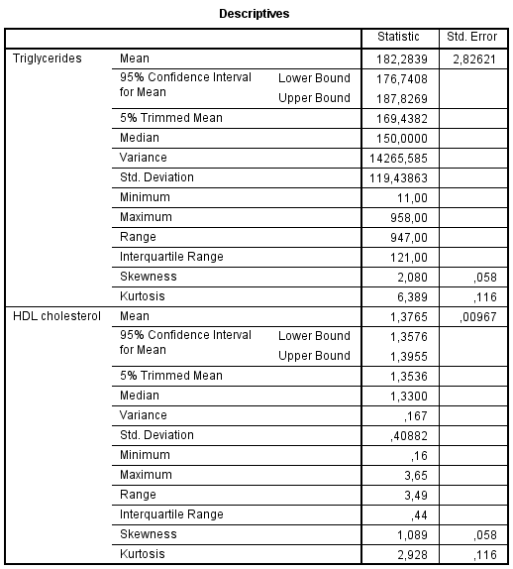
Output in the following table with statistics: average, median and standard deviation

Slide 16
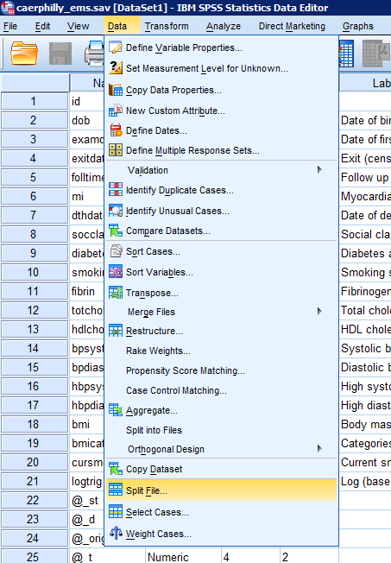
Split File: separate analyses
Sometimes it is convenient to carry on analyses separately for different sub-groups. You can use:
«Data > Split File»

Slide 17
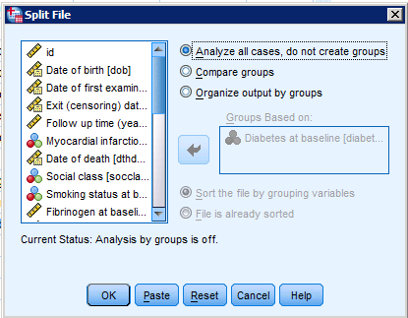
Split File: separate analyses
The standard setting is «Analyze all cases, do not create groups»
Then, you can make a choice.

Slide 18
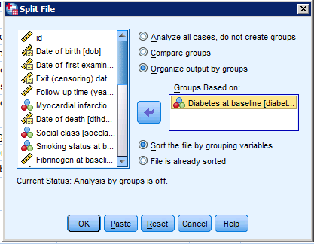
Split File: separate analyses
With «Organize output by groups» you can select a categorical variable so that all analyzes are done separately .

Slide 19
Split File: separate analyses
Under «Current status» you can see the current settings

Slide 20
Split File: separate analyses
Under «Current status» you can see the current settings
NB! For a t-test, you can not have Split File on the group variable.

Slide 21
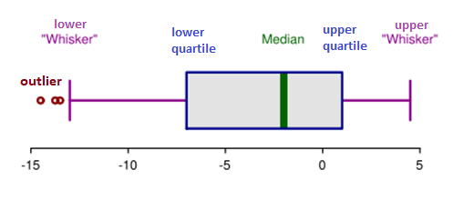
Boxplot
The Boxplot is the best way to represent the distribution of data graphically, by visualizing centering and variability. The box plot shows
Median (50% of data on each side)
Interquartile range IQR (25%, 75% on each side)
Extreme values are represented as ”o” or ”*”

Slide 22
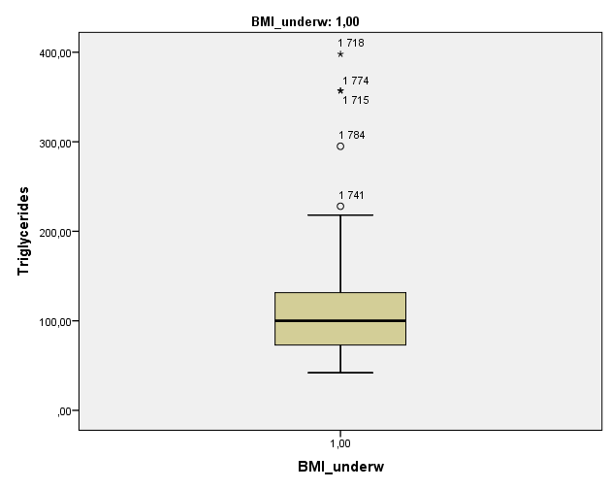
= IQR

Slide 23
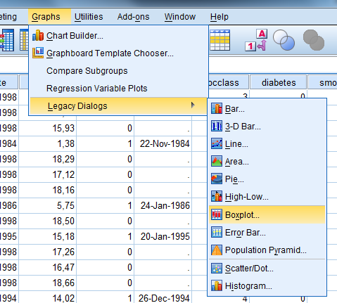
How to make a Boxplot
Go to «Graphs > Legacy dialogs > Boxplot»

Slide 24
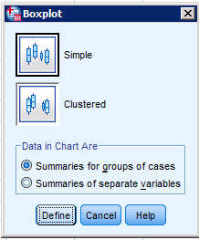
How to make a Boxplot
Go to «Graphs > Legacy dialogs > Boxplot»
Select«Simple» and «Define»

Slide 25
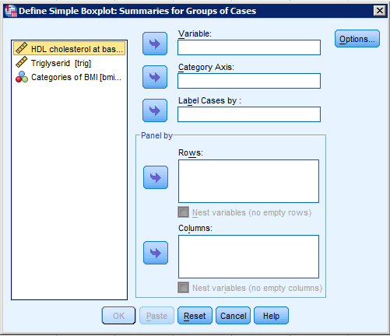
How to make a Boxplot
Go to «Graphs > Legacy dialogs > Boxplot»
Move the variable of interest in «Variable»

Slide 26
How to make a Boxplot
Go to «Graphs > Legacy dialogs > Boxplot»
Move the variable of interest in «Variable»
Can devide boxplot with a group variable in «Category Axis»

Slide 27
Exercise 1a
We want to explore the relationship between triglycerides in blood («trig») and BMI («bmicat») in the Caerphilly study.
Make a boxplot of the distribution of triglyceride conditioned to the four BMI categories.

Slide 28
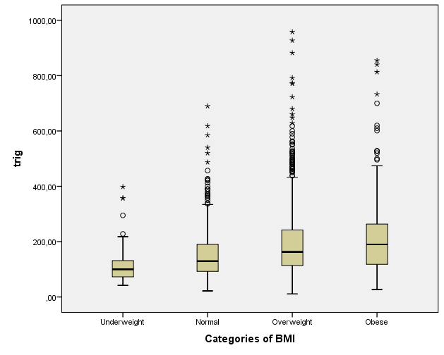

Slide 29
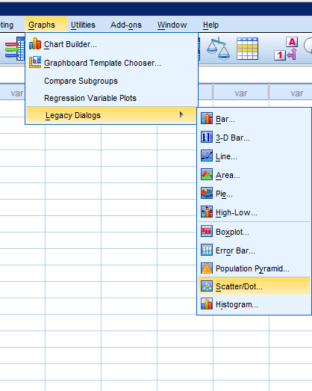
Scatterplot
To visualize the relationship between two continuous variables, we can use the scatterplot.
Go to «Graphs > Legacy dialogs > Scatter/Dot»

Slide 30
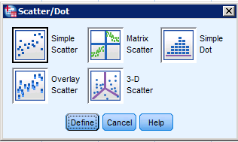
Scatterplot
To visualize the relationship between two continuous variables, we can use the scatterplot.
Go to «Graphs > Legacy dialogs > Scatter/Dot»
«Simple scatter» and «Define»

Slide 31
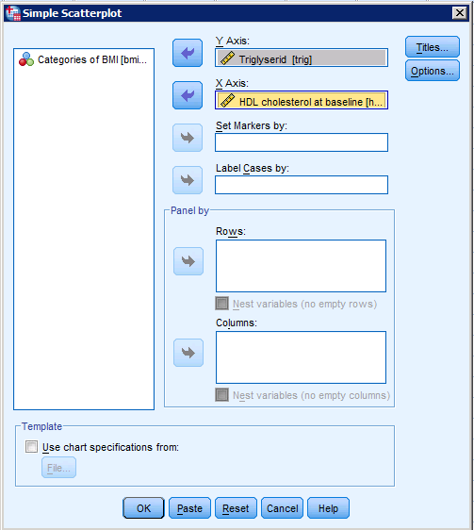
Choose the variables from the list on the left:
Move Triglyserid to «Y Axis» as the vertical axis

Slide 32
Choose the variables from the list on the left:
Move Triglyserid to «Y Axis» as the vertical axis
Move HDL to «X axis» as the horizontal axis
Click «OK»

Slide 33
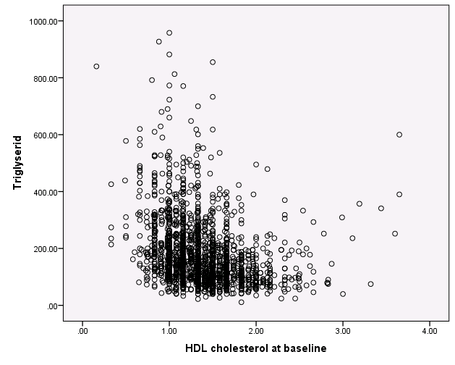

Slide 34
Choose the variables from the list on the left:
Move Triglyserid to «Y Axis» and HDL to «X axis»
Move a categorical variable to «Set markers by».
This gives different color for the categories.

Slide 35
NB – if the observation for the category is MISSING, the circle disappears (with the color "invisible")

Slide 36
Exercise 1b
Create a scatter plot to investigate the relationship between BMI as continuous variable («bmi») and HDL cholesterol («hdlchol»)
Does there appear to be any connection?
Create the same scatter plot, but with different colors for smokers and non-smokers.

Slide 37
Normality plots
In many statistical analyses, it is convenient to assume normal distributed data. To investigate whether this assumption holds, use three plots:
Histogram

Slide 38
Normality plots
In many statistical analyses, it is convenient to assume normal distributed data. To investigate whether this assumption holds, use three plots:
Histogram
Boxplot

Slide 39
Normality plots
In many statistical analyses, it is convenient to assume normal distributed data. To investigate whether this assumption holds, use three plots:
Histogram
Boxplot
Quantile-Quantile (QQ) plot

Slide 40
Normality plots
In many statistical analyses, it is convenient to assume normal distributed data. To investigate whether this assumption holds, use three plots:
Histogram
Boxplot
Quantile-Quantile (QQ) plot
The first two check if the variable is symmetrical and not skewed. The QQ plot compares the data to a normal distribution on a straight line (deviations indicate outliers and heavy tails).

Slide 41
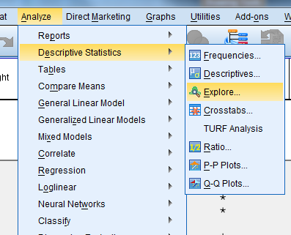
All these plot are under Explore:
Go to «Analyze > Descriptive statistics > Explore»

Slide 42
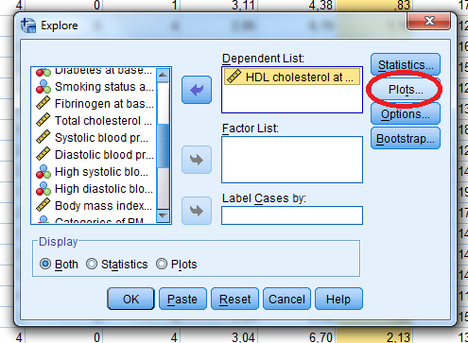
All these plot are under Explore:
Go to «Analyze > Descriptive statistics > Explore»
Click «Plots»

Slide 43
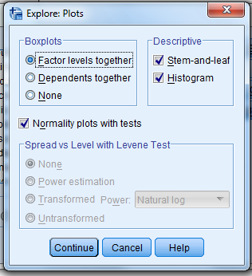
All these plot are under Explore:
Go to «Analyze > Descriptive statistics > Explore»
Click «Plots»
Select: «Factor levels together»

Slide 44
All these plot are under Explore:
Go to «Analyze > Descriptive statistics > Explore»
Click «Plots»
Select: «Factor levels together»
Select «Histogram»

Slide 45
All these plot are under Explore:
Go to «Analyze > Descriptive statistics > Explore»
Click «Plots»
Select: «Factor levels together»
Select «Histogram»
For QQ-plot: select «Normality plots with tests»

Slide 46
All these plot are under Explore:
Go to «Analyze > Descriptive statistics > Explore»
Click «Plots»
Select: «Factor levels together», «Histogram» and «Normality plots with tests»
Click «Continue» and «OK»

Slide 47
Exercise 1c
Investigate if the variables HDL cholesterol («hdlchol») and triglyceride («trig») from the Caerphilly study can be assumed as normal with an histogram, boxplot and QQ plot.

Slide 48
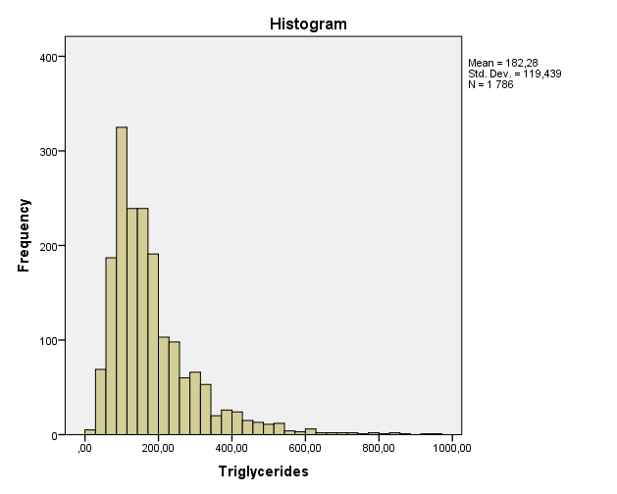
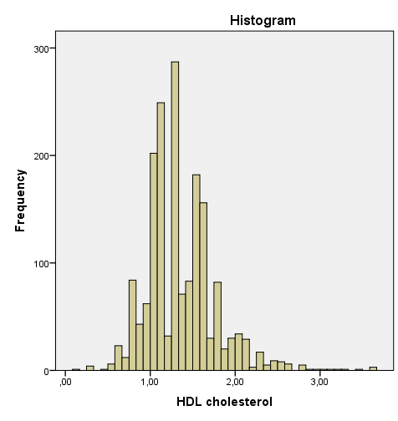

Slide 49
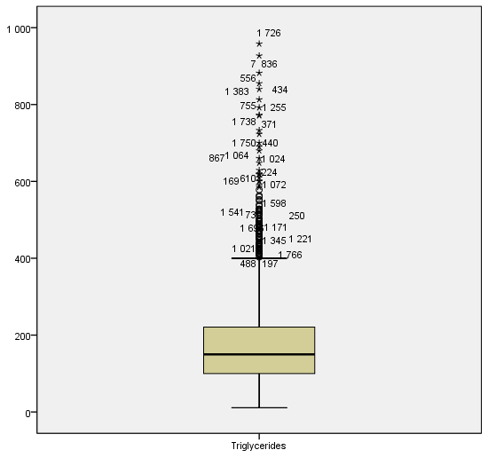
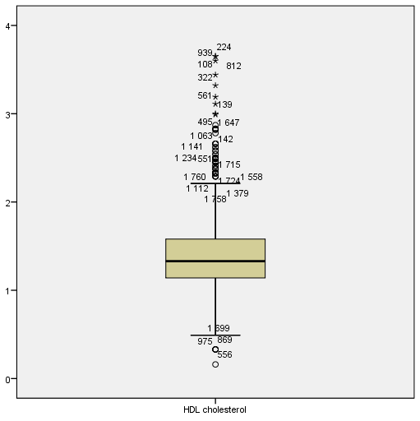

Slide 50
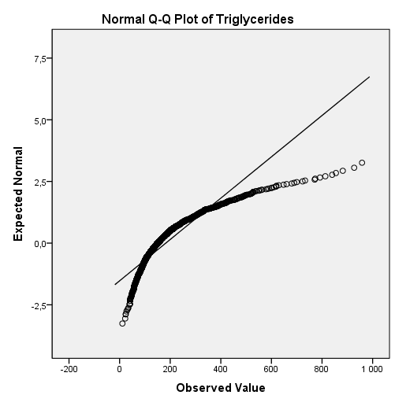
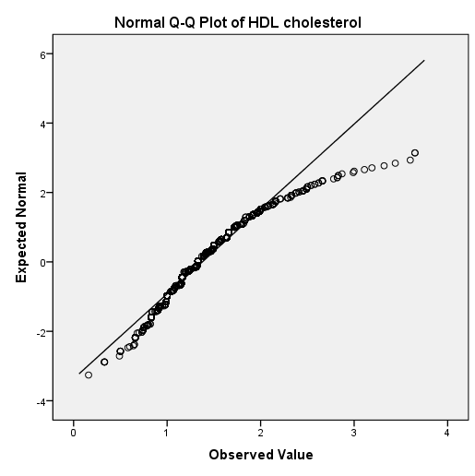

Slide 51
Exercise 1c
Investigate if the variables HDL cholesterol («hdlchol») and triglyceride («trig») from the Caerphilly study can be assumed as normal with an histogram, boxplot and QQ plot.
Conclusion: We can assume that HDL cholesterol is normally distributed (at least approximately), but triglyceride does not seem to be normal.

Slide 52
Summary
With «Graphs > Legacy dialogs» you can create many different plots. For example scatterplot and boxplot
With «Analyze > Descriptive statistics > Explore» you can find summary statistics and create histograms, boxplot and normality plot

