Slide 1
Part 2 - Compare average in different groups

Slide 2
Comparing average
Often we want to compare the average of a continuous variable in different groups.
Examples:
Continuous variable | Categorical variable
Height | Before and after a treatment
Weight | Treatment and placebo
Bloodbpressure | Men and women
Triglycerides in blood | Two different treatments
CD4 counts | Sick and healthy
Cholesterol | Normal and overweight
….. | …..

Slide 3
Paired or independent sample
When comparing the average in different groups, we must distinguish between two different layouts:
Paired observations; The same individual is measured twice. Example: before and after treatment.
Independent samples; two independent groups of individuals have been measured. Example: treatment and placebo.

Slide 4
Paired or independent sample
When comparing the average in different groups, we must distinguish between two different layouts:
Paired observations; The same individual is measured twice.
Independent samples; two independent groups of individuals have been measured. This gives two different t-tests:
Paired sample t-test
Independent sample t-test

Slide 5
Example
Paired Observations | Independent Samples
Before and after treatment | Men and women
Two different treatments on the same subject | Treatment and placebo in two independent groups
Treatment and placebo with identical twins | Case and control
… | …

Slide 6
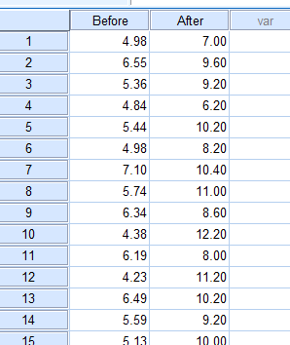
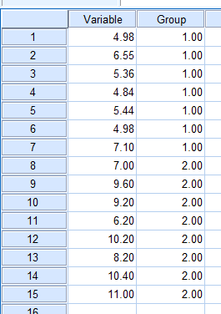
Paired or independent sample in SPSS
We need to set up the data differently for the paired and the independent setup.
Paired Independent

Slide 7
T-test & normality
If the variables are approximately normal
T-test

Slide 8
T-test & normality
If the variables are approximately normal
T-test
If the variables are far from normality
Non-parametric test
Transformation of data (ex: log-scale)

Slide 9
T-test & normality
If the variables are approximately normal
T-test
If the variables are far from normal
Non-parametric test
Transformation of data (ex: log-scale)
Check for normality with visual plots:
Histogram (one peak, simmetry)
Boxplot (simmetry)
QQ-plot (in line, withouth «heavy tails»)

Slide 10
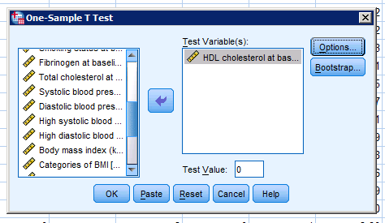
T-test for one sample
A one-sample T-test of the average of a variable equals to a certain value
Go to «Analyze > Compare Means > One Sample T-test»

Slide 11
T-test for one sample
A one-sample T-test of the average of a variable equals to a certain value
Go to «Analyze > Compare Means > One Sample T-test»
Enter the value you want to test in «Test Value».

Slide 12
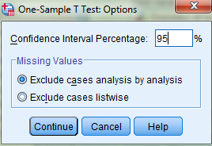
T-test for one sample
A one-sample T-test of the average of a variable equals to a certain value
Go to «Analyze > Compare Means > One Sample T-test»
Enter the value you want to test in «Test Value».
Click «Options», and set 95% CI.

Slide 13
T-test for one sample
A one-sample T-test of the average of a variable equals to a certain value
Go to «Analyze > Compare Means > One Sample T-test»
Enter the value you want to test in «Test Value».
Click «Options», and set 95% CI.
Click «Continue» and «OK» in the previous box.

Slide 14
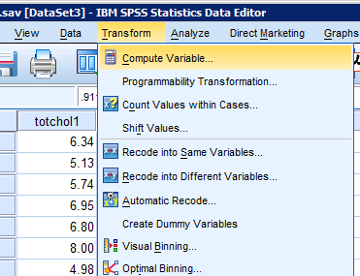
Paired-Samples T-test
We want to test if there are significant differences in blood pressure at two measurements. To use the t-test, we need to check the normality, but for a paired sample we have to check that the difference between measurements is normally distributed.
First, create a variable with the difference: «Transform => Compute variable»

Slide 15
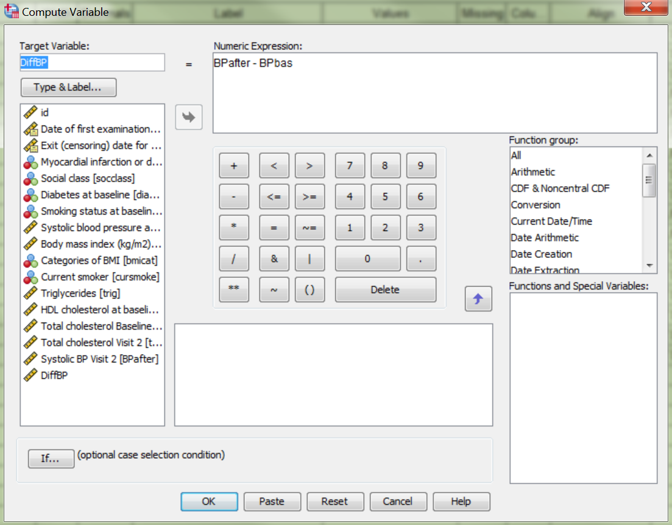
Enter new variable name: DiffBP.
NB! The name can not contain spaces.

Slide 16
Enter new variable name: DiffBP.
NB! The name can not contain spaces.
Write the desired transformation in
Numeric Expression:
BPafter – BPbas

Slide 17
Enter new variable name: DiffBP.
NB! The name can not contain spaces.
Alternatively...
Here you can also select variables in the table and double-click / drag.

Slide 18
Enter new variable name: DiffBP.
NB! The name can not contain spaces.
Write the desired transformation in
Numeric Expression:
BPafter – BPbas
Click«OK»
NB! if any of the cells for one of the variables are missing, the difference will also be missing

Slide 19
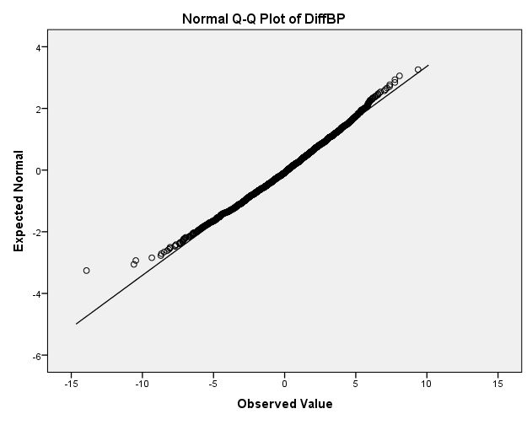
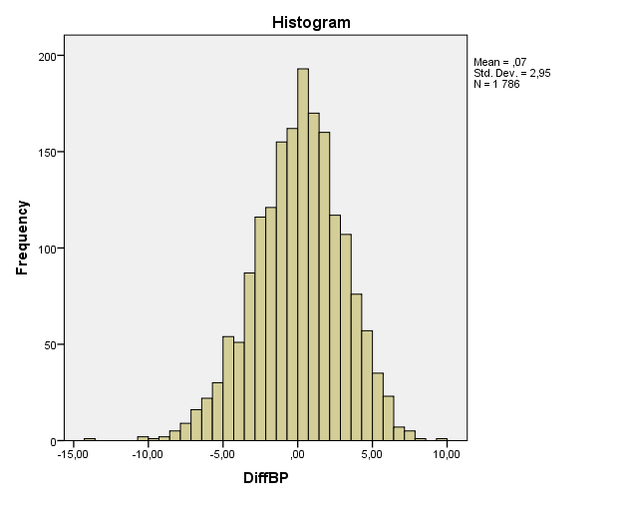
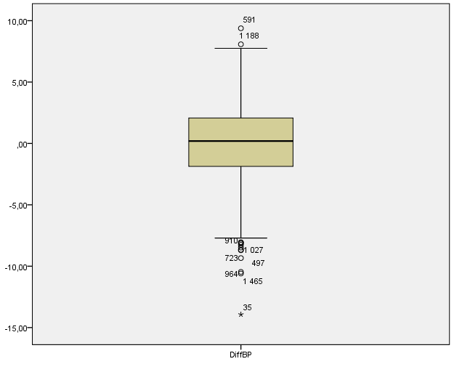
Then we can create histogram, boxplot and QQ-plot for the difference DiffBP (as in Part 1).
Normality seems to be fulfilled: T-test works fine!
On the line
Simmetric
One peak

Slide 20
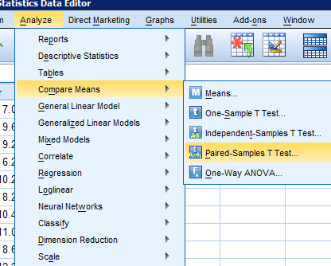
Paired-Samples T Test
We want to test if there is a significant difference in blood pressure before and after a treatment.
Go to «Analyze => Compare means => Paired-Samples T-test»

Slide 21
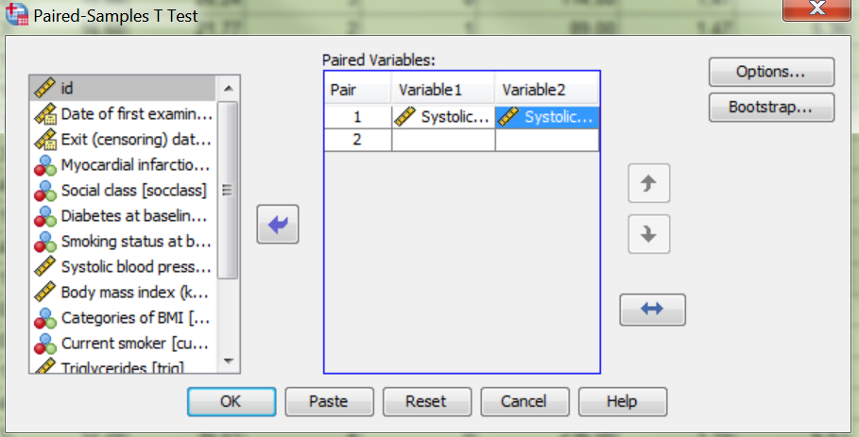
Paired-Samples T Test
We want to test if there is a significant difference in blood pressure before and after a treatment.
Go to «Analyze => Compare means => Paired-Samples T-test»
Move BPbas to Variable1 and BPafter to Variable2.

Slide 22
Paired-Samples T Test
We want to test if there is a significant difference in blood pressure before and after a treatment.
Go to «Analyze => Compare means => Paired-Samples T-test»
Move BPbas to Variable1 and BPafter to Variable2.
Click «OK».

Slide 23
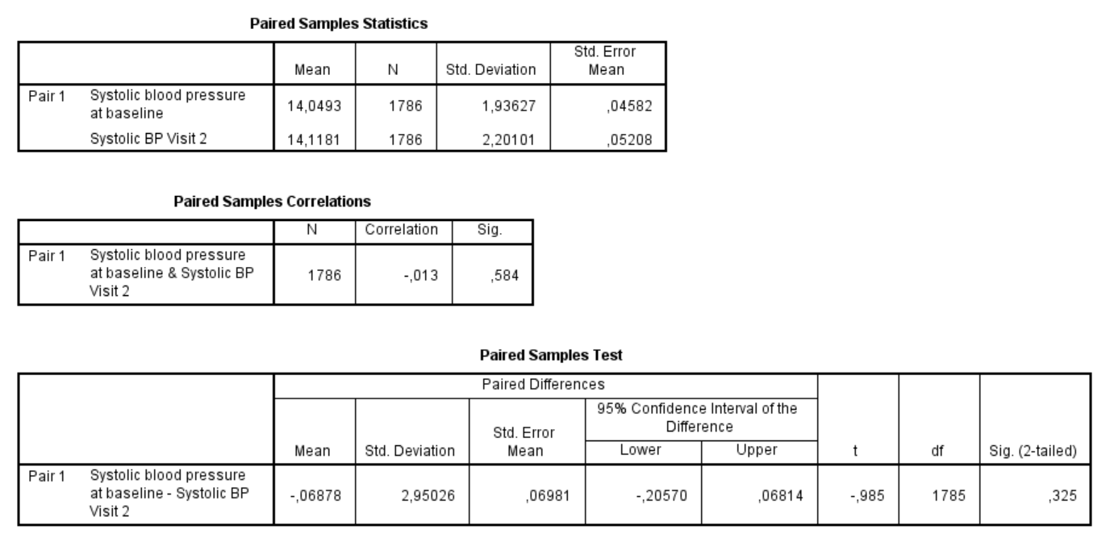
Paired sample T Test output

Slide 24
Paired sample T Test output
First we have average and standard deviation (SD) for the two samples

Slide 25
Paired sample T Test output
Then we have the test of the difference: mean differance between before and after

Slide 26
Paired sample T Test output
The P-value of the test is bigger than 0.05, so it is not significant. This imply that the mean difference is equal to 0.

Slide 27
Paired sample T Test output
Note: Confidence Interval for the means difference.
NB - SPSS tests the difference Variable1 - Variable2, so Before minus After, then an increase of the average will give a negative difference.
If you want to invert, you have to select After as Variable1 and Before as Variable2.

Slide 28
Exercise 2a
The Caerphilly study measured total cholesterol in two different visits («totchol» and «totchol2»). Check if there is a significant difference in total cholesterol between first and second visits. Hint:
Check for normality
Paired samples T test

Slide 29
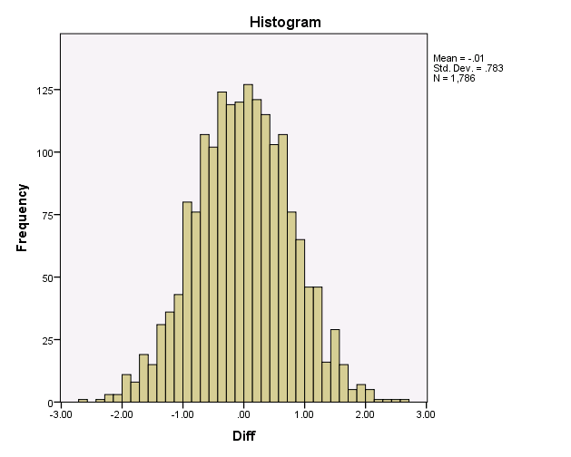
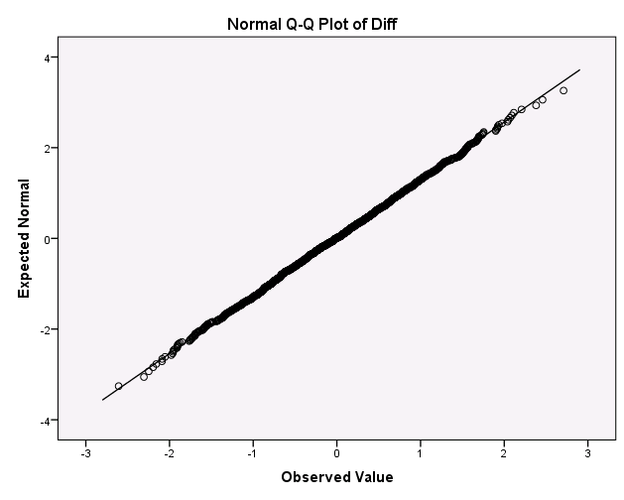
Exercise 2a - Solution
Step 1: Normality plot of difference => Assuming normality is fine.

Slide 30
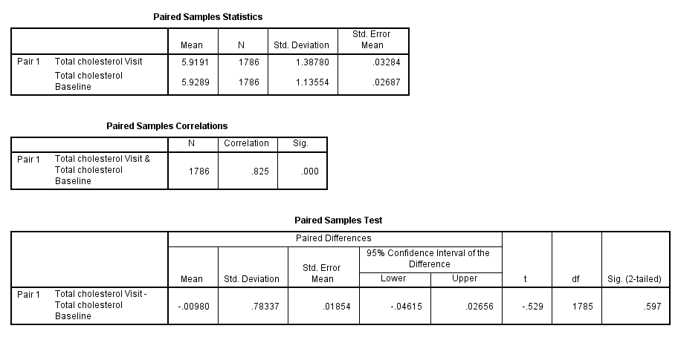
Steg 2: Paired samples T test

Slide 31
Steg 2: Paired samples T test
The P-value is over 0.05: the difference of the total cholesterol between visit 1 and visit 2 is non-significant.

Slide 32
Independent Samples T test
We want to test if the average in two different groups is different: eg. blood pressure measured in smokers and non-smokers. If the variable in both groups can be assumed to be normal, you can use: Independent Samples T test.

Slide 33
How to check normality?
Remember! When the variable is measured in independent groups, the data file must be organized in a variable column and a group-indicator column.
Data file needs to be re-structured if necessary!

Slide 34
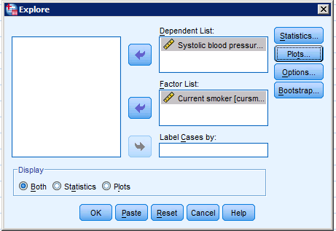
How to check normality?
Remember! When the variable is measured in independent groups, the data file must be organized in a variable column and a group-indicator column.
«Analyze => Descriptive Statistics => Explore» move group-indicator to Factor List.

Slide 35
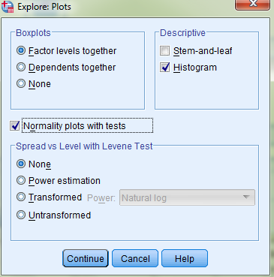
How to check normality?
Remember! When the variable is measured in independent groups, the data file must be organized in a variable column and a group-indicator column.
«Analyze => Descriptive Statistics => Explore» move group-indicator to Factor List.
Click «Plots» and removes «Stem-and-leaf». Select «Histogram» and «Normality plots with test», as in Part 1.

Slide 36
How to check normality?
Remember! When the variable is measured in independent groups, the data file must be organized in a variable column and a group-indicator column.
«Analyze => Descriptive Statistics => Explore» move group-indicator to Factor List.
Click «Plots» and removes «Stem-and-leaf». Select «Histogram» and «Normality plots with test», as in Part 1.

Slide 37
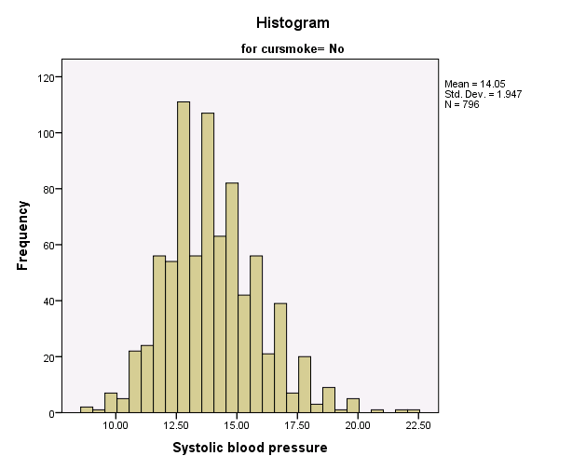
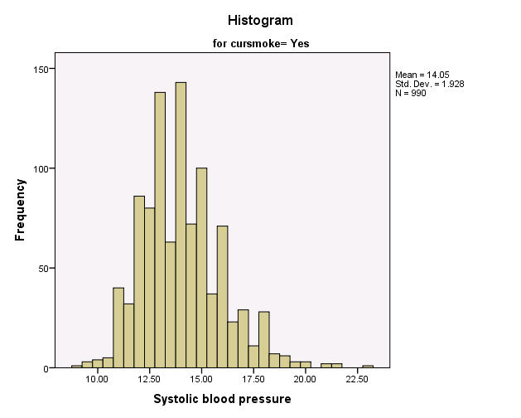
Normality plot for the two groups (Smoker / Non-smoker) separately:
Non-smoker Smoker

Slide 38
Normality plot for the two groups (Smoker / Non-smoker) separately:
Non-smoker Smoker
It seems possible to assume normality in both groups.

Slide 39
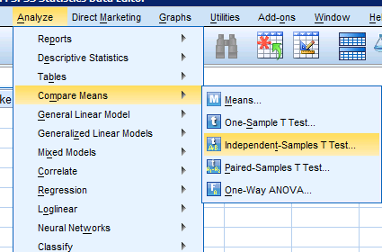
To test the difference of the two averages:
Go to «Analyze => Compare Means => Independent Samples T test»

Slide 40
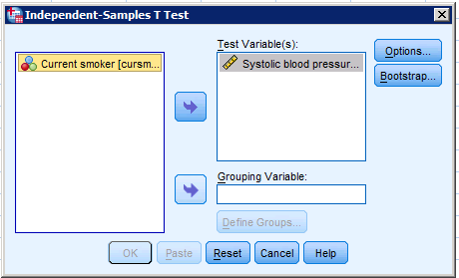
To test the difference of the two averages:
Go to «Analyze => Compare Means => Independent Samples T test»
Move the continuous variable (BPbas) to «Test Variable(s)»

Slide 41
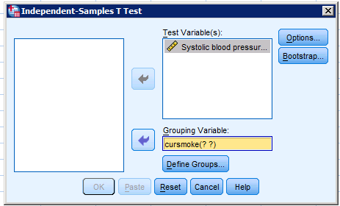
To test the difference of the two averages:
Go to «Analyze => Compare Means => Independent Samples T test»
Move the continuous variable (BPbas) to «Test Variable(s)» and group-indicator (Smoker) to «Grouping Variable», click «Define Groups»

Slide 42
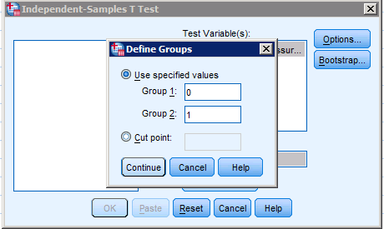
To test the difference of the two averages:
Go to «Analyze => Compare Means => Independent Samples T test»
Move the continuous variable (BPbas) to «Test Variable(s)» and group-indicator (Smoker) to «Grouping Variable», click «Define Groups»
Group-indicator is defined ‘Smoker=1’, ‘non-smoker=0’ (check in Variable view):
Write 0 in Group 1

Slide 43
To test the difference of the two averages:
Go to «Analyze => Compare Means => Independent Samples T test»
Move the continuous variable (BPbas) to «Test Variable(s)» and group-indicator (Smoker) to «Grouping Variable», click «Define Groups»
Group-indicator is defined ‘Smoker=1’, ‘non-smoker=0’ (check in Variable view):
write 0 in Group 1
write 1 in Group 2

Slide 44
To test the difference of the two averages:
Go to «Analyze => Compare Means => Independent Samples T test»
Move the continuous variable (BPbas) to «Test Variable(s)» and group-indicator (Smoker) to «Grouping Variable», click «Define Groups»
Group-indicator is defined ‘Smoker=1’, ‘non-smoker=0’ (check in Variable view):
write 0 in Group 1
write 1 in Group 2
«Continue» and «OK»

Slide 45
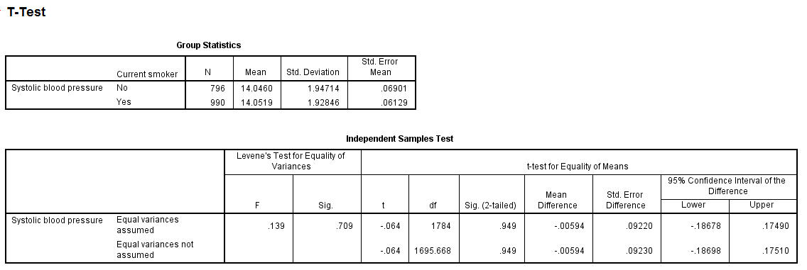
Independent Samples T test is calculated for two cases: equal or different variance in the two groups.
Levene’s test check the null hypotesis of equal variance.

Slide 46
Independent Samples T test is calculated for two cases: equal or different variance in the two groups.
Levene’s test check the null hypotesis of equal variance.
If the p-value > 0.05 the variance is equal,

Slide 47
Independent Samples T test is calculated for two cases: equal or different variance in the two groups.
Levene’s test check the null hypotesis of equal variance.
If the p-value > 0.05 the variance is equal, then read the first line (of the Independent Samples T test)

Slide 48
Independent Samples T test is calculated for two cases: equal or different variance in the two groups.
Levene’s test check the null hypotesis of equal variance.
If the p-value > 0.05 the variance is equal, then read the first line
If the p-value < 0.05 the variance is different,

Slide 49
Independent Samples T test is calculated for two cases: equal or different variance in the two groups.
Levene’s test check the null hypotesis of equal variance.
If the p-value > 0.05 the variance is equal, then read the first line
If the p-value < 0.05 the variance is different, then read the second line (of the Independent Samples T test)

Slide 50
For systolic blood pressure in smokers and non-smokers, Levene's test is not significant (p = 0.7). So, we assume equal variance in the two groups

Slide 51
For systolic blood pressure in smokers and non-smokers, Levene's test is not significant (p = 0.7). So, we assume equal variance in the two groups
and we use the first line.

Slide 52
For systolic blood pressure in smokers and non-smokers, Levene's test is not significant (p = 0.7). So, we assume equal variance in the two groups
and we use the first line. The p-value for the mean difference the groups is not significant.
Conclusion: There is no effect of smoking on blood pressure. Strange?

Slide 53
Exercise 2b
The Caerphilly study recorded many different lifestyle markers and variables from blood, as smoking («cursmoke») and HDL cholesterol («hdlchol») Determine if the level of HLD cholesterol is different between smokers and non-smokers.

Slide 54
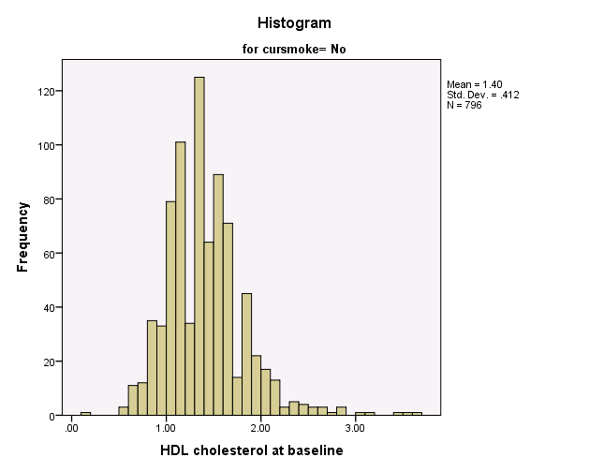
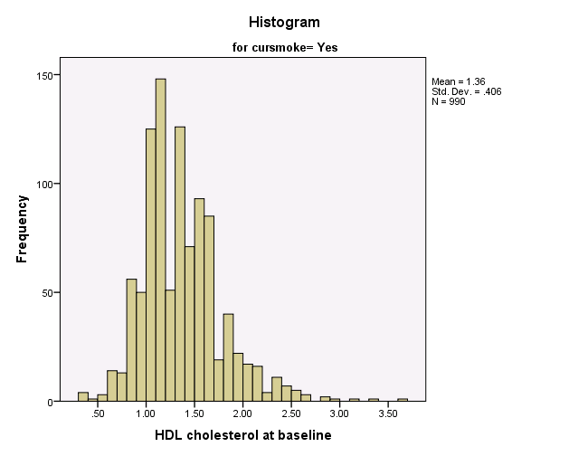
Normality

Slide 55
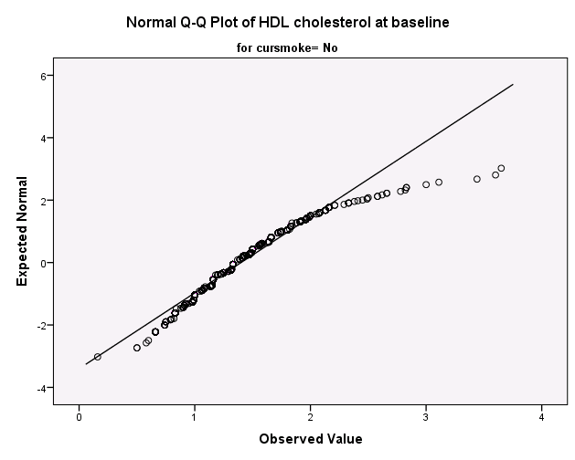
There are some observations (5-10) that are far from the line, but they are just a small portion of around 800 units in each group. It seems okay to assume normality.

Slide 56
Levene's test is not significant, so we can assume equal variance in both groups.

Slide 57
Levene's test is not significant, so we can assume equal variance in both groups.
The p-value (p=0.028) is less than 0.05 so there is a significant difference in LDL cholesterol between smokers and non-smokers.

Slide 58
Levene's test is not significant, so we can assume equal variance in both groups.
The p-value (p=0.028) is less than 0.05 so there is a significant difference in LDL cholesterol between smokers and non-smokers.
But is this difference clinically relevant??

Slide 59
Non-parametric test
It may happen that variables you are interested in are not normally distributed. For example, the distribution can be very skewed or have many extreme values / outliers.

Slide 60
Non-parametric test
It may happen that variables you are interested in are not normally distributed. For example, the distribution can be very skewed or have many extreme values / outliers.
There are two possibilities:
Transformation of the variable
Non-parametric test.

Slide 61
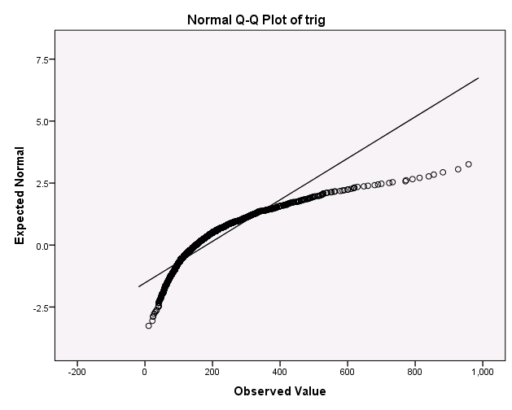
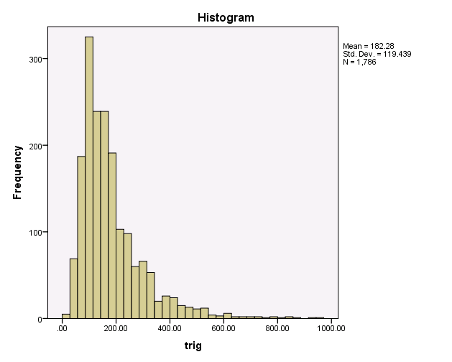
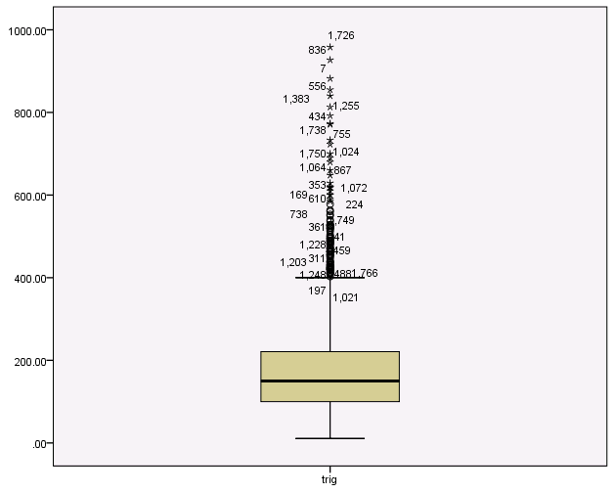
Look at the distribution of triglycerides (mg/dL) in the Caerphilly study. Not normally distributed!

Slide 62
We want to test the difference in triglycerides between smokers and non-smokers, but we cannot use the t-test directly.
An alternative is to use a non-parametric test and the most common are:

Slide 63
We want to test the difference in triglycerides between smokers and non-smokers, but we cannot use the t-test directly.
An alternative is to use a non-parametric test and the most common are:
Wilcoxon signed rank test for paired samples
Mann-Whitney U test for independent sample (also called Wilcoxon rank sum test)

Slide 64
We want to test the difference in triglycerides between smokers and non-smokers, but we cannot use the t-test directly.
An alternative is to use a non-parametric test and the most common are:
Wilcoxon signed rank test for paired samples
Mann-Whitney U test for independent sample (also called Wilcoxon rank sum test)
To test the difference of triglycerides in smokers and non-smokers, we need an independent sample test as the Mann-Whitney U test.

Slide 65
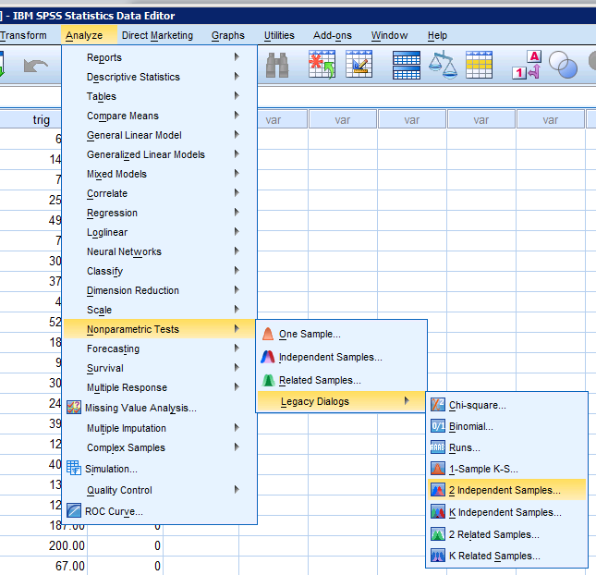
Alt. 1: Mann-Whitney U test
Go to «Analyze => Non-parametric test =>
Legacy Dialogs => 2 Independent Samples»

Slide 66
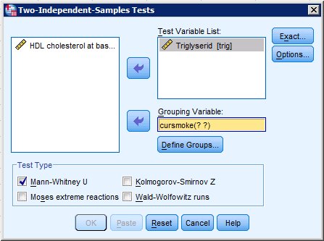
The test has the same set-up as the Independent Samples T test
Move Triglyceride to Test Variable List

Slide 67
The test has the same set-up as the Independent Samples T test
Move Triglyceride to Test Variable List, Smoker to Grouping Variable and click «Define Groups»

Slide 68
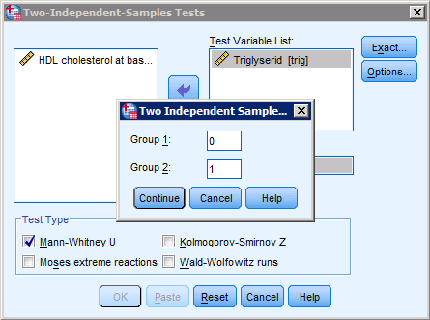
The test has the same set-up as the Independent Samples T test
Move Triglyceride to Test Variable List, Smoker to Grouping Variable and click «Define Groups»
Enter 0 (non-smoker) as Group 1, enter 1 (smoker) as Group 2.

Slide 69
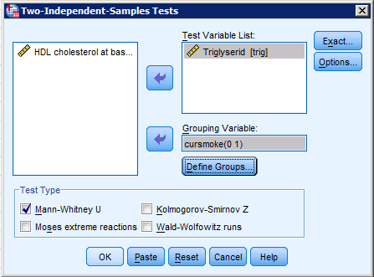
The test has the same set-up as the Independent Samples T test
Move Triglyceride to Test Variable List, Smoker to Grouping Variable and click «Define Groups»
Enter 0 (non-smoker) as Group 1, enter 1 (smoker) as Group 2.
Select«Mann-Whitney U test» under Test type.
Press «OK»

Slide 70
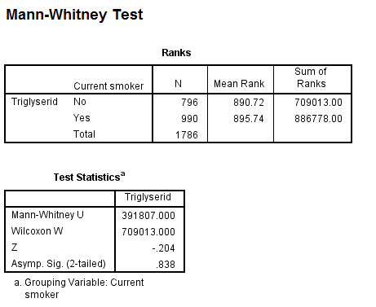
Output
The p-value of the test is under
”Asymp. Sig (2-tailed)”.
In this case, the p-value is not significant and we cannot say that there is a difference in the triglyceride level between smokers and non-smokers.

Slide 71
Alt. 2: Transforming data
In some cases a transformation of the data can approximate a normal distribution, for example to a logaritmic-scale. So, we can use the T-test on the trasformed variable.
Go to «Transform =>
Compute variable»

Slide 72
Enter the name of the new variable in «Target variable» NB! No spaces in the name!

Slide 73
Enter the name of the new variable in «Target variable» NB! No spaces in the name!
Write Lg10(variable) Ln(variable) in «Numeric Expression»
Click«OK»

Slide 74
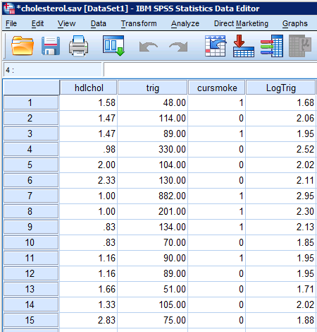
It provides a new variable called LogTrig, logarithm of the variable trig.
If we’re lucky, the new variable «LogTrig» is normally distributed
We check LogTrig

Slide 75
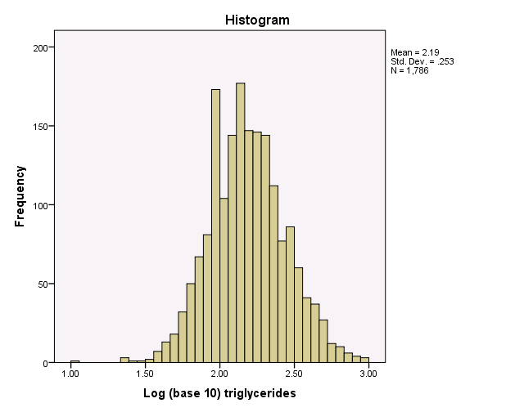
Looks pretty good! Can use T-test.

Slide 76
Exercise 2c
Log-transform triglyceride («trig»), and test the difference of the log-triglyceride average between smokers and non-smokers («cursmoke»).

Slide 77
The difference in the triglyceride level on the log scale between smokers and non-smokers is not significant.
Same conclusion as before.

Slide 78
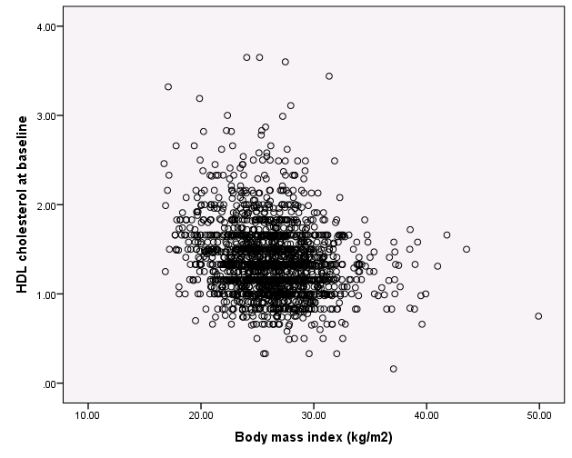
Regression
We may also want to investigate the relationship between two continuous variables, for example BMI and cholesterol. This can be done graphically, with the scatter plot from in Part 1, or ...

Slide 79
The relationship between the variables can also be studied through a regression model:

Slide 80
The relationship between the variables can also be studied through a regression model:

Slide 81
The relationship between the variables can also be studied through a regression model:
Two advantages: - With more independent variables, it will adjust estimates and avoid confounding - If two groups are coded as 0 and 1, a regression model will give the same answer as the t-test.

Slide 82
The relationship between the variables can also be studied through a regression model:
Two advantages: - With more independent variables, it will adjust estimates and avoid confounding - If two groups are coded as 0 and 1, a regression model will give the same answer as the t-test.
You can use regression to get a version of the T-test adjusted for other variables.

Slide 83
Lexicon in SPSS
$$cholesterol =b_{O}+b_{1}BMI+b_{2}smoker$$
Utfall/outcome - Dependent variable

Slide 84
Lexicon in SPSS
$$cholesterol =b_{O}+b_{1}BMI+b_{2}smoker$$
Utfall/outcome - Dependent variable
Covariates, predictors – Independent variables

Slide 85
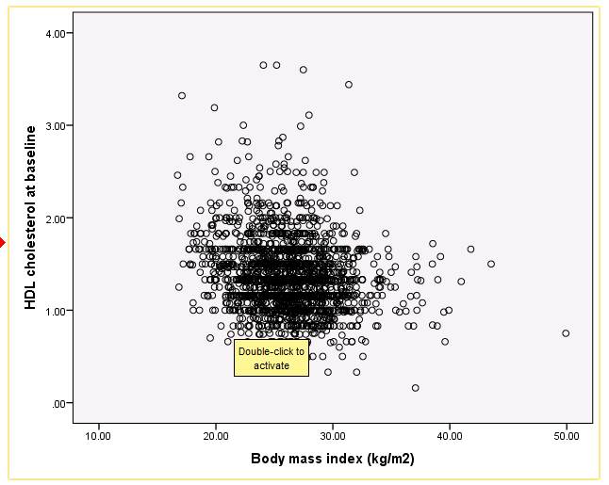
Regression line on the scatterplot
Double click on the plot to access the «Chart Editor»

Slide 86
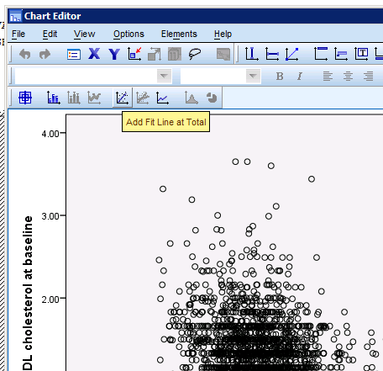
Regression line on the scatterplot
Double click on the plot to access the «Chart Editor»
«Add Fit line at Total»

Slide 87
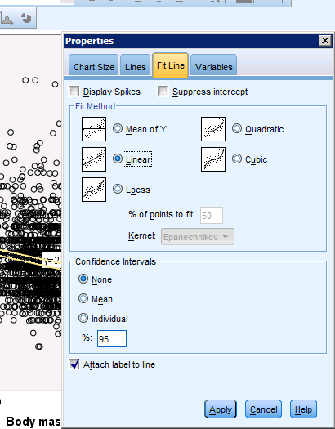
Regression line on the scatterplot
Double click on the plot to access the «Chart Editor»
«Add Fit line at Total»
Under «Fit Line»

Slide 88
Regression line on the scatterplot
Double click on the plot to access the «Chart Editor»
«Add Fit line at Total»
Under «Fit Line» «Linear» as «Fit method»

Slide 89
Regression line on the scatterplot
Double click on the plot to access the «Chart Editor»
«Add Fit line at Total»
Under «Fit Line» «Linear» as «Fit method» and «None» in «Confidence Intervals»

Slide 90
Regression line on the scatterplot
Double click on the plot to access the «Chart Editor»
«Add Fit line at Total»
Under «Fit Line» «Linear» as «Fit method» and «None» in «Confidence Intervals»
Select «Attach label to line» and click «Apply»

Slide 91
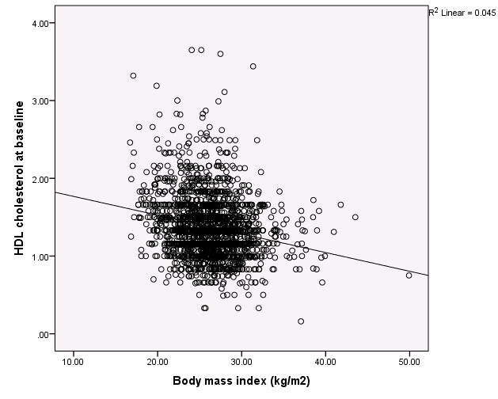
Then we get a regression line in the scatter plot that represents the regression model.

Slide 92
Regression model
We first set up a simple regression model with HDL cholesterol as a function of BMI.
Go to «Analyze => Regression => Linear»

Slide 93
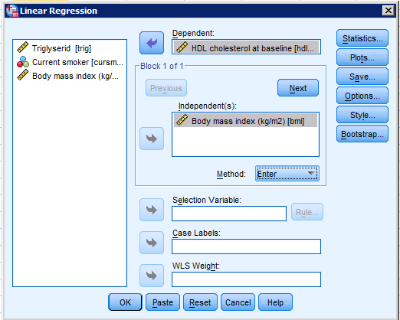
Regression model
We first set up a simple regression model with HDL cholesterol as a function of BMI.
Move the outcome HDL cholesterol to Dependent

Slide 94
Regression model
We first set up a simple regression model with HDL cholesterol as a function of BMI.
Move the outcome HDL cholesterol to Dependent
Move the covariate(s), BMI to Independent(s).

Slide 95
Regression model
We first set up a simple regression model with HDL cholesterol as a function of BMI.
Move the outcome HDL cholesterol to Dependent
Move the covariate(s), BMI to Independent(s).
Leave «Method» as «Enter»
Click «OK»

Slide 96
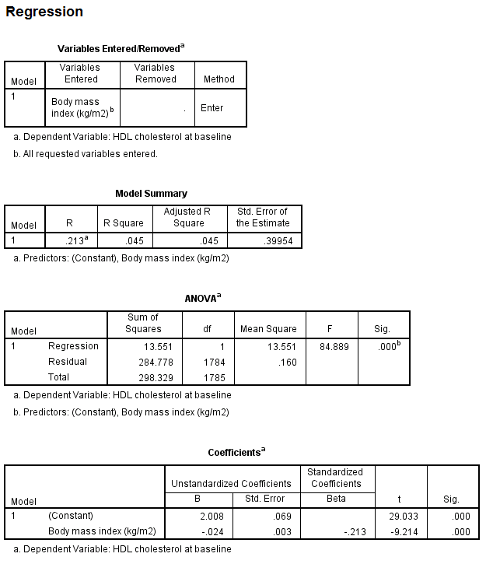
Long output! Look at the bottom:
Regression coefficients

Slide 97
Long output! Look at the bottom:
Regression coefficients
P-values

Slide 98
Long output! Look at the bottom:
Regression coefficients
P-values
Goodness of fit R² (Coefficient of determination)

Slide 99
Exercise 2d
Make a regression model with blood pressure («BPbas») as function of smoking («cursmoke»)
Compare the p-value of the regression coefficient for the effect of smoking with the p-value of the t-test comparing smokers and non-smokers (slide 49)

Slide 100
Exercise 2d: Solution
P-value.

Slide 101
Exercise 2d: Solution
mean

Slide 102
Exercise 2d: Solution
The value of the test

Slide 103
When you want to include more independent variables, the different combinations can be controlled through the «Blocks» and «Method» functions.

Slide 104
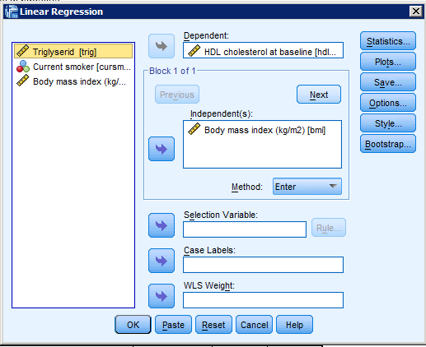
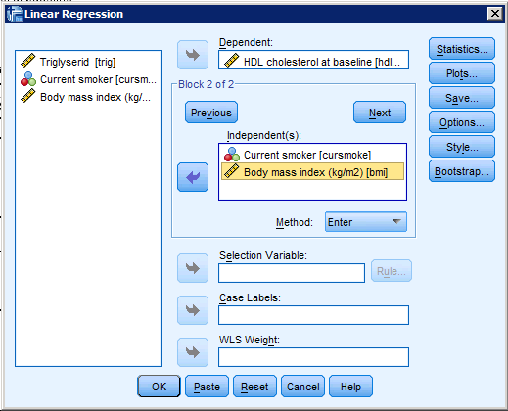
Blocks
With «Blocks» we can setup and test different regression models.
Start with the same model as before, click «Next», then select both Smoker and BMI as Independent in Block 2.

Slide 105
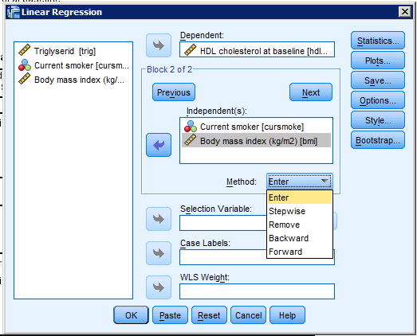
Method
With many independent variables (5-10), they can be take in/out according to specific procedure:
Enter: all toghether
Stepwise: «bigger effect» included first

Slide 106
Exercise 2e
We want to test the effect of smoking («cursmoke») on systolic blood pressure («BPbas») adjusted for BMI («bmi») in the data from the Caerphilly study.
Use «Blocks» to create two regression models, with blood pressure as outcome
Smoking («cursmoke»),
Smoking («cursmoke») and BMI («bmi») .
What can we conclude?

Slide 107
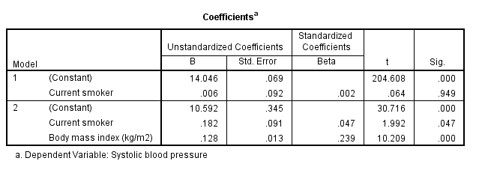
The unadjustd effect of smoking on bloodpressure is not significant.

Slide 108
The unadjustd effect of smoking on bloodpressure is not significant.
But if we adjust for BMI, the effect becomes much larger and significant.

Slide 109
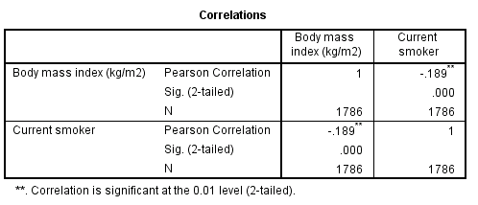
The unadjustd effect of smoking on bloodpressure is not significant.
But if we adjust for BMI, the effect becomes much larger and significant.
This happens because BMI and smoking are negatively correlated in the study.

Slide 110
Summary
T-test compares average of continuous variable between groups:
Paired T-test (ex. before and after treatment)
Independent sample T-test (ex. treatment/placebo)

Slide 111
Summary
T-test compares average of continuous variable between groups:
Paired T-test (ex. before and after treatment)
Independent sample T-test (ex. treatment/placebo)
T-tests require normal data, otherwise
Non-parametric test
Data transformation, ex. to logarithmic scale.

Slide 112
Summary
T-test compares average of continuous variable between groups:
Paired T-test (ex. before and after treatment)
Independent sample T-test (ex. treatment/placebo)
T-tests require normal data, otherwise
Non-parametric test
Data transformation, ex. to logarithmic scale.
Can also use regression to test differences, if groups are coded 0 and 1.

