Slide 1
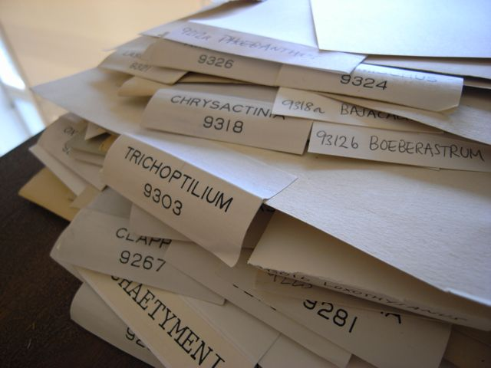
Erfarenheter och nyheter från det svenska initiativet för storskalig digitalisering av naturvetenskapliga samlingar; e-BioColl.se
Anders Telenius
GBIF-Sweden, Naturhistoriska riksmuseet, Stockholm

Slide 2
Experiences and News from the Swedish Initiative for Large-scale Digitisation of Natural History Collections; e-BioColl.se
Anders Telenius
GBIF-Sweden, Naturhistoriska riksmuseet, Stockholm

Slide 3
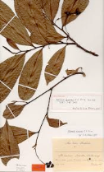
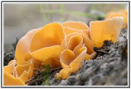

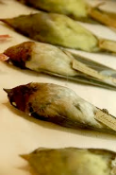
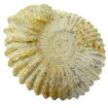
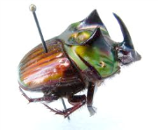
e-BioColl.se (Kongsvoll 2-4 Sep. 2014)
Specimens in Sweden
33 M specimens in Swedish biological collections
Ingelög T. 2013. Skatter i vått och torrt.
1.5 M invertebrates
2.0 M fungi
10.5 M plants
2.0 M fossils
16.4 M insects
0.6 M vertebrates
Fredrik Ronquist, Naturhistoriska riksmuseet, Stockholm

Slide 4
e-BioColl.se (Kongsvoll 2-4 Sep. 2014)
Present digitisation processes in Sweden
Manually at each institution; complete process step-by-step
Different methods according to specimen type
New accessions and types prioritized

Slide 5
Current digitization is slow…
Almost all digitization is externally funded
  Government initiatives: SESAM, ACCESS [not Kulturarvslyftet]
  Mellon Foundation (US), Brazil, Japan
  Artdatabanken Museum Support [cut back 25 % from 2014]. Accounts for more than 90 % of the digitized specimens at 4 of the 6 large Swedish herbaria
Digitization focused on special collections:
  Foreign material
  Type material
  Exception: Artdatabanken Museum Support (Nordic plants and fungi)
Background digitization rate is extremely low
  Entomological collections at Swedish Museum of Natural History
  current rate 10 000 / yr -> 300 years
Traditional manual digitization is expensive
  Cost 20–65 SEK / specimen
  All Swedish insect collections @ 50 SEK/specimen -> 800 M SEK
  All Swedish plant collections @ 35 SEK/specimen -> 300 M SEK
Fredrik Ronquist, Naturhistoriska riksmuseet, Stockholm

Slide 6
Swedish georeferenced occurrence records (~40 M GBIF records)
Time profile
Fredrik Ronquist, Naturhistoriska riksmuseet, Stockholm

Slide 7
Taxonomic profile
Ingelög T. 2013. Skatter i vått och torrt.
Fredrik Ronquist, Naturhistoriska riksmuseet, Stockholm

Slide 8
e-BioColl.se (Kongsvoll 2-4 Sep. 2014)
Digitised specimens in Sweden
33 M specimens in Swedish biological collections
Ingelög T. 2013. Skatter i vått och torrt.
1.5 M invertebrates
2.0 M fungi
10.5 M plants
2.0 M fossils
16.4 M insects
0.6 M vertebrates
Fredrik Ronquist, Naturhistoriska
riksmuseet, Stockholm

Slide 9
e-BioColl.se (Kongsvoll 2-4 Sep. 2014)
eBioColl.se background:
Discussions held with collection managers on presumptive digitisation initiative (2011-2012)
Continuing discussions and workshop planning: Large-scale digitisation infrastructure in Sweden (2012-2013)
Pilot at MKC (Media Conversion Centre) and at the Museum of Evolution

Slide 10
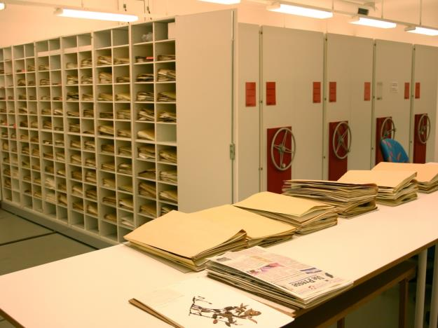
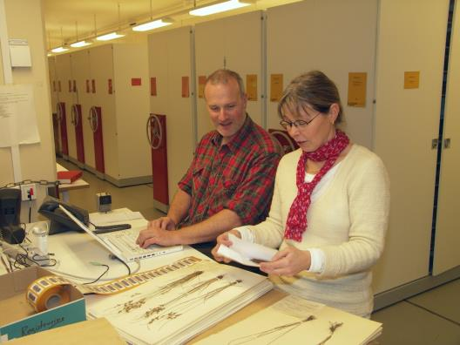
Herbarium GB in Gothenburg
– an infrastructure for biodiversity research
• ca 1 million specimens
• of which 2 500 are type specimens
• Herbarium GB is # 65–70 among 3240 registered herbaria in the world
(Index Herbariorum)
The new localities: controlled indoor climate: compacting system; insects proof cabinets
Number of specimens: 1 million specimens from all over the world.(number 70–80 in the world; but only number 4 in Sweden)
Claes Persson, curator at the herbarium in Gothenburg
Notes:
The new localities: controlled indoor climate: compacting system; insects proof cabinets
Number of specimens: 1 million specimens from all over the world.(number 70–80 in the world; but only number 4 in Sweden)

Slide 11
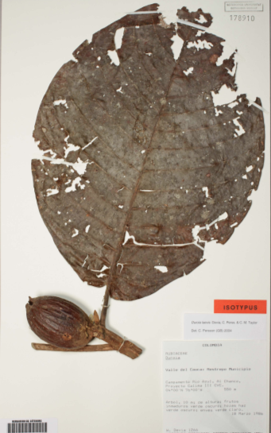
Digitization of herbarium GB
Digitization at herbarium GB started in 2006, when we as a member of the ”Virtuella herbariet” received a grant from Swedish Taxonomic Initiative to digitize our vascular plants.
Up to now we have digitized 128 000 specimens, mostly fungi. The digitization means entering label in a database.
2000 of the databased specimens are types. and these are also scanned as Global Plants
Claes Persson, curator at the herbarium in Gothenburg
Notes:
The digitalization at herbarium GB started 2006, when we as a member of the ”Virtuella herbariet” received a grant from Swedish Taxonomic Initiative to digitize our vascular plants.
Up to now we have digitilized 128 000 specimens, mostly fungi. The digitalization means entering label in a database.
2000 of dhe databased specimens are types. and these are also scanned and Global Plants

Slide 12
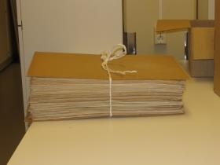
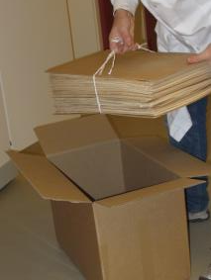
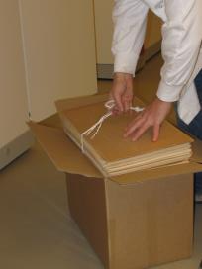
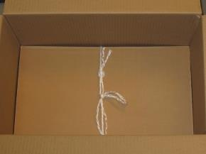
Packing
• 5000 sheets
were shipped
to MKC
• material kept in
their folders
It took us 1.5 days to pack 5000 sheet (that included counting all the sheets) but we think one person can easily pack 10 000 specimens per day, maybe more ….
Claes Persson, curator at the herbarium in Gothenburg
Notes:
It took us 1.5 days to pack 5000 sheet (that included counting all the sheets)
but we think that one person can easily pack 10 000 specimens per day, maybe more ….

Slide 13
Workflow at MKC
• The labels on the covers were photographed and
and the text were OCR’d and split into
continent, genus, epithet, and author and delivered to us as a csv file
Species or a genus name is necessary to append to the image to be of any use
Claes Persson, curator at the herbarium in Gothenburg
Notes:
Species or a genus name is necessary to append to the image to be of any use

Slide 14
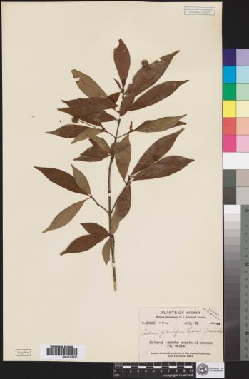
Workflow at MKC
• sheets were placed with a scale bar at the lower end and a color bar on the right hand side
• barcodes were glued onto each sheet
• sheets were photographed at 600 ppi
• 400-450 exp/shift
After being photographed at MKC we received 2 photosof each file, one JPG and one TIFF-file, one text file with OCR interpreted text of the label etc of each. In addition we received one CSV file with OCR information of all covers.
Claes Persson, curator at the herbarium in Gothenburg
Notes:
After being photographed at MKC we received 2 photosof each file, one JPG and one TIFF-file, one text file with OCR interpreted text of the label etc of each. In addition we received one CSV file with OCR information of all covers.

Slide 15
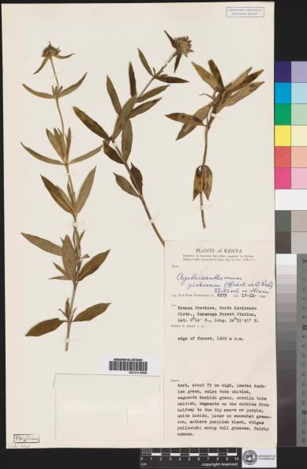
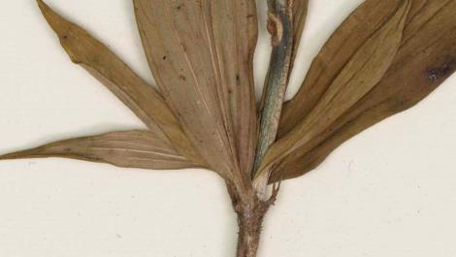
The quality of the images
The quality of the images was very good in respect to sharpness, contrast, brightness etc (although sometimes with some shades), and on par with our scanned specimens for the GPI project.
Claes Persson, curator at the herbarium in Gothenburg
Notes:
The quality of the images was very good in respect to sharpness, contrast, brightness etc (although sometimes with some shades), and on par with our scanned specimens for the GPI project.

Slide 16

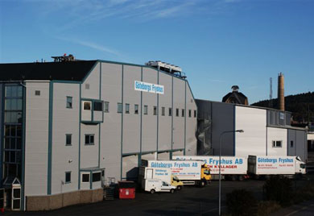
post-processing
• freezing the material (1 week
to several months)
• unpacking (several months)
• data cleaning and re-interpreting
the OCR-files etc. (several
years)
Regular freezes may be a bottleneck
Claes Persson, curator at the herbarium in Gothenburg
Notes:
• regular freezes can be a
bottleneck

Slide 17
Challenges - MKC
Mercury Chloride
Volume
Imaging: brightness – shades - contrast
Large 3-d objects (depth of field)
Different solutions requred for different types of (botanical) collections
Label information variable in style and content
Adam Rönnlund, Mediakonverteringscentret (MKC), Fränsta

Slide 18
Handling procedures - MKC
Delivery by cardboard boxes
Material split into 3-4 batches/box
Minimal handling procedures preferred
Specimen order within batches retained
Box returned after scanning
Adam Rönnlund, Mediakonverteringscentret (MKC), Fränsta

Slide 19
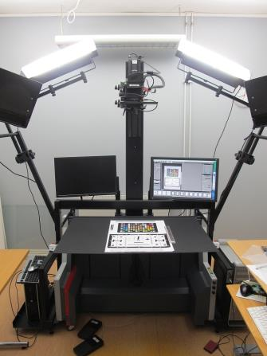
Imaging - MKC
Sinar Large-format camera
Digital back-end Sinar Exact
Camerahus P3
Lens CMV 60mm
Four shots (4x48Mpixel
= 192Mpixel)
Fixed position (not on glass)
Soft lighting –> minimizes
shades
Adam Rönnlund, Mediakonverteringscentret (MKC), Fränsta

Slide 20
Work flow - MKC
Envelope image in one shot
OCR-interpretation in four lines (Continent, Genus, Species, Auctor)
Linking envelope image to following bar codes
Bar code application (self-adhesive labels)
Specimen image by four shots
OCR-interpretation of specimen label information
Adam Rönnlund, Mediakonverteringscentret (MKC), Fränsta

Slide 21
Subsequent tratment: data - MKC
DNG to TIFF
Bildbehandling
OCR-interpretation
Each scanned specimen reproduced in four files (TIFF 600ppi, JPEG 300ppi, text file and .xml file)
File names as bar code
Indexing
Adam Rönnlund, Mediakonverteringscentret (MKC), Fränsta

Slide 22
Experience - MKC
400-450 exposures/shift
Fixad colour- and scale reference
Bar codes applied during imaging
Soft lighting – low contrast
Data quaity chec – csv file for database import
Adam Rönnlund, Mediakonverteringscentret (MKC), Fränsta

Slide 23
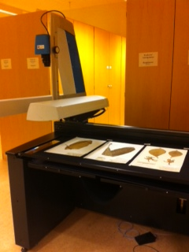
Pilot study at the Museum of Evolution, Uppsala
Set-up:
600 dpi
Scanning time 15 s
Three sheets per scan
Automatic cropping and saving of images
Notes:
Describe scanning process

Slide 24
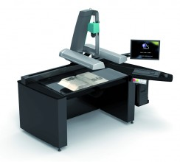
Supra-scan™ Quartz A1
(I2S DigiBook+Kirtas Technologies, Pessac, France)
Linear scanner
Tri-linear CCD sensor camera
LED lighting system
400 to 1000 dpi (A1 to A4 format)
Post-processing software LIMB™
Notes:
Originally designed for scanning books, but has been used to scan the herbarium of the natural history museum in paris.

Slide 25
New set-up: two scanning methods
Method 1
Single image of each sheet
Three sheets per scan
220 sheets per hour
Method 2
Unfolding envelopes
Turning over labels
Two sheets per scan
140 sheets per hour
Notes:
225 resp 150 with two operators. 1000 vs 700 sheets per day accounting for preparation, post-processing etc.

Slide 26
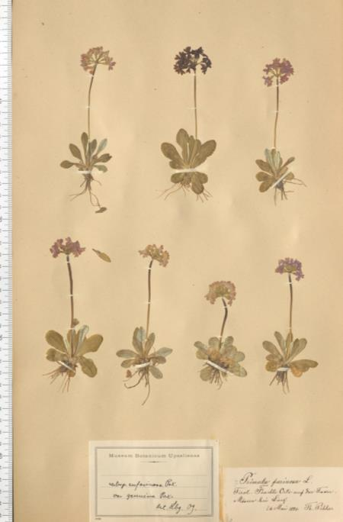
Nice image: Plant material, labels neatly placed next to each other on the sheet... In only 15 seconds, you get three nice images.
When new labels cover older labels a second image of the same sheet is needed to obtain all information. (Ca. 15% had double labels.)
Notes:
Nice image: Plant material, labels neatly placed next to each other on the sheet... In only 15 seconds, you get three nice images.

Slide 27
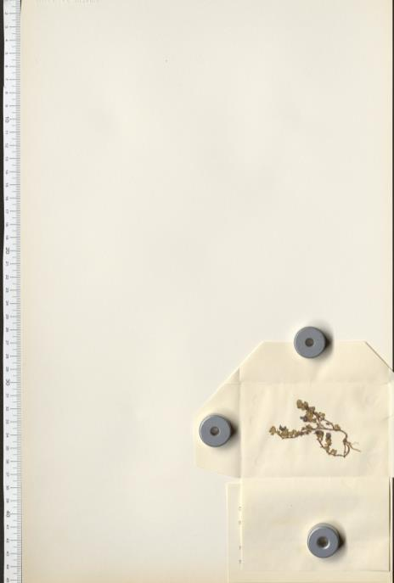

When the plant material is contained in an envelope attached to the sheet…
…the plant material gets visible, but the label is covered... (Approximately 1/3 of the documents had envelopes.)
Notes:
Another case is when the plant material is contained in an envelope attached to the sheet. Approximately 1/3 of the documents had envelopes

Slide 28
Conclusions
Efficient and user-friendly scanning method
No transport or freezing costs
Space demanding
Ergonomic aspects
Important to consider the level of information required by the users

Slide 29
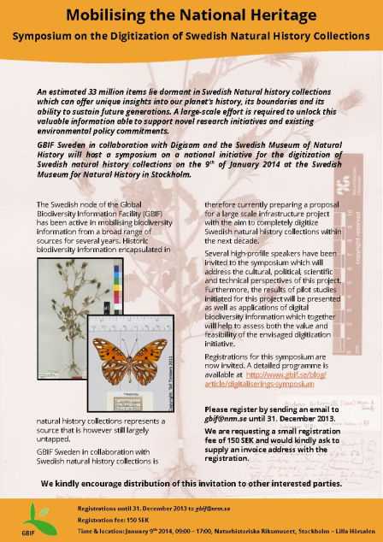
e-BioColl.se (Kongsvoll 2-4 Sep. 2014)
eBioColl.se background:
Discussions held with collection managers on presumptive digitisation initiative (2011-2012)
Continuing discussions and workshop planning: Large-scale digitisation infrastructure in Sweden (2012-2013)
Pilot at MKC (Media Conversion Centre) and at the Museum of Evolution

Slide 30
eBioColl.se objectives:
Imaging of invidual collection specimen and transcription and databasing of label information
Digitization of Swedish Herbaria in the next 5 years
Complete digitization of Swedish Natural History collections in the next decade
Continuous digitization infrastructure for Swedish Natural History collections
Establishment of an international digitization network
Stefan Daume, Naturhistoriska riksmuseet, Stockholm

Slide 31
eBioColl.se motivation:
Cultural/political
Research
National heritage
Systematics
Educational access
Climate change
Curation support
Invasive species
Information repatriation
Conservation biology
…
…
Stefan Daume, Naturhistoriska riksmuseet, Stockholm

Slide 32
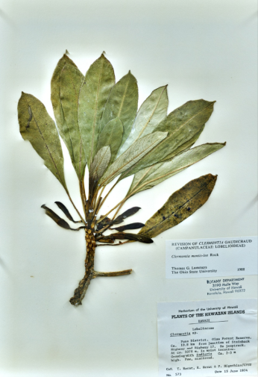
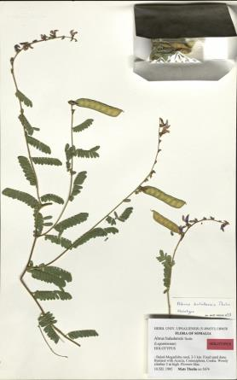
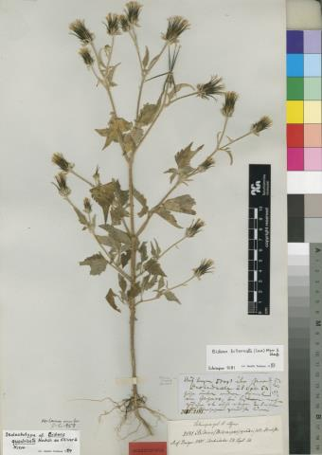
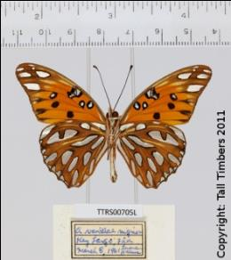
WHAT ?
…
Notes:
-take images
-information extraction
-is this overkill?
-foto is the lowest common denominator providing access to all information and supporting all processes

Slide 33
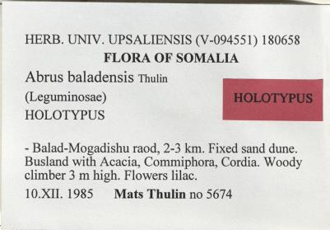
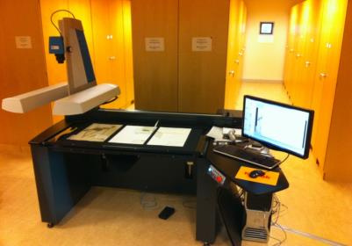
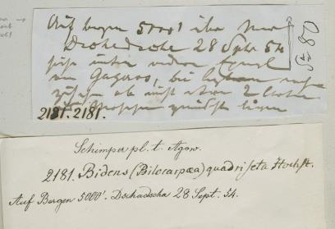
INFORMATION EXTRACTION
Industrial imaging
Adaptive information extraction
Automation support
OCR
Crowdsourcing
Stefan Daume, Naturhistoriska riksmuseet, Stockholm
Notes:
-SHOW: automation scale from OCR to manual
-with intermediate stages
-SHOW: Notes from nature

Slide 34
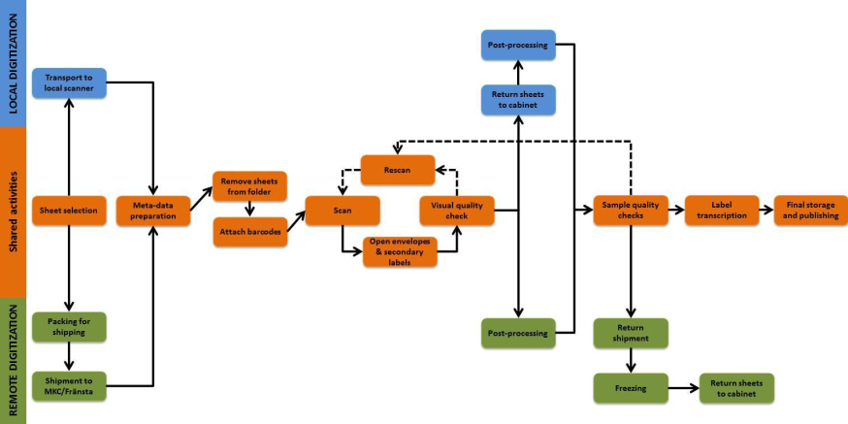
e-BioColl.se (Kongsvoll 2-4 Sep. 2014)
The proposed future digitisation process
3
7
5
1
4
6
8
10
11
6
5
6
2
9
7
9
3
9

Slide 35
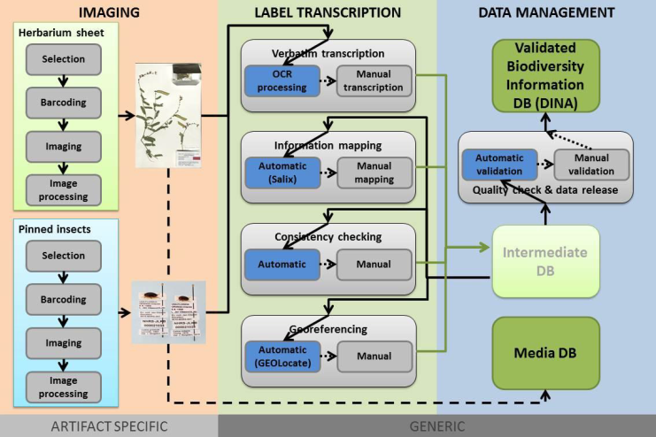
e-BioColl.se (Kongsvoll 2-4 Sep. 2014)
Workflow processes
1
2
3
2a
1a
2b
2c
1b
2d
1c

Slide 36
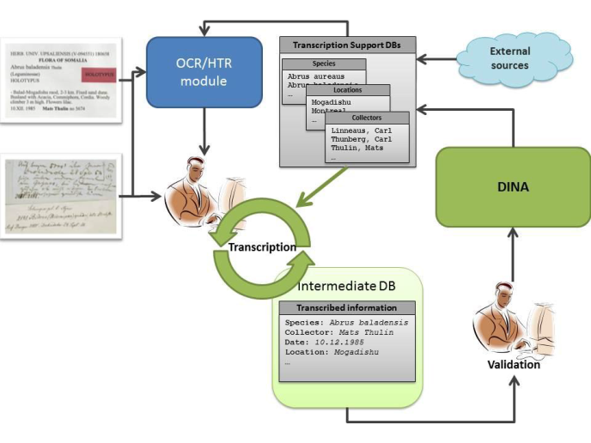
e-BioColl.se (Kongsvoll 2-4 Sep. 2014)
Transcription, Validation
1
5
4
2
3

Slide 37
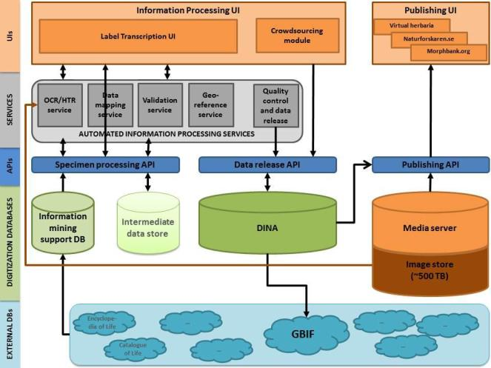
e-BioColl.se (Kongsvoll 2-4 Sep. 2014)
Data Management

Slide 38
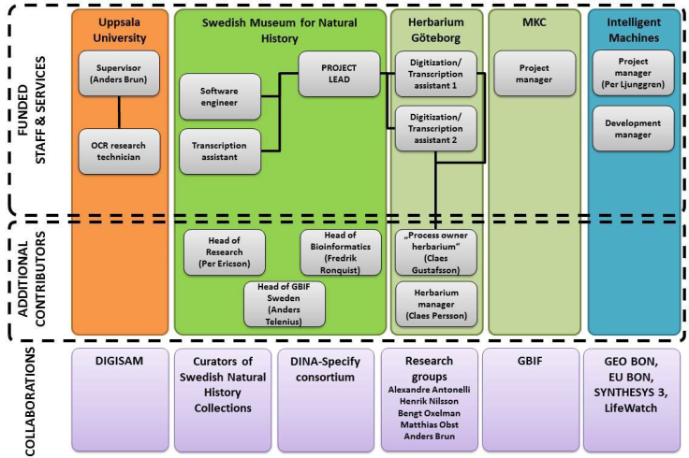
e-BioColl.se (Kongsvoll 2-4 Sep. 2014)
Responsibilities; collaborators

Slide 39
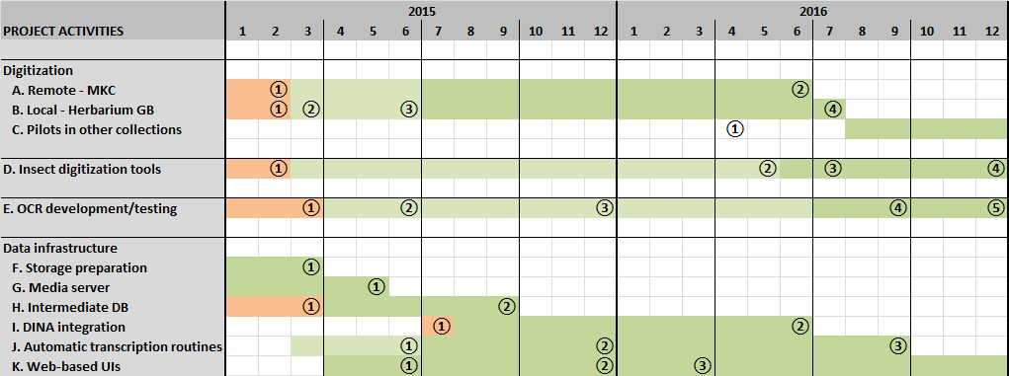
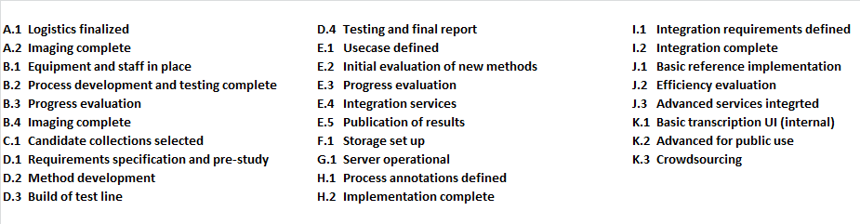
e-BioColl.se (Kongsvoll 2-4 Sep. 2014)
eBioColl.se GANT chart

Slide 40
e-BioColl.se (Kongsvoll 2-4 Sep. 2014)
Application approval?
7 november 2014
Start possible January 2015
If not; repeated application in 2015?
If not; increased application in 2015/2016?
If not; participant in other collaborative effort 2014, 2015, 2016..?

Slide 41
e-BioColl.se (Kongsvoll 2-4 Sep. 2014)
DEDDI? (Design of a European Distributed Digitisation Infrastructure for Natural Heritage)
Partners:
  CETAF: Consortium of European Taxonomic Facilities, Brussels, Belgium
  IICT: Instituto de Investigação Científica Tropical, Lisboa, Portugal (GBIF PT)
  IBSAS: Institute of Botany, Slovak Academy of Sciences, Bratislava, Slovakia (GBIF SK)
  FUB-BGBM: Botanic Garden and Botanical Museum, Freie Universität Berlin, Germany (GBIF DE)
  MfN: Museum für Naturkunde, Berlin, Germany
  NBC: Naturalis Biodiversity Center, Leiden, the Netherlands (GBIF NL)
  NHM: Natural History Museum, London, UK
  NRM: Swedish Museum of Natural History, Stockholm (GBIF SE)
  RBGK: Royal Botanic Gardens, Kew, UK
  SP2000: Species 2000 / Catalogue of Life Secretariat, Leiden, the Netherlands (GBIF SP2000)
  UEF: Digitarium, University of Eastern Finland, Joensuu
  AUTh: Aristotle University, Thessaloniki, Greece
  INES, Supercomputer (Centre Informatique National de l`Einseignement Supèrieure), France
Design of a European Distributed Digitisation
Infrastructure for Natural Heritage

Slide 42
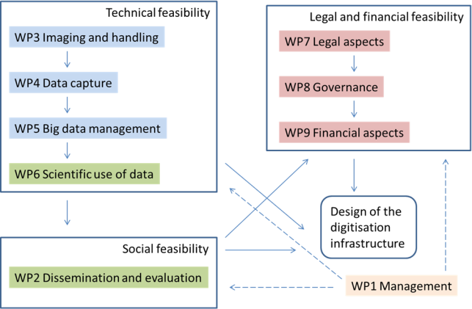
e-BioColl.se (Kongsvoll 2-4 Sep. 2014)
DEDDI? N.b. Research infrastructure design..!

Slide 43
e-BioColl.se (Kongsvoll 2-4 Sep. 2014)
DEDDI? (WP1 + 7-9 Project Management)
WP2 (CETAF): Societal impact (Dissemination) and outreach)
  Communication strategy
  Communication platform
  Networking actions
  Linking with cultural heritage
  Dissemination of results
  Engagement of relevant actors beyond the project
  Impact assessment
The task begins by communicating with the stakeholders and general public, about the aims, progress and achievements of the project. It will be necessary to go beyond a one-way dissemination activity in order to establish a dialogue with the community to get acceptance for re-engineering of collection use and access practices. The aim is to maximise the societal impacts of the project, and to invite the stakeholders to be involved and included in the project. Evaluation of the results and impact assessment will be the final products of the task.
1
2
3
4

Slide 44
e-BioColl.se (Kongsvoll 2-4 Sep. 2014)
DEDDI?
WP3 (NBC): Imaging and handling
  Logistics (collection transports and/or digitisation facility transports
  Specimen imaging techniques
  Digitisation processes
  Health and safety protocols
  Robotics and warehousing
The overall objective of WP 3 is to design the setups for imaging different sample types (semi-) automatically in various digitization factories set up across Europe. This includes quality checking, assurance and approval protocols to ensure high quality output, and cost-effective image capture and storage. The feasibility of alternatives for the model of distributed digitization facilities will be investigated, most notably the concept of mobile, travelling digitization facilities. Available imaging techniques and equipment will be assessed and necessary or desired improvements for these identified. Health and safety protocols for specimen handling will be established.
1
2

Slide 45
e-BioColl.se (Kongsvoll 2-4 Sep. 2014)
DEDDI?
WP4 (NRM): Data Capture
  Methods for automated label and text analysis
  Crowd sourcing and citizen science platforms for validating and annotating data
  Lookup services for taxonomy and other content
  Quality control of taxon and occurrence data
  Transcribing accession books and other unpublished literature
  New techniques for data mining/machine learning
The objectives of WP4 are to assess the state of transcribing data from images with various methods such as distance workers, volunteers and through automatic image analysis, including use of OCR and other methods. Techniques for data mining and machine learning will be tested and recommendations of their use will be made. Various transcription systems and services will be tested and new solutions developed as appropriate. Distance work in various regions of Europe and the world will be promoted and tested with real applications. The technologies of annotating data and distributed digitization workflows will be assessed and refined.
1
2
3
4
5

Slide 46
e-BioColl.se (Kongsvoll 2-4 Sep. 2014)
DEDDI?
WP5 (MfN): Big Data Management
  Media data
  Digital preservation
  High performance replication
  Modelling
The objective is to design the data centre operations in a petabyte scale. An enterprise information architecture for the entire digitisation operation will be designed. This includes determining number of data centres, data transfers, data replication, and strategies for long term preservation. The full life cycle of data will be considered. Relations to existing collection data systems and image databases will be determined, as well as use of data standards. Open access to data will be promoted.
1

Slide 47
e-BioColl.se (Kongsvoll 2-4 Sep. 2014)
DEDDI?
WP6 (NHM): Scientific Use of Data
  Prioritisation and description of additional scientific data requirements
  Destructive sampling for chemical characterisation and DNA barcoding
  In-situ taxon-aware trait extraction
The goal of this WP is to identify, describe and assess the prospects of capturing additional scientific data as a coupled process to the digitisation workflows and develop best practices for facilitating the extraction of morphometric, chemical and molecular data.
1

Slide 48
e-BioColl.se (Kongsvoll 2-4 Sep. 2014)
DEDDI? (Design of a European Distributed Digitisation Infrastructure for Natural Heritage)
Partners:
  CETAF: Consortium of European Taxonomic Facilities, Brussels, Belgium
  IICT: Instituto de Investigação Científica Tropical, Lisboa, Portugal (GBIF PT)
  IBSAS: Institute of Botany, Slovak Academy of Sciences, Bratislava, Slovakia (GBIF SK)
  FUB-BGBM: Botanic Garden and Botanical Museum, Freie Universität Berlin, Germany (GBIF DE)
  MfN: Museum für Naturkunde, Berlin, Germany
  NBC: Naturalis Biodiversity Center, Leiden, the Netherlands (GBIF NL)
  NHM: Natural History Museum, London, UK
  NRM: Swedish Museum of Natural History, Stockholm (GBIF SE)
  RBGK: Royal Botanic Gardens, Kew, UK
  SP2000: Species 2000 / Catalogue of Life Secretariat, Leiden, the Netherlands (GBIF SP2000)
  UEF: Digitarium, University of Eastern Finland, Joensuu
  AUTh: Aristotle University, Thessaloniki, Greece
  INES, Supercomputer (Centre Informatique National de l`Einseignement Supèrieure), France
Design of a European Distributed Digitisation
Infrastructure for Natural Heritage
Due 2014-09-02, 5.00 PM…

Slide 49
End!

