Slide 1
Persistent Identifiers
Herbarieworkshop, Kongsvoll Fjellstue September 2014. Dag Endresen, NHM
Connecting Data
Notes:
September 2014, CC-by-3.0 Dag Endresen, GBIF-Norway, NHM-UiO. Persistent Identifiers. Herbarieworkshop at Kongsvoll Fjellstue 1-4 September 2014.

Slide 2
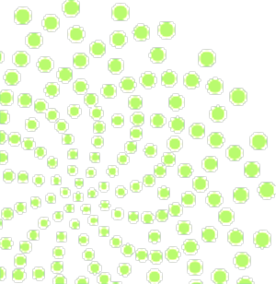
The purpose of identifiers
…is to name things,
making it possible to refer to them.
Notes:
Kunze, J. A. (2003). Towards electronic persistence using ARK identifiers. Proceedings of the ECDL Web Archiving Workshop 2003. Available at http://www.cdlib.org/inside/diglib/ark/arkcdl.pdf
Coyle, K. (2006). Managing technology: Identifiers: unique, persistent, global. Journal of academic librarianship, 34(4): 428-431.
Campbell, D. (2007). Identifying the identifiers. Proceedings of the International Conference on Dublin Core and Metadata Applications.

Slide 3
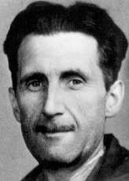
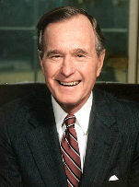
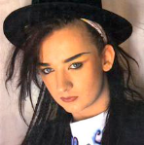
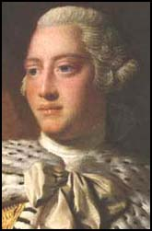
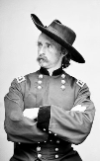
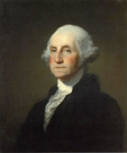
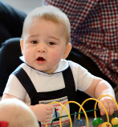
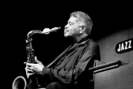
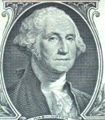
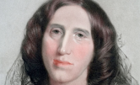
Name ambiguity: George
Notes:
George Orwell, George Harrison, George Bush, George Bush jr, George Soros, George Washington, Boy George, George (Seinfeld), George Lucas, George Clooney, Prince George of Cambridge, King George III of England, George Armstrong Custer, Georges Enescu, Curious George, St George in New Brunswick, George Coleman, George Eliot

Slide 4
What is an identifier:
“Each identifier refers to one and only one thing” (Coyle 2006).
“An association between a string and a thing” (Kunze 2003).
“A stated association between a symbol and a thing; that the symbol may be used to unambiguously refer to the thing within a given context” (Campbell 2007).
Notes:
Kunze, John A. (2003). Towards electronic persistence using ARK identifiers. Proceedings of the ECDL Web Archiving Workshop 2003. Available at http://www.cdlib.org/inside/diglib/ark/arkcdl.pdf
Coyle, K. (2006). Managing technology: Identifiers: unique, persistent, global. Journal of academic librarianship, 34(4): 428-431.
Campbell, D. (2007). Identifying the identifiers. Proceedings of the International Conference on Dublin Core and Metadata Applications.

Slide 5
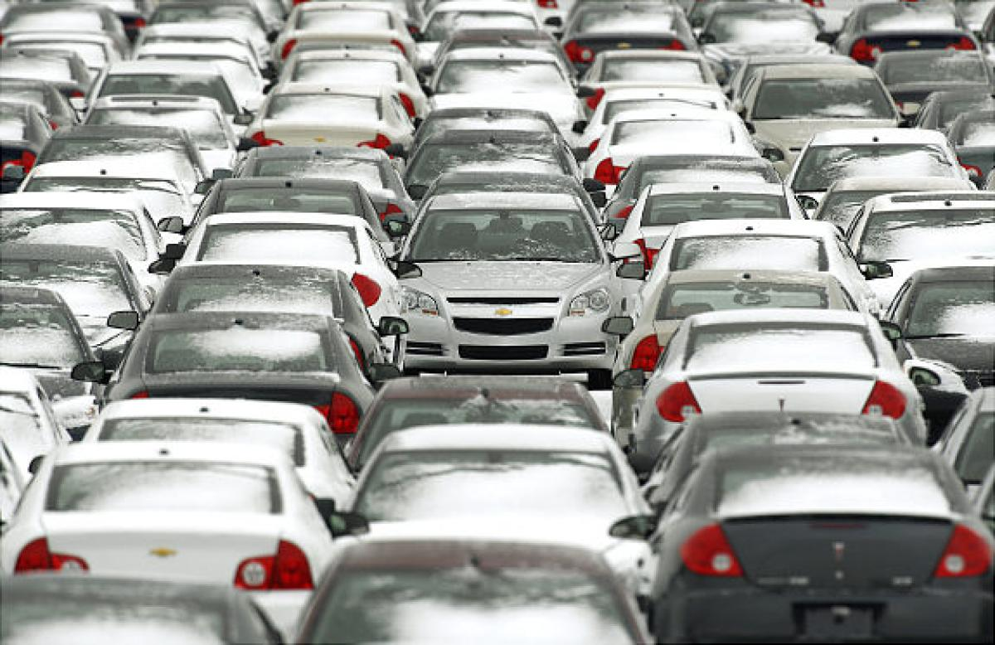
Notes:
Photo: Sancya/AP./ Published: 03/31/2009 3:58:00, http://www.nydailynews.com/news/money/pile-unsold-cars-graveyards-gallery-1.45144

Slide 6
When is the identifier “good enough”
Unique and persistent - within a given context.
“The common experience is that an identifier is created within a system or within a context, and that at a later date it needs to be used in another or larger context” (Coyle 2006).
Expanding context:
Within one museum collection (catalog number).
Within a network between museum collections (collection code + catalogue number).
Within biodiversity information network (institution code + collection/dataset code + catalogue number).
At the Internet (e.g. http URI, DOI, LSID, etc…)
… larger contexts are possible to imagine in the future!?
Notes:
Image: http://www.hypnosisinmelbourne.com.au/index.php?p=49
Coyle, K. (2006). Managing technology: Identifiers: unique, persistent, global. Journal of academic librarianship, 34(4): 428-431.
----
Når er en ID nøkkel “god nok”?
Unik og stabil – innen en gitt kontekst.
“The common experience is that an identifier is created within a system or within a context, and that at a later date it needs to be used in another or larger context” (Coyle 2006).
Kontekst:
Innen en museumssamling (katalognummer).
Innen et nettverk av museumssamlinger (samlingskode + katalognummer).
Innen biodiversitet informasjonsnettverk (institusjonskode + samlings-/datasett-kode + katalognummer).
På Internett (e.g. http URI, DOI, LSID, osv.…)
… bredere sammenhenger er mulig i fremtiden!?

Slide 8
Identify the thing that you care about
The specimen itself (the physical entity)
Image of the specimen
Description of the specimen
Location where the specimen was captured
The occurrence event when the specimen was captured…

Slide 9
Record-level Terms
dcterms:type | dcterms:modified | dcterms:language | dcterms:rights | dcterms:rightsHolder | dcterms:accessRights | dcterms:bibliographicCitation | dcterms:references | institutionID | collectionID | datasetID | institutionCode | collectionCode | datasetName | ownerInstitutionCode | basisOfRecord | informationWithheld | dataGeneralizations | dynamicProperties
Occurrence
occurrenceID | catalogNumber | occurrenceRemarks | recordNumber | recordedBy | individualID | individualCount | sex | lifeStage | reproductiveCondition | behavior | establishmentMeans | occurrenceStatus | preparations | disposition | otherCatalogNumbers | previousIdentifications | associatedMedia | associatedReferences | associatedOccurrences | associatedSequences | associatedTaxa
MaterialSample
materialSampleID
Event
eventID | samplingProtocol | samplingEffort | eventDate | eventTime | startDayOfYear | endDayOfYear | year | month | day | verbatimEventDate | habitat | fieldNumber | fieldNotes | eventRemarks
dcterms:Location
locationID | higherGeographyID | higherGeography | continent | waterBody | islandGroup | island | country | countryCode | stateProvince | county | municipality | locality | verbatimLocality | verbatimElevation | minimumElevationInMeters | maximumElevationInMeters | verbatimDepth | minimumDepthInMeters | maximumDepthInMeters | minimumDistanceAboveSurfaceInMeters | maximumDistanceAboveSurfaceInMeters | locationAccordingTo | locationRemarks | verbatimCoordinates | verbatimLatitude | verbatimLongitude | verbatimCoordinateSystem | verbatimSRS | decimalLatitude | decimalLongitude | geodeticDatum | coordinateUncertaintyInMeters | coordinatePrecision | pointRadiusSpatialFit | footprintWKT | footprintSRS | footprintSpatialFit | georeferencedBy | georeferencedDate | georeferenceProtocol | georeferenceSources | georeferenceVerificationStatus | georeferenceRemarks
GeologicalContext
geologicalContextID | earliestEonOrLowestEonothem | latestEonOrHighestEonothem | earliestEraOrLowestErathem | latestEraOrHighestErathem | earliestPeriodOrLowestSystem | latestPeriodOrHighestSystem | earliestEpochOrLowestSeries | latestEpochOrHighestSeries | earliestAgeOrLowestStage | latestAgeOrHighestStage | lowestBiostratigraphicZone | highestBiostratigraphicZone | lithostratigraphicTerms | group | formation | member | bed
Identification
identificationID | identifiedBy | dateIdentified | identificationReferences | identificationVerificationStatus | identificationRemarks | identificationQualifier | typeStatus
Taxon
taxonID | scientificNameID | acceptedNameUsageID | parentNameUsageID | originalNameUsageID | nameAccordingToID | namePublishedInID | taxonConceptID | scientificName | acceptedNameUsage | parentNameUsage | originalNameUsage | nameAccordingTo | namePublishedIn | namePublishedInYear | higherClassification | kingdom | phylum | class | order | family | genus | subgenus | specificEpithet | infraspecificEpithet | taxonRank | verbatimTaxonRank | scientificNameAuthorship | vernacularName | nomenclaturalCode | taxonomicStatus | nomenclaturalStatus | taxonRemarks
ResourceRelationship (Auxiliary Terms)
resourceRelationshipID | resourceID | relatedResourceID | relationshipOfResource | relationshipAccordingTo | relationshipEstablishedDate | relationshipRemarks
MeasurementOrFact (Auxiliary Terms)
measurementID | measurementType | measurementValue | measurementAccuracy | measurementUnit | measurementDeterminedDate | measurementDeterminedBy | measurementMethod | measurementRemarks
Darwin Core
Notes:
Darwin Core, http://rs.tdwg.org/dwc/terms/

Slide 10
Term name: | occurrenceID
Identifier: | http://rs.tdwg.org/dwc/terms/occurrenceID
Class: | http://rs.tdwg.org/dwc/terms/Occurrence
Definition: | An identifier for the Occurrence (as opposed to a particular digital record of the occurrence). In the absence of a persistent global unique identifier, construct one from a combination of identifiers in the record that will most closely make the occurrenceID globally unique.
Comment: | For a specimen in the absence of a bona fide global unique identifier, for example, use the form: "urn:catalog:[institutionCode]:[collectionCode]:[catalogNumber]". Examples: "urn:lsid:nhm.ku.edu:Herps:32", "urn:catalog:FMNH:Mammal:145732". For discussion see http://code.google.com/p/darwincore/wiki/Occurrence
Notes:
occurrenceID [http://code.google.com/p/darwincore/wiki/Occurrence]. Quick Reference: [http://rs.tdwg.org/dwc/terms/index.htm#occurrenceID]. The occurrenceID is supposed to (globally) uniquely identify an occurrence record, whether it is a specimen-based occurrence, a one-time observation of a species at a location, or one of many occurrences of an individual who is being tracked, monitored, or recaptured. Making it globally unique is quite a trick, one for which we don't really have good solutions in place yet, but one which ontologists insist is essential.

Slide 11
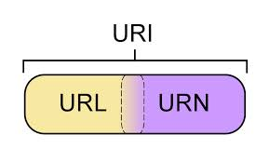
Identifiers for museum collections
The longevity of museums lead to:
“The need to use identifiers from our past in the current highly-networked digital systems” (Coyle 2006 [talking about libraries]).
Specify a namespace for the identifiers?
URI – uniform resource identifier (unique in the context of the web).
URN – uniform resource name (name not tied to location).
URL – uniform resource locator (network location as identifier).
PURL – persistent URL (commitment to service longevity).
Something else…?
DOI – digital object identifier
ARK – archival resource key
UUID – universal unique identifier
Notes:
Coyle, K. (2006). Managing technology: Identifiers: unique, persistent, global. Journal of academic librarianship, 34(4): 428-431.

Slide 12
Persistent Identifier systems
Persistent Identifier (PID)
Globally Unique Identifier (GUID)
Universal Resource Identifier (URI)
Persistent Uniform Resource Locator (PURL)
Life Science Identifier (LSID)
Digital Object Identifier (DOI)
Handle system (Handle)
Archival Resource Key (ARK, EZID)
Universally Unique Identifier (UUID)
Reuse existing
identifiers!
Notes:
Reuse identifiers

Slide 13
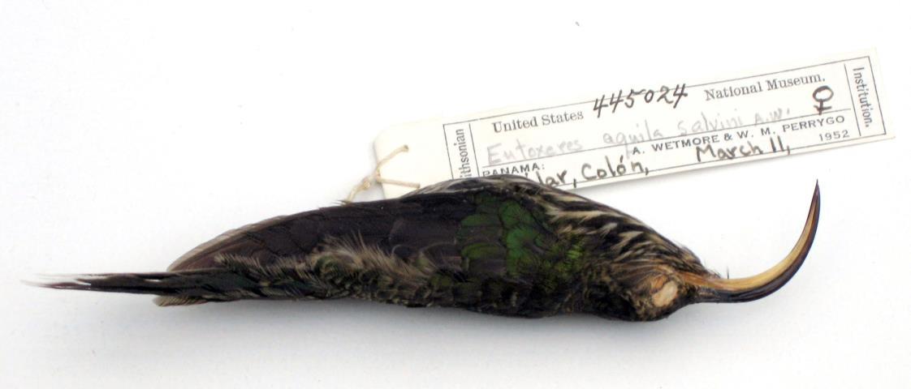
Reuse existing identifiers
PURL
http://hdl.handle.net/1839/00-0000-0000-0009-3C7E-F
http://zoobank.org/urn:lsid:zoobank.org:pub:CDC8D258-8F57-41DC-B560-247E17D3DC8C
urn:lsid:Orthoptera.speciesfile.org:TaxonName:xx
urn:lsid:catalogueoflife.org:taxon:d755ba3e-29c1-102b-9a4a-00304854f820:ac2009
Photo: Smithsonian National Museum of Natural History, USNM-445024-Eutoxeres-aquila
Notes:
Photo: A white-tipped sicklebill hummingbird (Eutoxeres aquila) collected by Perrygo and Wetmore in Panama, Credit National Museum of Natural History, USNM-445024-Eutoxeres-aquila. http://collections.nmnh.si.edu/search/birds/?irn=4343984, http://www.mnh.si.edu/onehundredyears/profiles/Watson_Perrygo/USNM-445024-Eutoxeres-aquila-2_lg.jpg

Slide 14
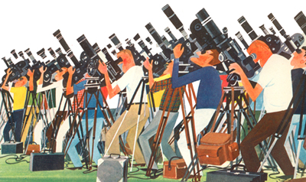
http://purl.org/nhmuio/id/41d9cbb4-4590-4265-8079-ca44d46d27c3
Illustration by Miroslav Šašek (1963)
Notes:
Image: This is Cape Canaveral (M. Sasek, 1963), http://blog.miroslavsasek.com/wp-content/uploads/2009/05/moon-birdwatchers-400.jpg by Miroslav Šašek(1916-1980), http://www.miroslavsasek.com/, http://www.ilike.org.uk/2009/05/this_is_m_sasek.html

Slide 15
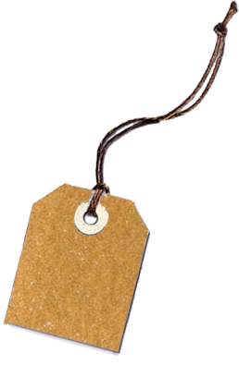
Persistent Identifiers
Globally unique
Scalability, number of IDs
Community acceptance
Long-term life-cycle
Resolvable, resolution service(s)
Cost per identifier
People-friendly or machine-friendly
Solution for the generation of new IDs
Central generation, PID issuer
Distributed generation at source
Notes:
Once a name is allocated, there is a social expectation that the name should always refer to the item and that the item, or at least information about the item, should be retrievable on production of its name to the correct service.
----
Globalt unike ID-nøkler.
Skalerbar modell, antall ID-nøkler.
Sosial aksept i fagmiljøet.
Lang livssyklus for ID-nøkler.
”Resolution service(s)”.
Kostnad per ID-nøkkel.
Bruker- eller maskin-vennlig.
Løsning for å generere nye ID-nøkler.
Sentralisert system for nye ID-nøkler.
Føderert generering av ID ved kilde.

Slide 16
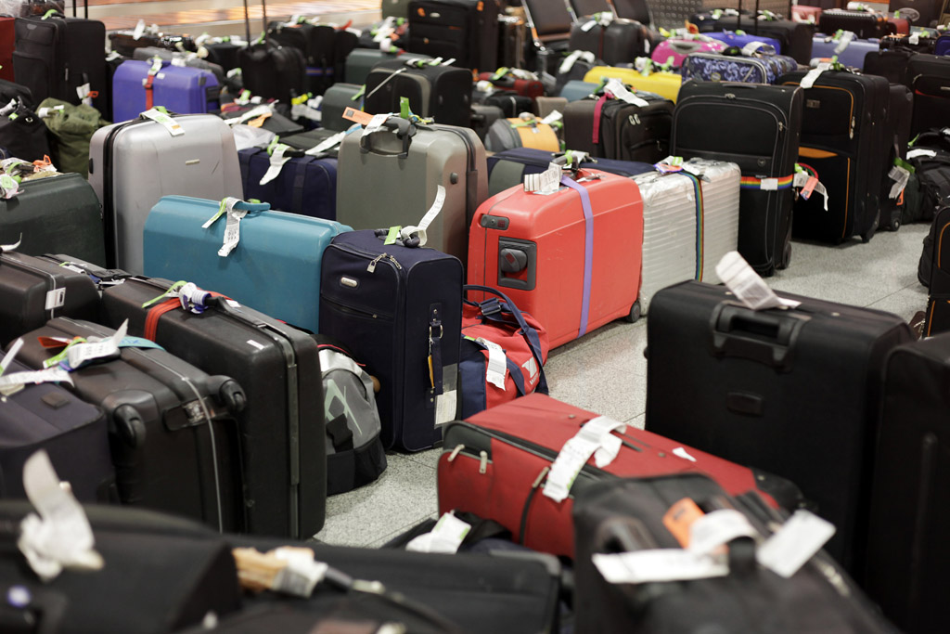
Notes:
Photo: BELGA_imagebroker_J.Schulzki

Slide 17
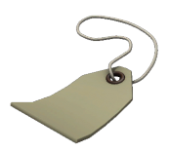
Universally Unique Identifier (UUID)
A UUID is a 16-octet (128-bit) 36-chars number.
Example: C37E3F9B-BCAF-4479-8EB7-3346A2DB2373
The probability of one duplicate would be about 50% if every person on earth create 600 million UUIDs.
Allows for easy generation at source in a distributed network.
Notes:
Example: http://purl.org/nhmuio/id/c37e3f9b-bcaf-4479-8eb7-3346a2db2373 :: http://gbif.no/resolver/c37e3f9b-bcaf-4479-8eb7-3346a2db2373 :: http://macnhm19.uio.no/id/c37e3f9b-bcaf-4479-8eb7-3346a2db2373
http://macnhm19.uio.no/id/C37E3F9B-BCAF-4479-8EB7-3346A2DB2373

Slide 18
Identifier
Resolver
Specimen
Location

Slide 19
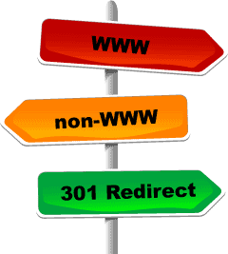
Persistent Uniform Resource Locator
PURL technology provides a robust resolution service ready for the future - and a stable solution that is working well right now.
PURL for the NHM-resolver:
http://purl.org/nhmuio/id/[PID]
The NHM-PURL redirects here:
http://gbif.no/resolver/[PID]
Could with few modifications redirect e.g. here:
http://gbif.org/resolver/[PID]
Notes:
PURL --> Easy to redirect resolution service to say a global GBIF operated service…
----
PURL teknologi gir en fremtidsrettet og stabil “resolution service” for nåtiden.
PURL for ID-tjenesten: http://purl.org/nhmuio/id/[PID]
PURL redirigerer ID-tjenesten hit: http://gbif.no/resolver/[PID]
Kan med få endringer redirigere f.eks. hit: http://gbif.org/resolver/[PID]

Slide 20
http – PURL – UUID
http://purl.org/nhmuio/id/41d9cbb4-4590-4265-8079-ca44d46d27c3

Slide 21
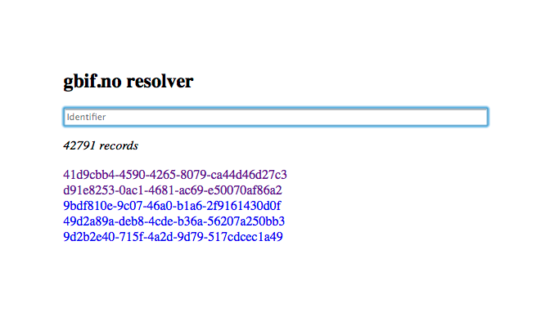
http://purl.org/nhmuio/id/UUID → http://gbif.no/resolver/UUID
Notes:
http://purl.org/nhmuio/id/ → http://gbif.no/resolver/

Slide 22
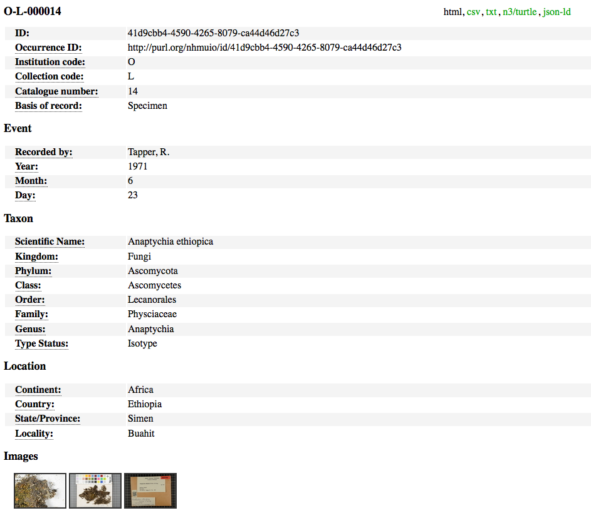
Including machine readable formats

Slide 23
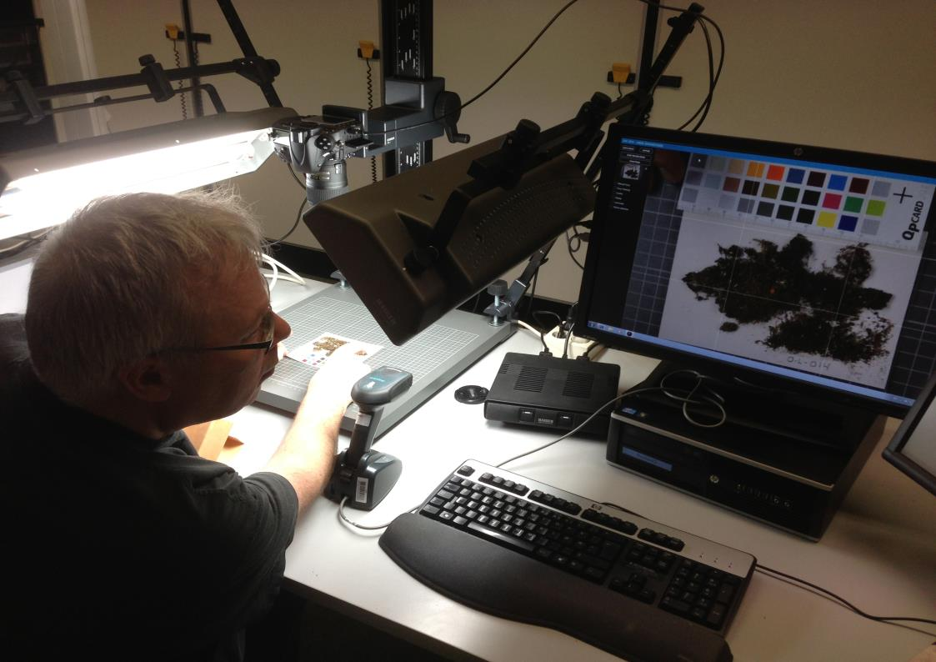
Catalog number: O-L-000014 http://purl.org/nhmuio/id/41d9cbb4-4590-4265-8079-ca44d46d27c3
Notes:
Imaging of the Lichen Type specimens, attaching UUIDs as QR Codes to the herbarium sheets. http://purl.org/nhmuio/id/41d9cbb4-4590-4265-8079-ca44d46d27c3, catalog number O-L-000014. http://nhm2.uio.no/typephotos/lichens/typephotoS.php?f=O-L-000014_s.jpg
See also: http://nhm2.uio.no/lav/web/index.html

Slide 24
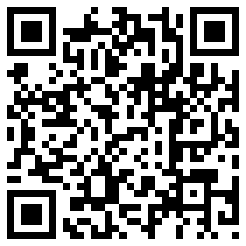
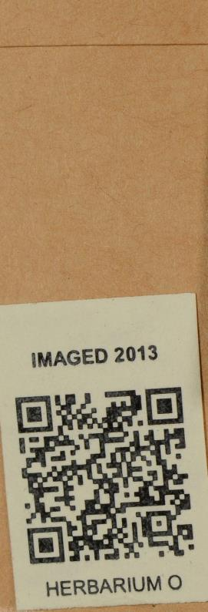
QR Code
Quick Response Code (QR code).
A type of matrix barcode (or two-dimensional code).
Popular due to its fast readability and large storage capacity.
The use of QR Codes is free of any license.
The QR Code is clearly defined and published as an ISO standard.
Invented in Japan by the Toyota subsidiary Denso Wave in 1994.
Notes:
“Quick Response Code” (QR-code).
En type matriks strekkode (eller to-dimensjonal kode).
Populær grunnet hurtig maskinlesbar og stor kapasitet for lagring.
Anvendelsen av QR koder er gratis uten begrensende lisensbetingelser.
Format for QR koder er entydig definert og publisert som en ISO standard.
Oppfunnet i Japan av et datterselskap til Toyota: Denso Wave i 1994.

Slide 25
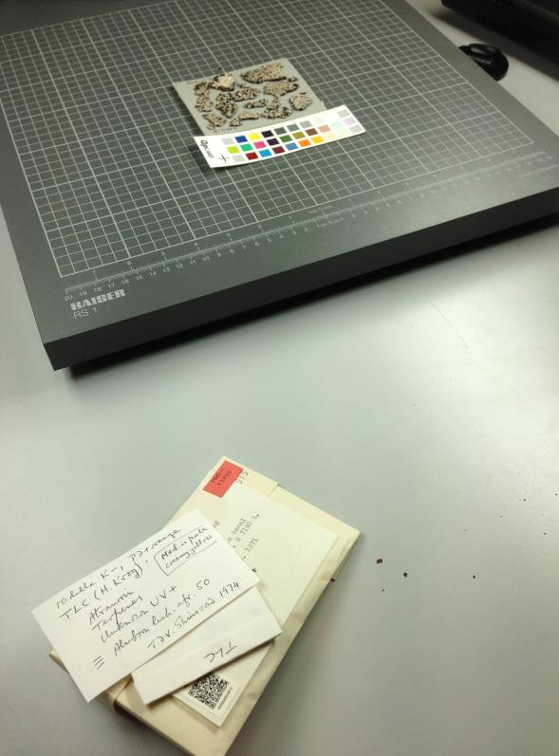
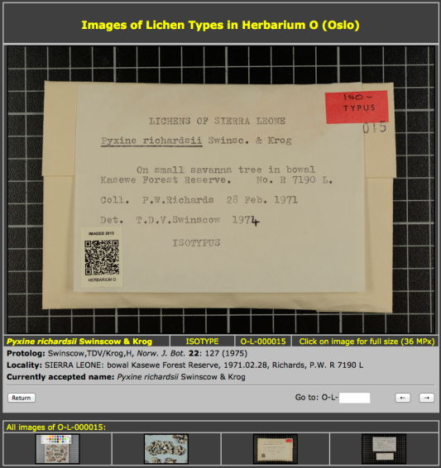
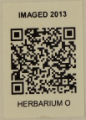
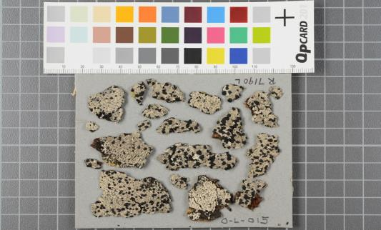
http://purl.org/nhmuio/id/d91e8253-0ac1-4681-ac69-e50070af86a2
Notes:
Imaging of the Lichen Type specimens, attaching UUIDs as QR Codes to the herbarium sheets. http://purl.org/nhmuio/id/d91e8253-0ac1-4681-ac69-e50070af86a2, catalog number O-L-000015. http://nhm2.uio.no/typephotos/lichens/typephotoS.php?f=O-L-000015_s.jpg

Slide 26
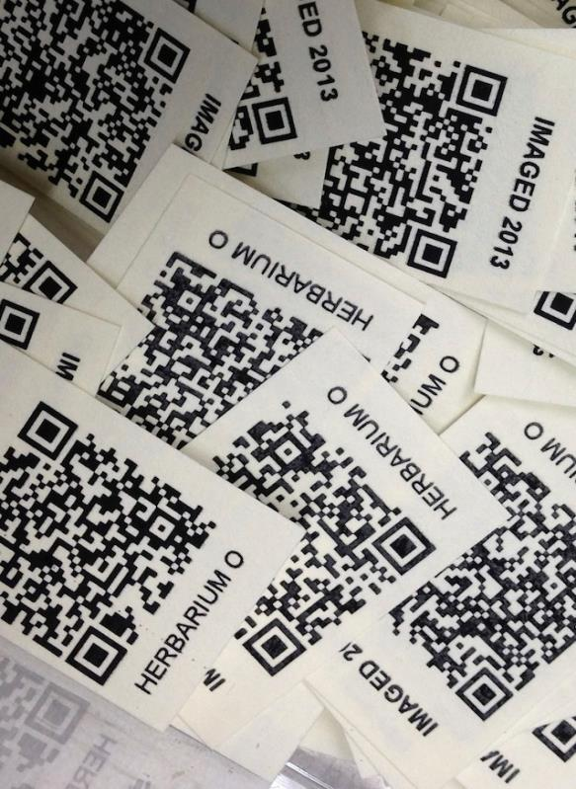
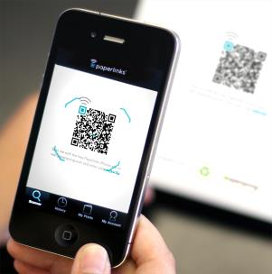
UUID QR codes for museum objects at NHM-UiO provides:
Machine-readable identifiers (using a simple smart phone - or a barcode reader)
Allows for new and efficient workflows for collection management.
Deployment for stable identifiers appropriate for data-basing.

Slide 27
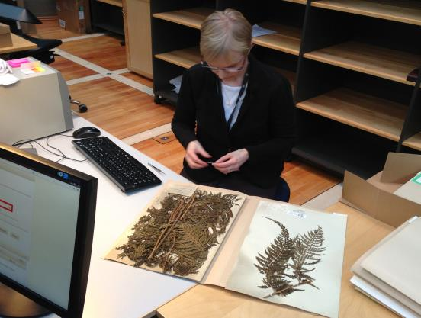
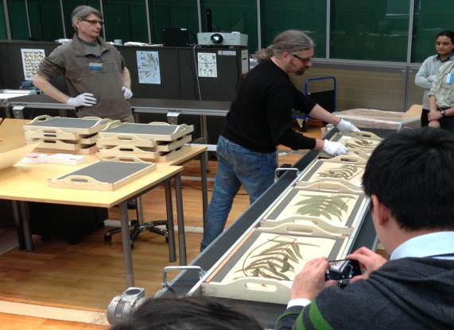
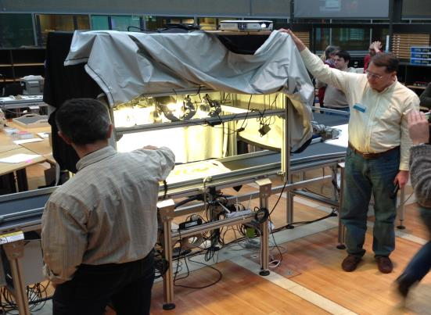
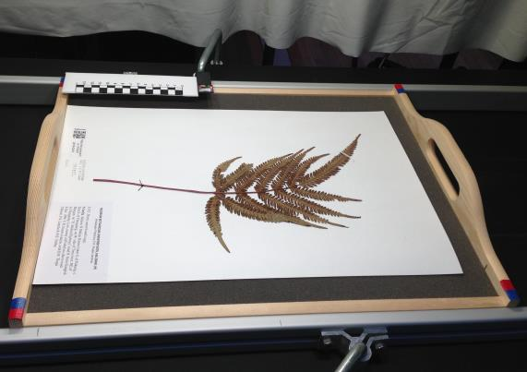
Efficient workflow routines
Notes:
Imaging of the UiO herbarium at Digitarium in Joensuu, Finland, photos: Dag Endresen, CC-by-3.0.

Slide 28
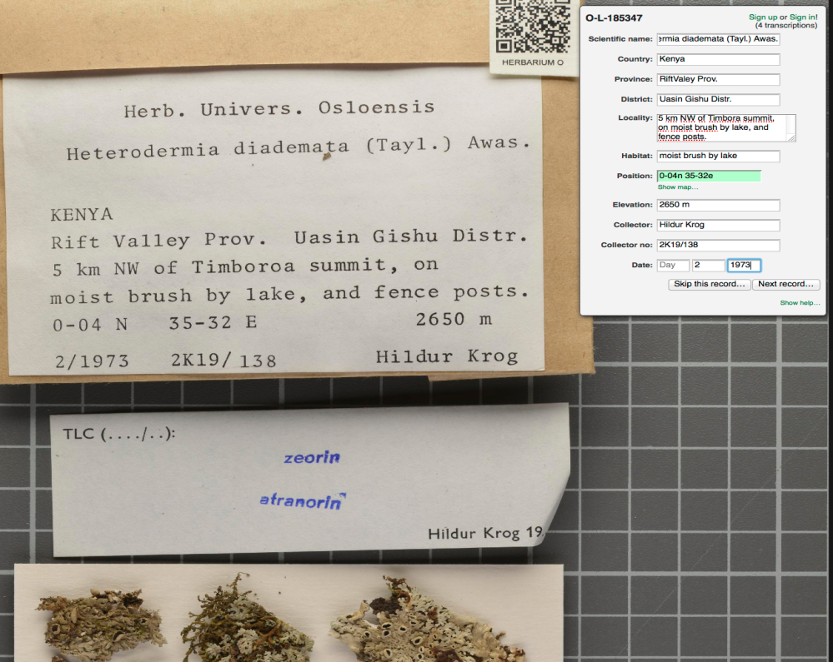
http://gbif.no/dugnad/
Notes:
PROTOTYPE: http://nhm2.uio.no/dugnad/transcribe

Slide 29
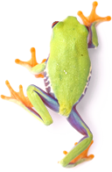
Data paper
Peer review option for biodiversity data sets.
Authors get scientific credit for data publication.
Meeting concerns over data quality.
Meeting concerns over data citation mechanism.
Towards → Each data set published through GBIF accompanied by a data paper…?
Data set identifier
DOI → dwc:datasetID …?
Notes:
Narwade, S., Kalra, M., Jagdish, R., Varier, D., Satpute, S., Khan, N., Talukdar, G., et al. (2011). Literature based species occurrence data of birds of northeast India. ZooKeys, 150: 407-417. Pensoft Publishers. DOI: 10.3897/zookeys.150.2002
Jones, K. E., Bielby, J., Cardillo, M., Fritz, S. A., OʼDell, J., Orme, C. D. L., Safi, K., et al. (2009). PanTHERIA: a species-level database of life history, ecology, and geography of extant and recently extinct mammals. (W. K. Michener, Ed.) Ecology, 90(9): 2648. Ecological Society of America. DOI: 10.1890/08-1494.1
Biodiversity Data Journal (BDJ) is a community peer-reviewed, open-access, comprehensive online platform, designed to accelerate publishing, dissemination and sharing of biodiversity-related data of any kind. http://www.pensoft.net/journals/bdj

Slide 30
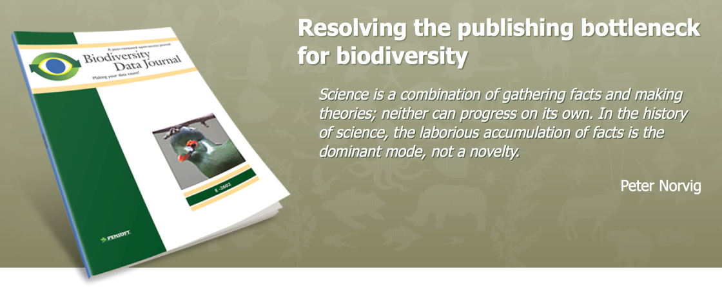
Biodiversity Data Journal
Why publish your data
Citable publication
Establish scientific priority
Increase collaboration
Link data to bigger network
Re-use and multiply effect
Respond to funding requirements
http://biodiversitydatajournal.com/
Smith V, Georgiev T, Stoev P, Biserkov J, Miller J, Livermore L, Baker E, Mietchen D, Couvreur T, Mueller G, Dikow T, Helgen K, Frank J, Agosti D, Roberts D, Penev L (2013) Beyond dead trees: integrating the scientific process in the Biodiversity Data Journal. Biodiversity Data Journal 1: e995. DOI: 10.3897/BDJ.1.e995
Notes:
http://biodiversitydatajournal.com/
Smith V, Georgiev T, Stoev P, Biserkov J, Miller J, Livermore L, Baker E, Mietchen D, Couvreur T, Mueller G, Dikow T, Helgen K, Frank J, Agosti D, Roberts D, Penev L (2013) Beyond dead trees: integrating the scientific process in the Biodiversity Data Journal. Biodiversity Data Journal 1: e995. DOI: 10.3897/BDJ.1.e995

Slide 31
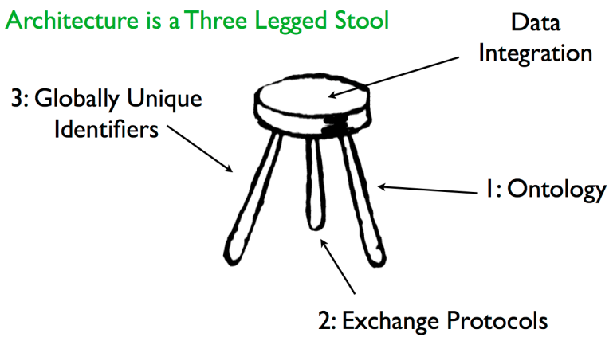
Globally unique identifiers are one of the three core components in the TDWG technical architecture.
Notes:
TDWG TAG: http://wiki.tdwg.org/TAG
Hyam, R (2006). A technical architecture for TDWG standards. Proceedings of TDWG 2006, St Louis, Missouri, USA. http://www.tdwg.org/proceedings/article/viewArticle/88
Image from: http://www.tdwg.org/fileadmin/2007meeting/slides/Hyam_OntologiesInTdwgArchitecture_abs229.pdf

Slide 32
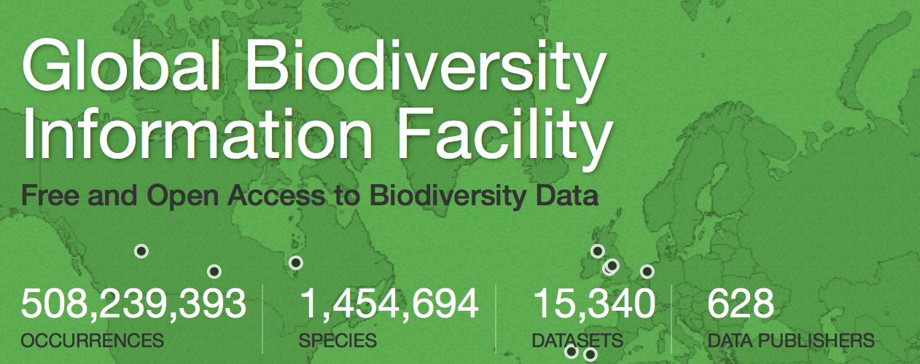
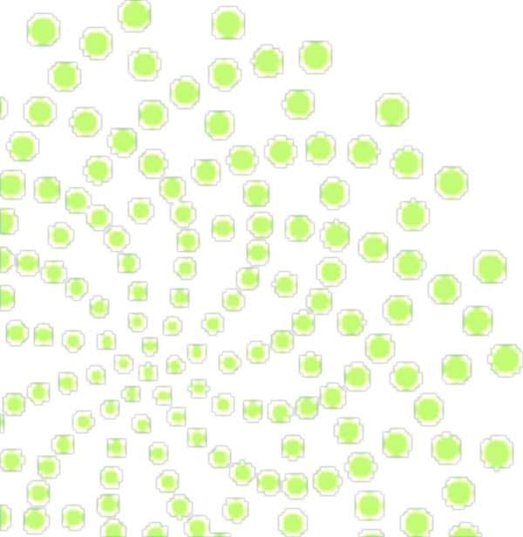
Status
27. August 2014
GBIF enables free and open access to biodiversity data online.
We are an international government-initiated and funded initiative focused on making biodiversity data available to all and anyone, for scientific research, conservation and sustainable development.
Notes:
GBIF: http://www.gbif.org/
what is the Global Biodiversity Information Facility?
GBIF enables free and open access to biodiversity data online. We are an international government-initiated and funded initiative focused on making biodiversity data available to all and anyone, for scientific research, conservation and sustainable development.
Hva er Global Biodiversity Information Facility (GBIF)?
GBIF arbeider for fri og åpen tilgang til biodiversitetsdata online. Vi er et internasjonalt og statlig initiert og finansiert nettverk med fokus på å bidra til at biodiversitetsdata er tilgjengelig for alle og enhver, for vitenskapelig forskning, bevaring og bærekraftig utvikling.

Slide 33
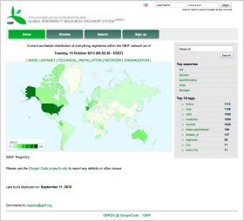
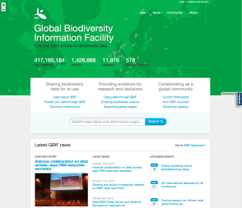
GBIF provides a data discovery system
global registry
data portal

Slide 34
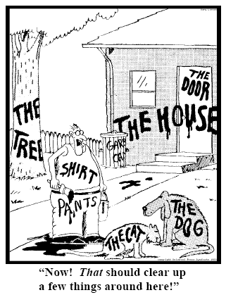
Thanks for listening!
Dag Endresen
dag.endresen@nhm.uio.no
Notes:
One proposed model for persistent and stable identifiers across biodiversity information resources could be: DOIs for datasets and collections, and UUIDs for species observations and collection specimens – and database records.
http://www.nhm.uio.no/forskning/prosjekter/gbif/
http://www.gbif.no

