Slide 2
Transcripton Tools:
Optical Character Recognition
Voice Recognition
Crowd-sourcing
Kongsvold, Norway
2 September 2014
Gil Nelson
iDigBio/Institute for Digital Information and Scientific Communication
Florida State University

Slide 3
Outline
Introduction to iDigBio (Integrated Digitized Biocollections)
Optical character recognition (OCR)
Voice recognition (VR)
Citizen science, volunteers, public participation
Questions and discussion are encouraged!

Slide 4
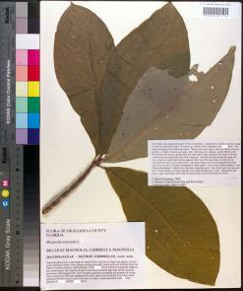
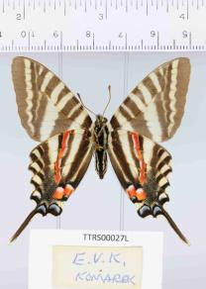
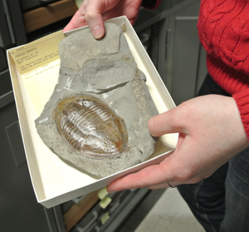
Estimates suggest that there may be 1.8 billion biological and paleobiological specimens in the United States, 3+ billion worldwide. No one really knows for sure!

Slide 5
In an effort to make these collections universally accessible to taxonomists, ecologists, researchers, and the general public, in 2011 the U.S. National Science Foundation launched a $100 million, 10-year Advancing Digitization of Biodiversity Collections program and named the University of Florida and Florida State University jointly as the national resource for digitization.
The scope of our work is limited to public, non-federal, U.S. collections, though NSF has encouraged us to develop international collaborations.

Slide 6
Advancing Digitization of Biodiversity Collections
Integrated Digitized Biocollections (iDigBio)
University of Florida
Florida State University
Florida Museum of Natural History
The goal is to digitize and make available via the Web at least
1 billion biological and paleontological records
over the 10-year life of the project.

Slide 7
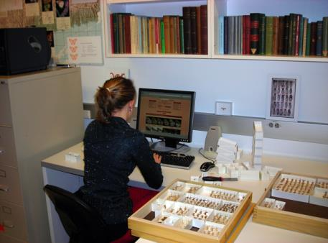
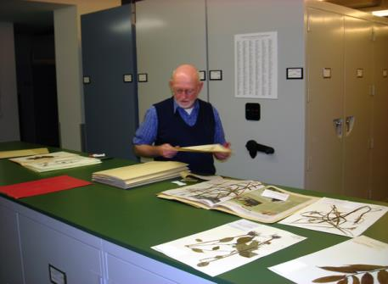
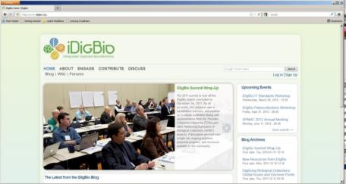
Mandate and Responsibility
Provide/facilitate portal access to collections data
Make information available and discoverable
Label Data and images
Enable digitization and research
Facilitate digitization workflows
Oversee implementation of standards
and best practices for digitization
Allow for data discovery across organismal groups
Be a client of digitization projects/networks
Actively seek partners and data sources
Respond to cyberinfrastructure needs
Engage communities
Collections
Research
Citizen science and education
Support ADBC goals
Access to information
Support for collections
Sustainability
www.idigbio.org

Slide 8
Thirteen Thematic Collections Networks (TCNs)
plus 2 Partner to Existing Networks (PENs)
InvertNet: An Integrative Platform for Research on Environmental Change, Species Discovery and Identification (Illinois Natural History Survey, University of Illinois) http://invertnet.org
Plants, Herbivores, and Parasitoids: A Model System for the Study of Tri-Trophic Associations (American Museum of Natural History) http://tcn.amnh.org
North American Lichens and Bryophytes: Sensitive Indicators of Environmental Quality and Change (University of Wisconsin – Madison) http://symbiota.org/nalichens/index.php http://symbiota.org/bryophytes/index.php (plus 2 PENs)
Digitizing Fossils to Enable New Syntheses in Biogeography - Creating a PALEONICHES-TCN (University of Kansas)
The Macrofungi Collection Consortium: Unlocking a Biodiversity Resource for Understanding Biotic Interactions, Nutrient Cycling and Human Affairs (New York Botanical Garden)
Mobilizing New England Vascular Plant Specimen Data to Track Environmental Change (Yale University)
Southwest Collections of Anthropods Network (SCAN): A Model for Collections Digitization to Promote Taxonomic and Ecological Research (Northern Arizona University) http://hasbrouck.asu.edu/symbiota/portal/index.php
iDigPaleo: Fossil Insect Collaborative: A Deep-Time Approach to Studying Diversification and Response to Environmental Change
Developing a Centralized Digital Archive of Vouchered Animal Communication Signals
The Macroalgal Herbarium Consortium: Accessing 150 Years of Specimen Data to Understand Changes in the Marine/Aquatic Environment

Slide 9
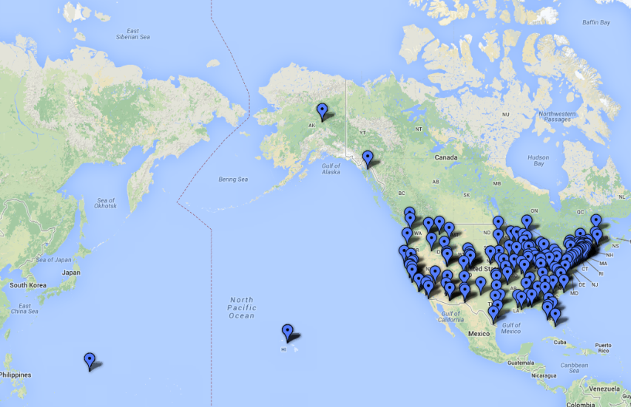
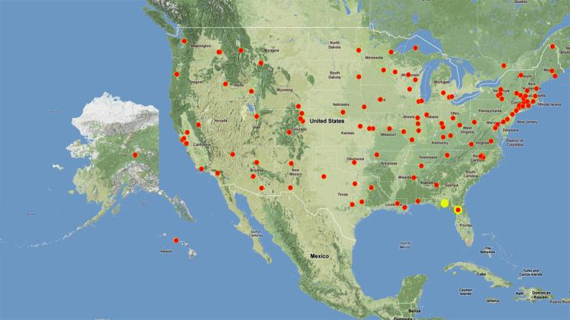
National Resource (iDigBio), Thematic Collection Networks (TCNs)
To date: 10 TCNs, 152 unique institutions, ~276 projects, 50 states

Slide 10
Advancing Digitization of Biodiversity Collections (ADBC)
Developing networks, enhancing communication, facilitating collaboration
To date: 10 TCNs, 152 unique institutions, ~276 projects, 50 states

Slide 11
Key Features of iDigBio
Ingest all contributed data with emphasis on use of GUIDs, no restrictions
Maintain persistent datasets and versioning, allowing new and edited records to be uploaded as needed while preserving existing records
Ingest textual specimen records, plus associated still images, video, audio, and other media (or links to these resources as determined by the provider)
Ingest linked documents and associated literature, including field notes, ledgers, monographs, related specimen collections, etc.
Provide virtual annotation capabilities and track annotations back to the originating collection (collaborating with FilteredPush)
Facilitate sharing and integration of data relevant to biodiversity research
Provide computational services for biodiversity research
Notes:
Storage and Services:
Provide computational services for biodiversity research: VPN e.g., (Symbiota instances, cloud platform available, GeoLocate)
Facilitate sharing and integration of data relevant to biodiversity research

Slide 12
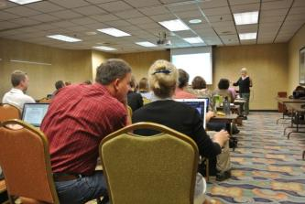
Information Dissemination
In March 2012, the iDigBio Steering Committee established a series of preparation-specific digitization training workshops focused on helping collections managers get started with and/or enhance local digitization programs, all to be held at host institutions.
DROID (Developing Robust Object->Image->Data, May 2012)
Herbarium digitization (Valdosta State, September 2012)
Fluid-preserved collections digitization (U. Kansas, March 2013)
Dried insect collections digitization (Field Museum, April 2013)
Collections Digitization (West Virginia, ASB, April 2013)
Imaging fluid-preserved invertebrates (U. Michigan, September 2013)
Georeferencing Train-the-Trainers (iDigBio, Gainesville, August 2103)
Paleontology digitization (Yale Peabody Museum, September 2013)
Small Herbarium Digitization (Florida State University, December 2013)
Digitization in the South Pacific (Honolulu, March 2014)
Paleoimaging (Austin, TX, April 2014)
Small Herbarium Digitization (Boise, Botany 2014, July 2014)
Leveraging Digitization Knowledge Across Multiple Domains (Santa Barbara, October 2014)

Slide 13
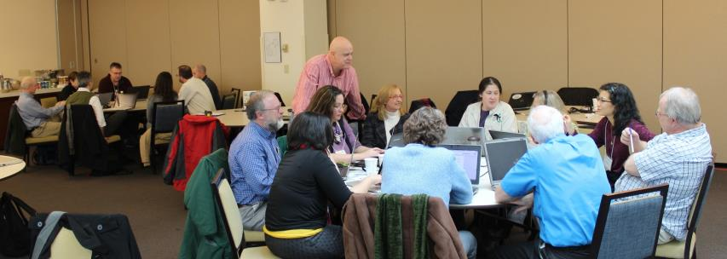
Collaborating on Best Practices
Product-oriented Workshops
Augmenting OCR Hackathon (Ft. Worth, February 2103)
Original Source Materials Digitization (Yale Peabody Museum, March 2014)
Recruiting and Retaining Small Collections in Digitization (Mt. Pleasant, MI, April 2014)
CitScribe Hackathon (iDigBio, Gainesville, December 2013)
Education and Outreach (iDigBio, Gainesville, January 2014)

Slide 14
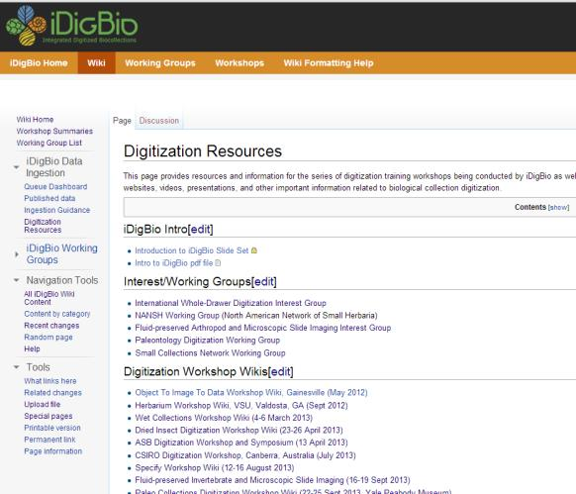
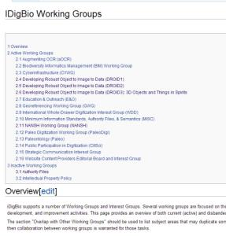
Wikis
Working groups Listservs

Slide 15
Augmenting OCR (aOCR) Working Group
https://www.idigbio.org/wiki/index.php/Augmenting_OCR
https://www.idigbio.org/wiki/index.php/Augmenting_OCR_Working_Group_Resources
iDigBio Coordinator: Deb Paul (dpaul@fsu.edu)
Resource: IDIGBIO-AOCR-L@LISTS.UFL.EDU
Purpose: This working group is attempting to improve OCR output and algorithm tools to speed up the digitization process.
To add yourself to the list, email listserv@lists.ufl.edu with the following command in the email:
subscribe IDIGBIO-AOCR-L first_name last_name
e.g., subscribe IDIGBIO-AOCR-L Jane Doe

Slide 16
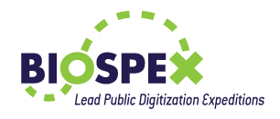
Methods for Transcribing Data From Labels
Manually keystroking data directly from label or image
Optical character recognition
(usually combined with keystroking from images)
Voice recognition
(usually combined with keystroking for corrections)
Crowd sourcing and volunteers

Slide 17
Products
Dragon Naturally Speaking
tesseract-ocr
An OCR Engine that was developed at HP Labs between 1985 and 1995... and now at Google.
ABBYY FineReader 12 Professional
ABBYY FineReader 12 Corporate
ABBYY Recognition Server

Slide 18
What is Optical Character Recognition (OCR)?
The mechanical or electronic conversion of scanned or photographed images of typewritten or printed text into machine-encoded/computer-readable text.

Slide 19
Limitations of OCR
Not a silver bullet!
Automated, hands-free transcription (image->OCR->parsing->record completion)
Parsing/NLP (Natural language processing)
Handwriting
Quality of labels matters
Label inconsistency can be challenging
Font matters, especially when variable from label to label
Typewriter-produced text can be problematic
Usually requires some level of user involvement

Slide 20
Uses for OCR
Concealed search field for robust searches of skeleton or sparsely populated records.
Capture and check bar code value against file names or records.
Finding related records by collector, collection date, locality, country, political subdivision.
Assistance to crowd sourced transcribers.
Display to data entry personnel.
Provide “cut and paste” opportunities.
Create equivalent of record fingerprints by removing punctuation, spaces, and converting to a single case.

Slide 21
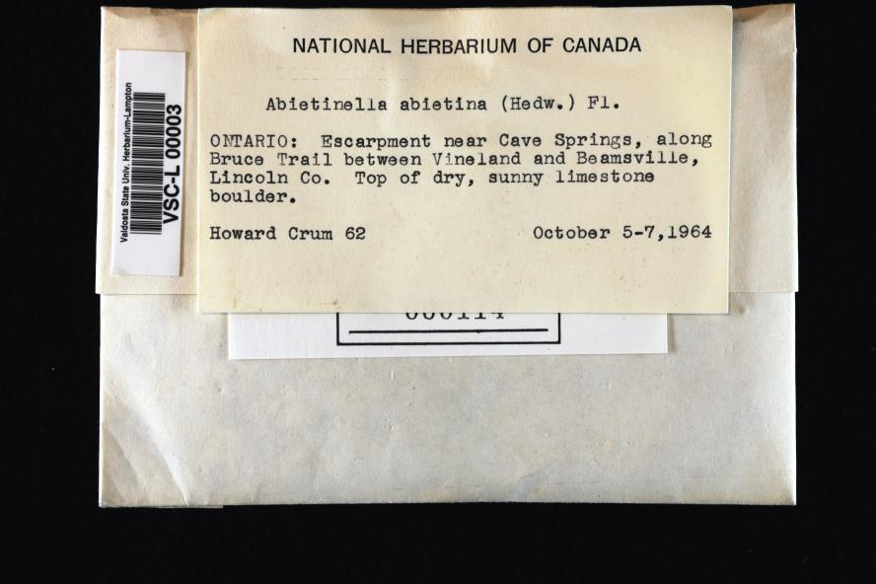
x height = ~60 pixels, minimum is about 20 pixels; 10 or fewer severely reduces readability
Imaged with a 24.5 mp Nikon D3x full frame camera (overkill?)

Slide 22
ABBYY

Slide 23
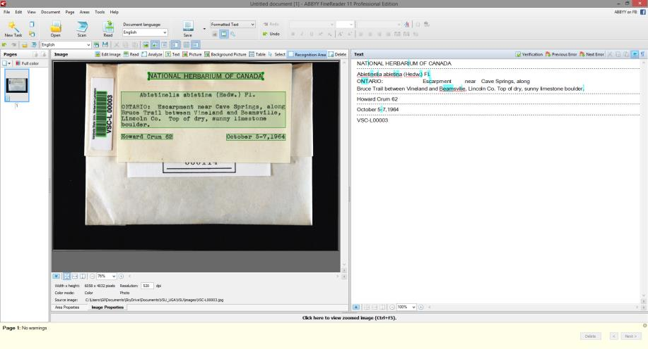
Demarcated text
ABBYY Interface
Read the embedded bar code, but not the text version
Can also set up a hot folder for batch processing labels overnight

Slide 24
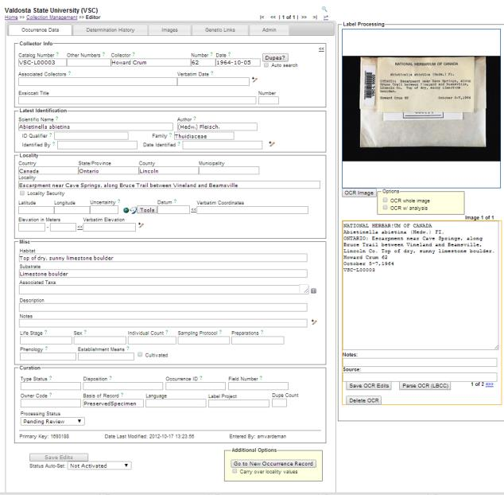
Symbiota

Slide 25
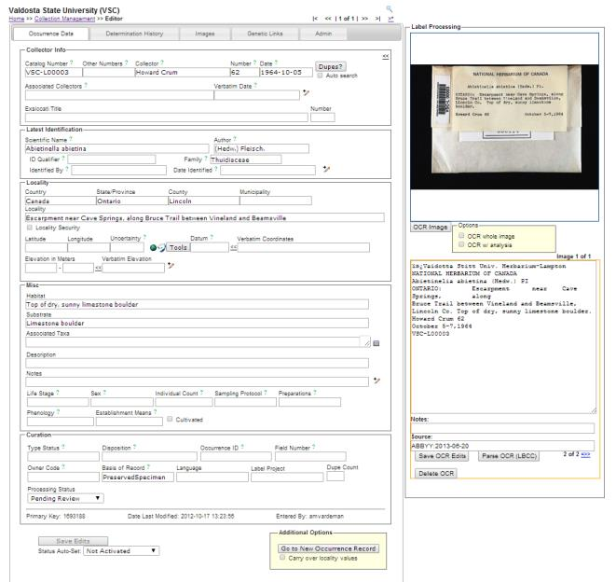

Slide 26
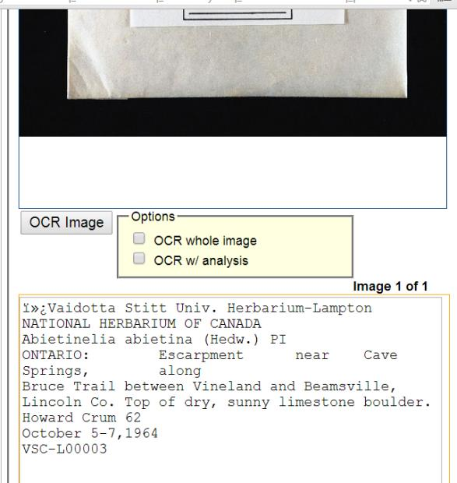

Slide 27
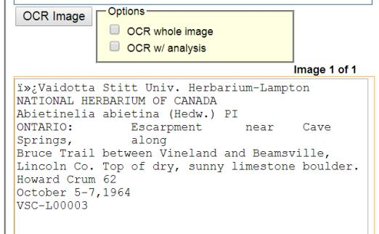
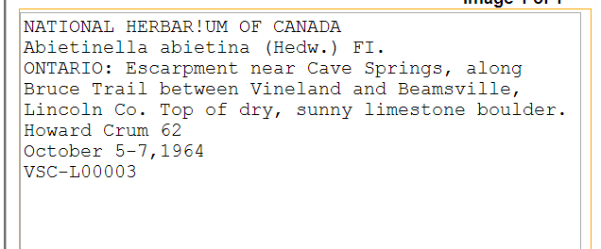

Slide 28
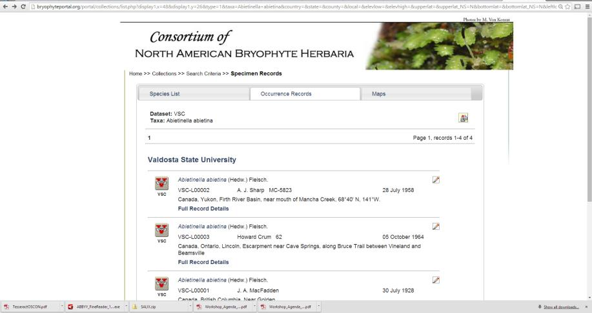

Slide 29
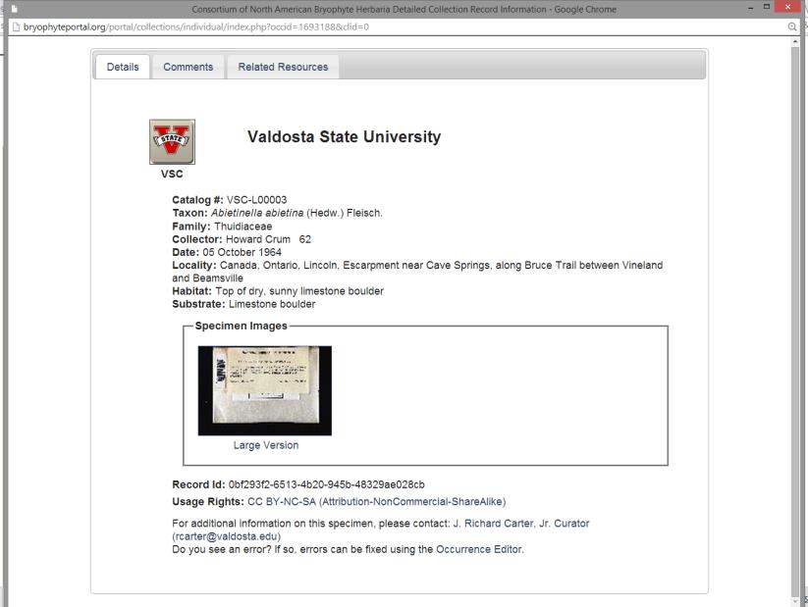

Slide 30
Packet
vs
Label (cropped vs imaged)
vs
Half sheet
vs
Whole sheet

Slide 31
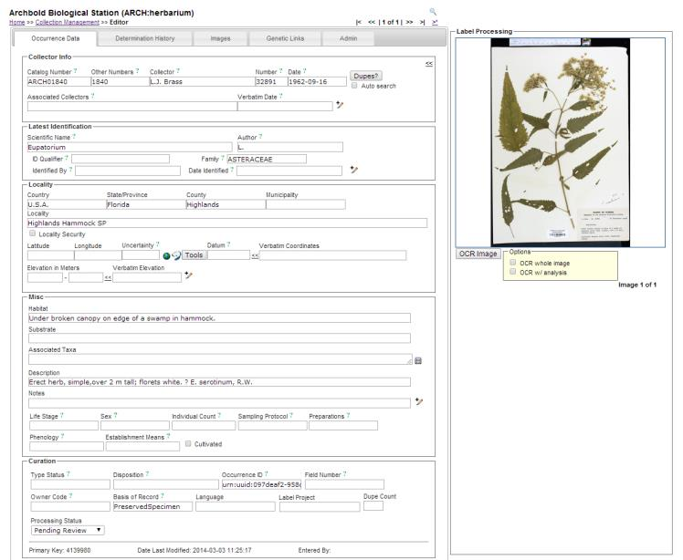

Slide 32
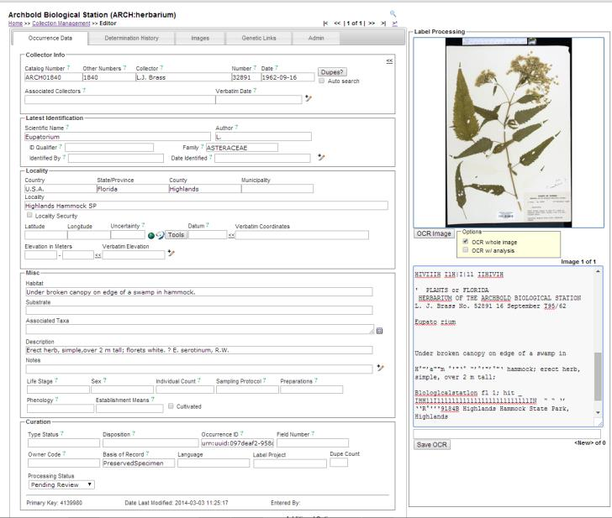
Full Sheet

Slide 33
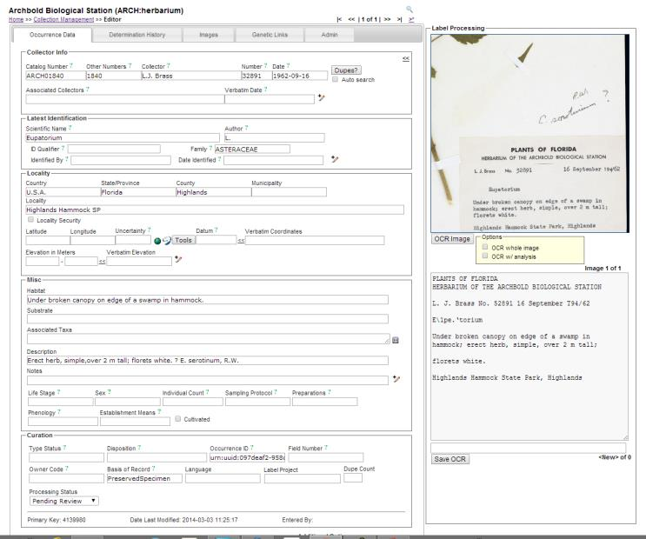
Label only

Slide 34
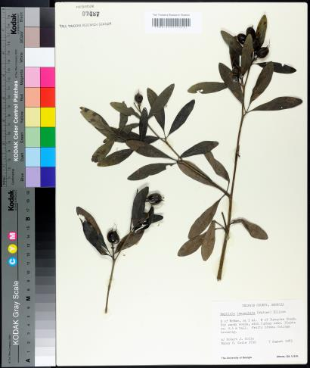
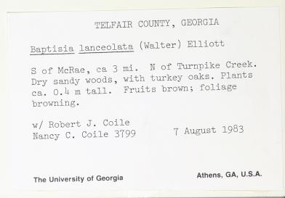
Labels cut or cropped from an image seem to work better, with at least a bit more accuracy.

Slide 35
_{TELFAIR COUNTY, GEORGIA}
Baptisia lanceolata (Walter) Elliott
S of McRae, ca 3 mi. N of Turnpike Creek. Dry sandy woods, with turkey oaks. Plants ca. 0.4 m tall. Fruits brown; foliage browning.
_{w/ Robert J. Coile}
Nancy C. Coile 3799 7 August 1983
_{The University of Georgia}
_{Athens, GA, U.S.A.}
_{HERBARHJM}
_{0748?}
_{1AU. UMBERS RESEARCH 5TAH9M}
TELFAIR COUNTY, GEORGIA Baptisia lanceolata (Walter) Elliott
S of McRae, ca 3 mi. N of Turnpike Creek. Dry sandy woods, with turkey oaks. Plants ca. O.it m tall. Fruits hrown; foliage hrowning.
w/ Robert J. Coile Nancy C. Coile 3Y99
_{7 August 1983}
_{The University of Georgia}
_{Athens, GA, U.S.A.}

Slide 36
SALIX
Semi-Automatic Label Information eXtraction System
(Daryl Lafferty, Arizona State University)
Download at: http://daryllafferty.com/salix/

Slide 37
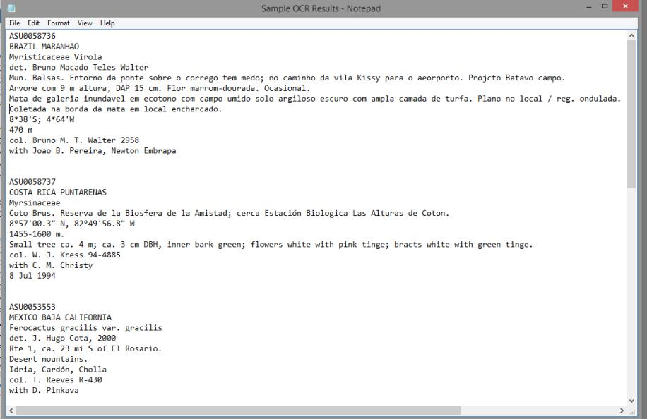
Bar code (catalog number)
Well formatted output
One of several ABBYY output file formats
Single file with demarcated text blocks (text or doc)
Individual text files for each extraction
Spreadsheet

Slide 38
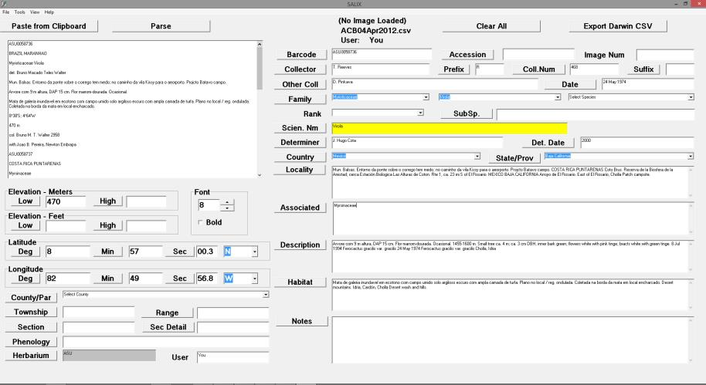

Slide 39
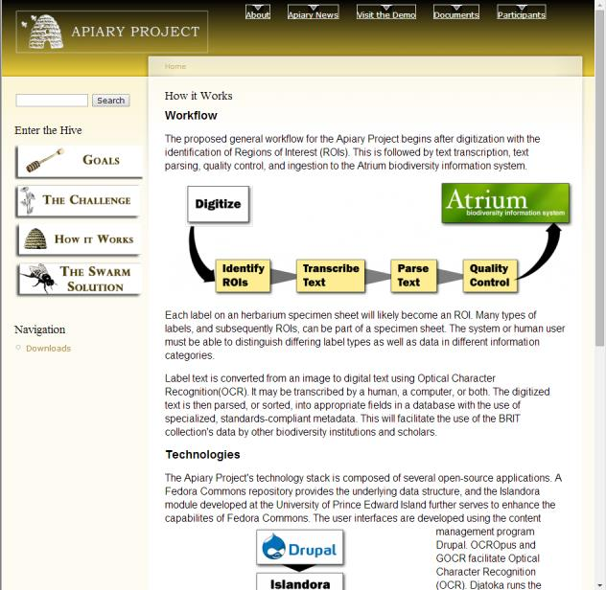
Botanical Research Institute of Texas (BRIT)
Open source tools
OCROpus
GOCR
Regions of Interest
Field selection
Drag and drop
Provides data to Atrium
Jason Best
(jbest@brit.org)

Slide 40
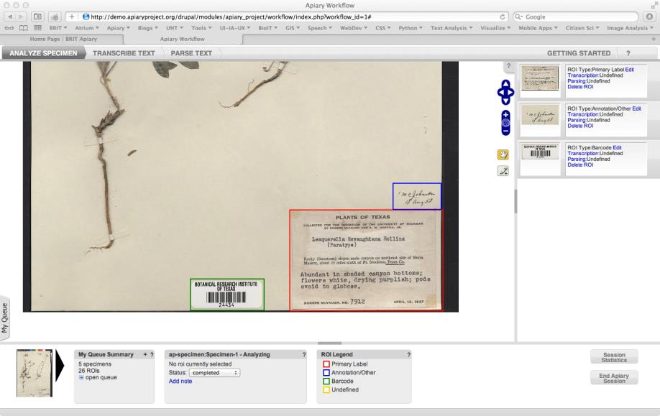
Notes:
A person inspects the image and delineates each area that has textual content. Additionally, the regions can be classified as primary label, annotation, barcode, etc.

Slide 41
What is Voice Recognition (VR)?
Voice or Speech recognition is the ability of a machine or software to:
identify words and phrases in spoken language and convert them to a machine-readable format,
receive and interpret dictation, and
understand and carry out spoken commands.

Slide 42
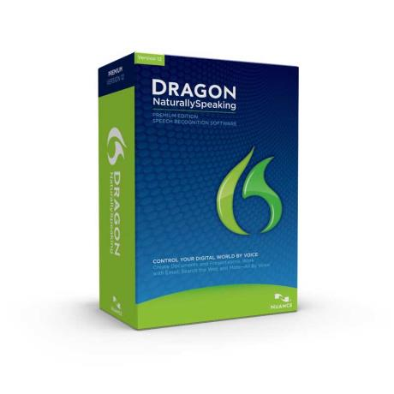
Voice Recognition for label transcription
Dragon Naturally Speaking (Via Voice)
Microsoft speech recognition
Mac dictation

Slide 43
Voice Recognition Tips
Training (the more you train, the better it works)
Individualized training; each profile is adapted to a single user
Headset
Restricted entry
Latin names (requires training)
Collector names (requires training)
Geography
Catalog or other numbers
Dates (varying formats; reads verbatim; dictate numerals, not entire year)
Patience!
Recommendation: Dragon Naturally Speaking
(Microsoft speech recognition is clunky)

Slide 44
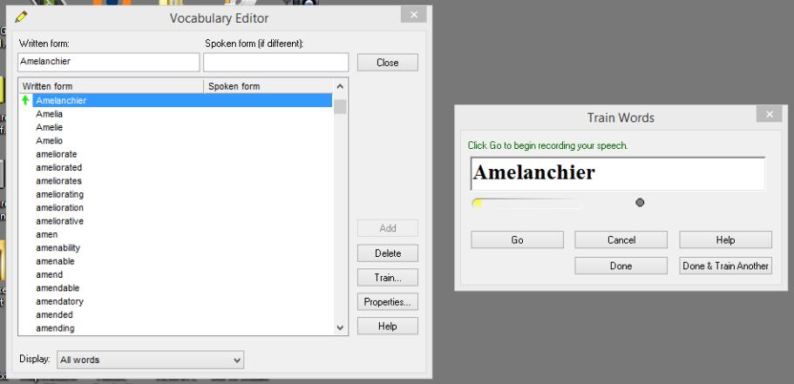

Slide 46
Procedure
Uses 3-column spreadsheet.
Column 1 = Image number (macro converts spoken number, as 9564 to DSC09564.jpg.
Column 2 = Record number of corresponding record in database.
Column 3 = View (in this case for paleontology, hence dorsal, ventral, hinge, etc.;
needed for multiple views).
Technician also uses commands to move cursor from column to column and
row to row.
Spreadsheet is processed and added to the database.

Slide 47
Public Participation in Scientific Research (PPSR)
Citizen Science
Amateur Science
Civic Science
Crowdsourced Science
Volunteer Monitoring

Slide 48
Public Participation in Scientific Research (PPSR)
: projects in which volunteers partner with scientists to answer real-world questions
(Cornell Lab of Ornithology)
: the systematic collection and analysis of data; development of technology; testing of natural phenomena; and the dissemination of these activities by researchers on a primarily avocational basis
(OpenScientist)
Long history in botany

Slide 49
Notes:
There are many programs out there transcribing data in various ways. There is still a lot to learn and understand about what makes one program or interface better for citizen science participation..

Slide 50
Citizen Scientists, Crowds, and Volunteers for Label Transcription
Issues
Recruitment
Keeping up with volunteers
Management
Ensuring quality
Proofing
Instability of student and volunteer labor
Potential for rapid productivity

Slide 51
www.notesfromnature.org
Notes:
NfN is another, slightly different platform

Slide 53
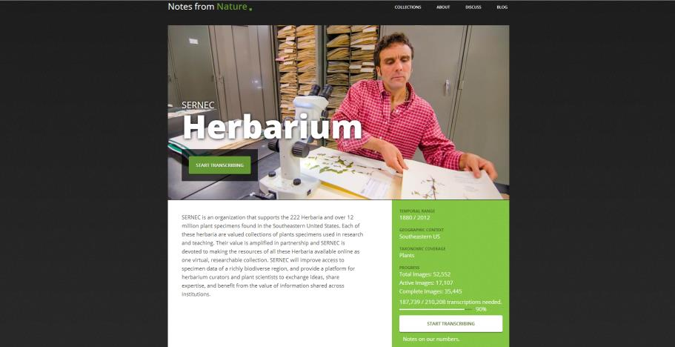

Slide 54
Notes:
Here users are asked to submit one field at a time

Slide 55
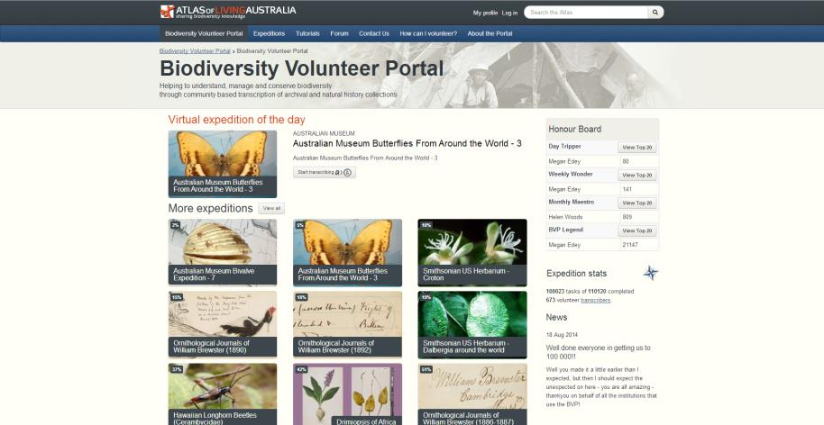

Slide 56
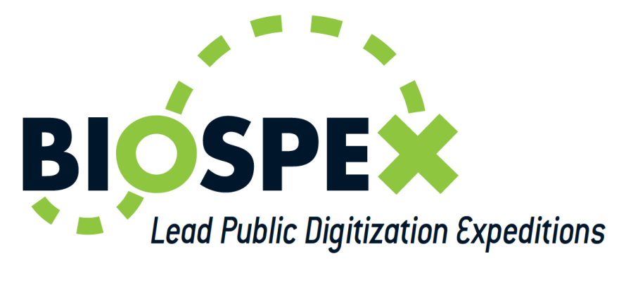
http://www.biospex.org/

Slide 59
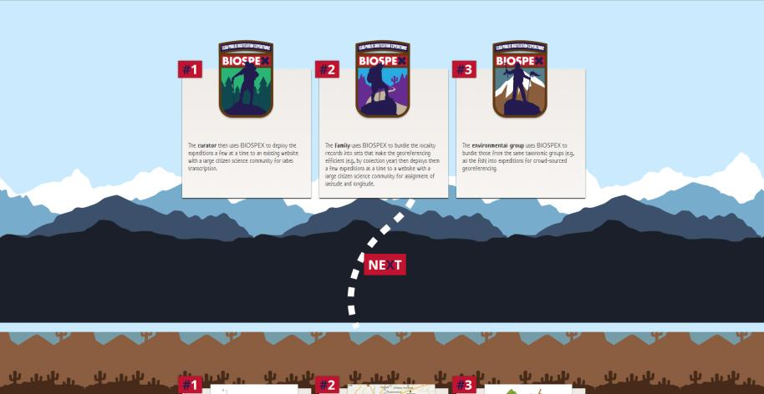

Slide 62
Origin of BIOSPEX
Public Participation Workshop Participants identified need for system that would
lower barriers to creation and management of public participation projects,
make data flow more easily among relevant platforms,
build capacity for recruiting and engaging with public participants, and
enable co-created citizen science projects.
http://www.biospex.org/

