Slide 1
RNA-seq pipeline
MBV3070
18th April, 2016
Ståle Nygård
Bioinformatics core facility, OUS/UiO
staaln@ifi.uio.no

Slide 2
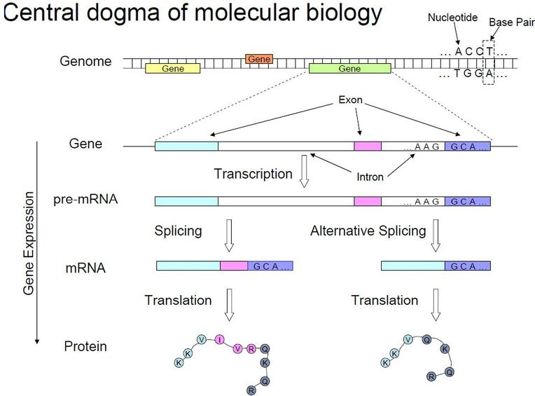
Gene expression
Gene expression is the process by which information from a gene is used in the synthesis of a functional gene product.

Slide 3
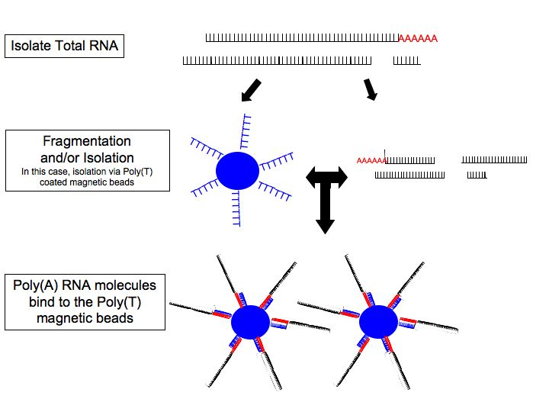
RNA sequencing (technology)

Slide 4
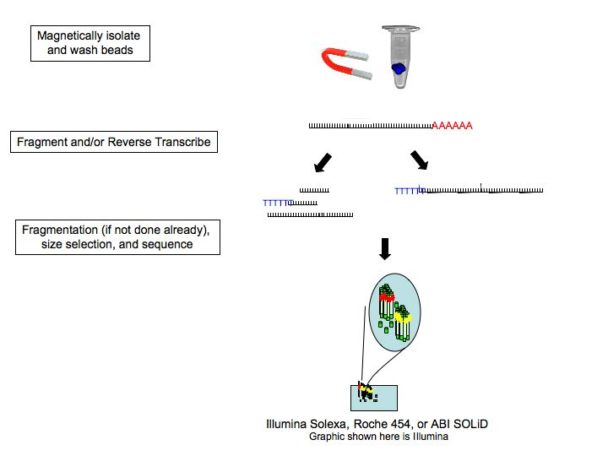
RNA sequencing (technology)

Slide 5
ELIXIR Galaxy RNA-seq pipeline
At galaxy-ntnu.bioinfo.no
Pipeline
  Tophat2 (alignment)
  FeatureCounts
  DESeq (differential expression)

Slide 6
DESeq bulids on negative binomial distribution

Slide 7
Estimating dispersion

