Slide 1
NeLS workshop
Dept of Informatics, UiO
20th April 2016
contact@bioinfo.no

Slide 2
Agenda
About ELIXIR Norway (short intro)
About NeLS/Galaxy/Storebioinfo (short intro)
Hands-on session
NeLS (file upload etc)
Galaxy (analysis)
Single tool
RNA-seq pipeline

Slide 3
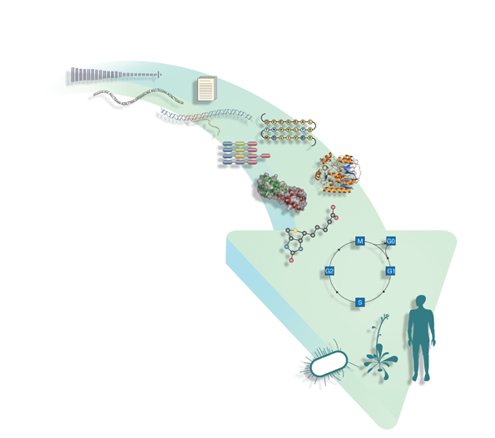
Bioinformatics underpins life-science research
1 Genomes
contain genes
2 Genes are transcribed
3 Transcripts translate to protein sequences
4 Proteins form three-dimensional structures
5 Proteins interact with each other and with small molecules to form pathways
6 Pathways combine to build systems

Slide 4
Bioinformatics underpins life-science research
Nucleotide sequence
ENA
Genomes
Ensembl, Integr8
Gene expression
ArrayExpress
Protein sequence
UniProt
Protein families,
motifs and domains
InterPro (11 databases)
Protein structure
MSD
Protein interactions
IntAct
Chemical entities
ChEBI
Pathways
Reactome
Systems
BioModels

Slide 5
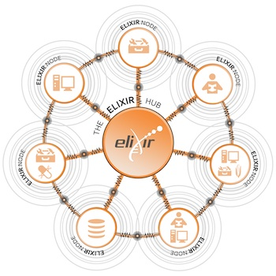
ELIXIR - Hub and node model
ELIXIR – A distributed European infrastructure for life-science information
ELIXIR Nodes builds on national strengths and priorities
ELIXIR Nodes build local bioinformatics capacity throughout Europe

Slide 6
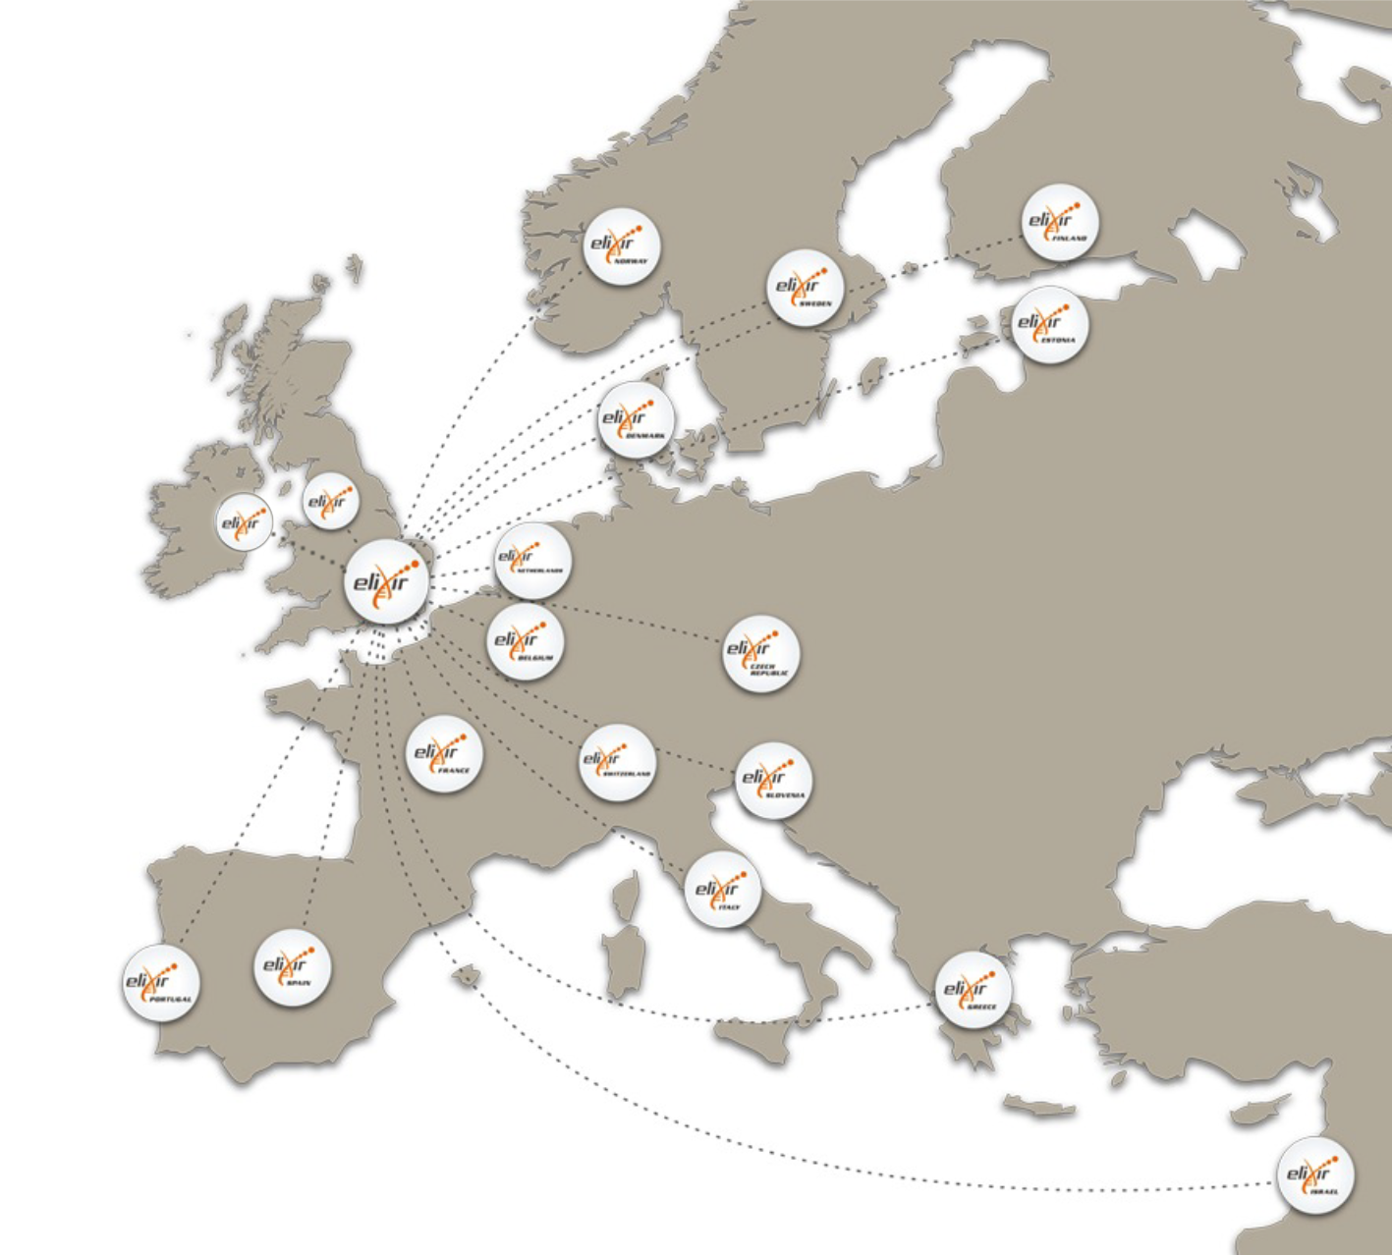
ELIXIR
ELIXIR Hub:
Hinxton, UK
ELIXIR members:
Czech republic
Estonia
Denmark
Finland
Israel
Netherlands
Norway
Italy
Belgium
Portugal
Sweden
Switzerland
UK
EMBL-EBI
France
Spain
• ~3 million life science researchers in Europe
• >9 million web hits a day at EMBL-EBI alone
• 1 million unique users per year
ELIXIR observers:
Greece
Slovenia
Ireland

Slide 7
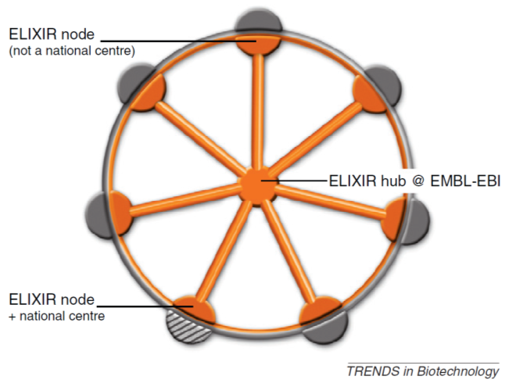
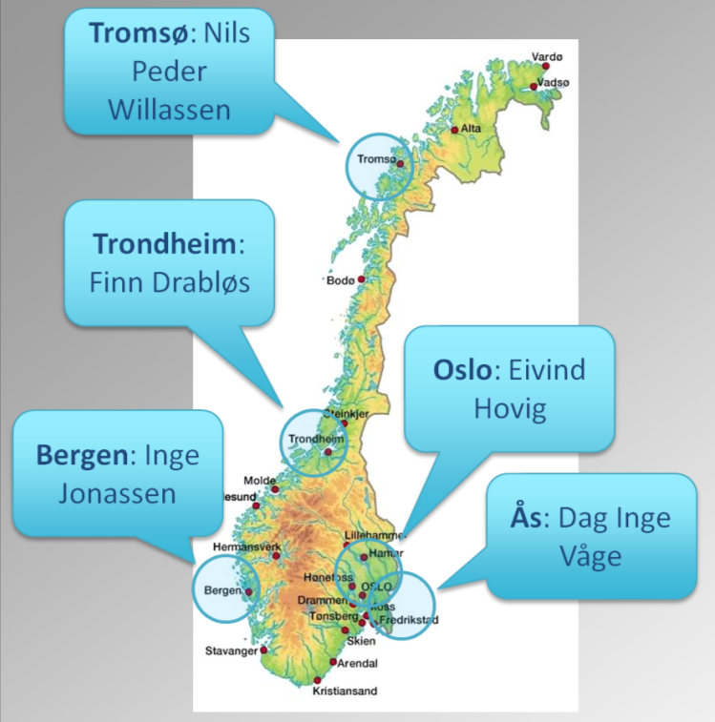
ELIXIR Norway

Slide 8
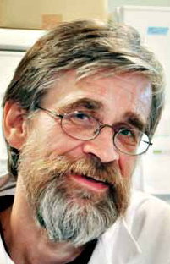
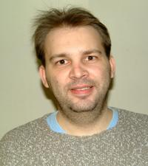
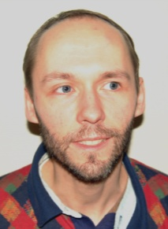
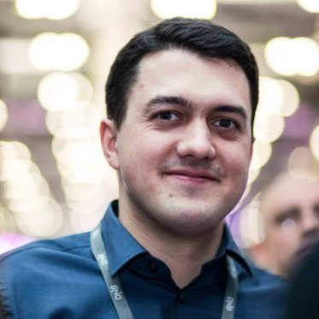
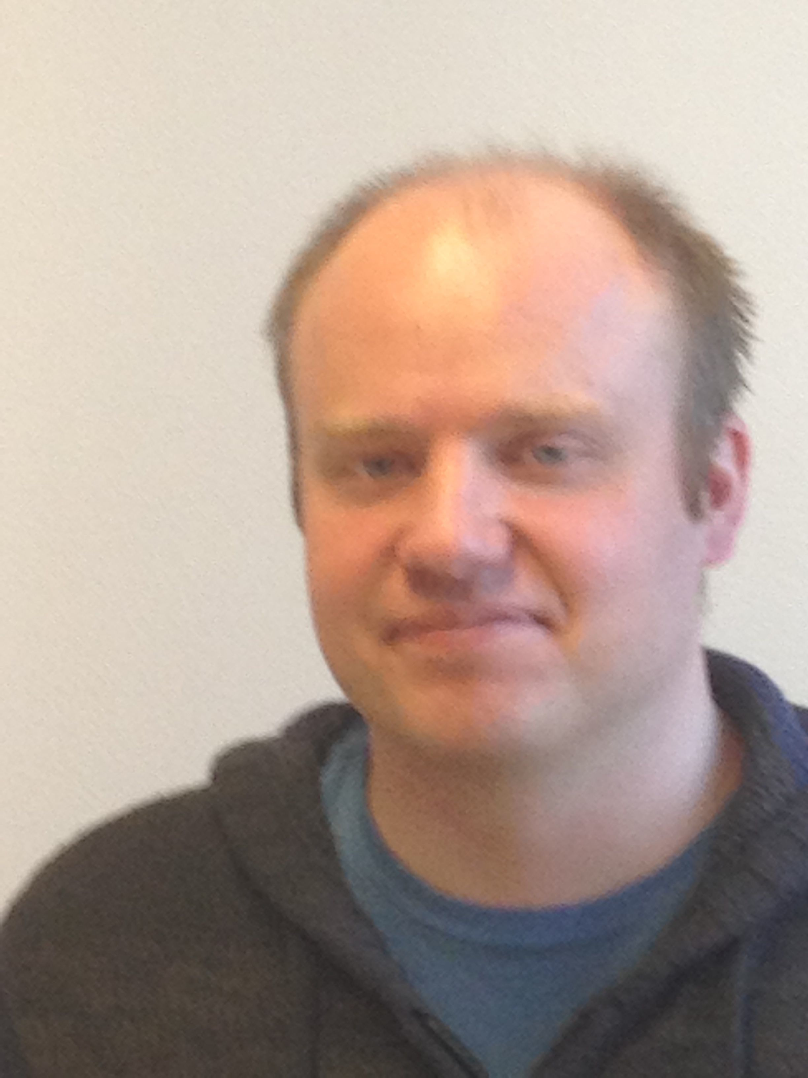
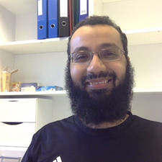
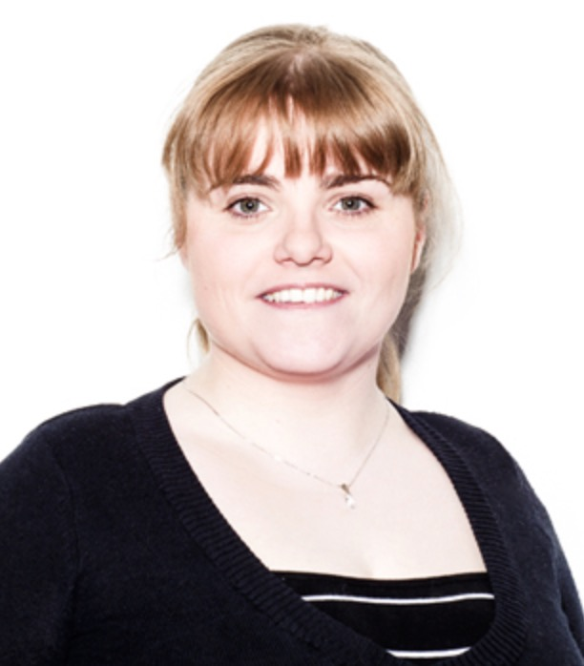
Inst. for cancer research, OUH
Vegard Nygaard Microarray and sequence data analysis
Sumana KalyanasundaramHTS analysis, general “omics”
Eivind Hovig
Scientific leader
Morten Johansen Programming, scripting, web servers
Oleg Agafonov
HTS, systems biology
Ståle Nygård
Service leader
Biomedical research group, UiO
Sveinung Gundersen
Hyperbrowser
Norwegian computing
center
Jon K. Lærdahl
Protein structure analysis
Marit Holden,
Statistical genomics
Antonio Mora
Gene regulation
Torbjørn Rognes Sequence analysis
Clara-Cecilie Günther
Statistical
genomics
Hildur Sif Thorarensen
Programming
Abdulrahman Azab
Computation

Slide 9
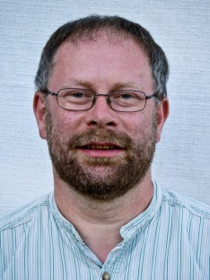
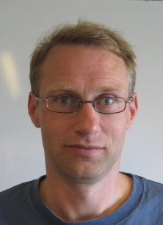
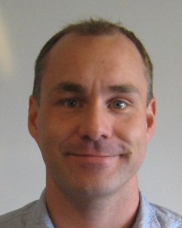
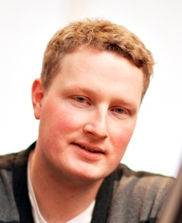
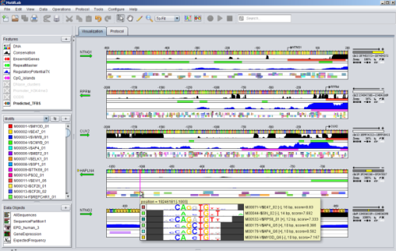
ELIXIR Norway Trondheim node – Integrated with the Bioinformatics Core Facility
Located in the Laboratory Centre of St Olavs Hospital and NTNU
Focus on biomedical research, gene regulation and large scale genomics
Helpdesk services by Bioinformatics Core Facility (BioCore, funded by NTNU)
Close collaboration with Genomics Core Facility (GCF)
Finn Drabløs
Professor
Leader ELIXIR-NTNU
Morten Rye
Researcher
ELIXIR-NTNU
Kjetil Klepper
Staff Engineer
ELIXIR-NTNU
Pål Sætrom
Professor
Head BioCore
Jostein Johansen
Senior Engineer
Manager BioCore
http://www.motiflab.org

Slide 10
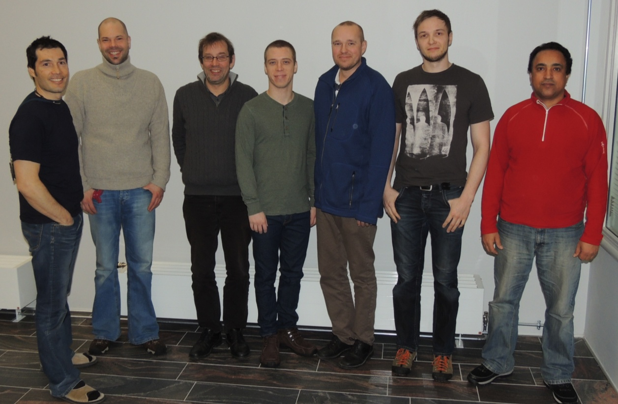
ELIXIR Norway Tromsø node - SYSBIO
Located both at the Science Park and NT faculty, UiT
Collaboration between Dept. of Chemistry and Dept. of Informatics, UiT
Focus on marine genomics/metagenomics
Contact persons; Erik Hjerde (Help desk) Nils Peder Willassen (Head)
From left to right: Erik Hjerde, Tim Kalkhe, Nils Peder Willassen, Edvard Pedersen, Peik Haugen, Espen Robertsen and Said Ahmed. Lars Ailo Bongo not present
ELIXIR Norway - Tromsø

Slide 11
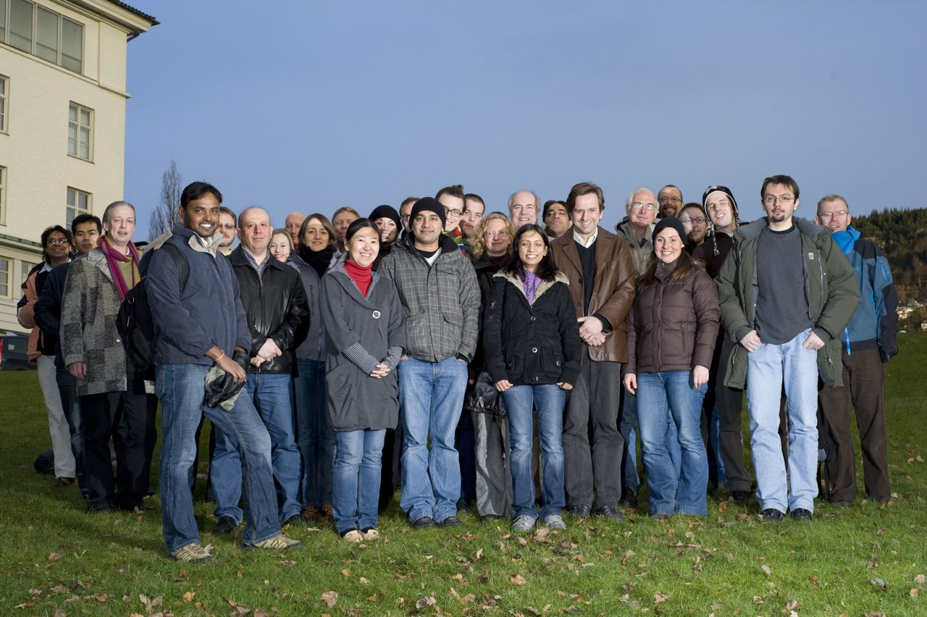
ELIXIR.NO Bergen node – the Computational Biology Unit
The University of Bergen coordinates the ELIXIR Norway project and the (aspiring) Norwegian ELIXIR Node
Bioinformatics at UiB organised in CBU – Computational Biology Unit – including research groups and a service group
ELIXIR Norway personnel includes programmers, service scientists
Close coupling with LiceBase within Sea Lice Research Centre (SFI)
Collaboration with Norwegian Genomics Consortium (NGC), PROBE (proteomics), Department of publich health (biobanks)
Project leader: Inge Jonassen
ELIXIR Norway - Bergen

Slide 12
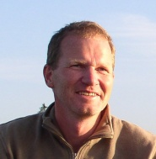
ELIXIR.NO Ås node
Located at Centre for Integrative Genetics (CIGENE), Norwegian University of Life Sciences (UMB).
CIGENE has established pipelines for handling large-scale sequencing data, with focus on de novo assembly (e.g. the Atlantic salmon genome) and development of DNA - markers (SNPs). The research is aimed at bridging the gap between genotype and phenotype in production biology species.
The primary contribution to ELIXIR Norway will be to make fish genomic resources and tools available to the national and international research community.
Node manager: Dag Inge Våge
ELIXIR Norway - Ås

Slide 13
Services we provide
High throughput sequencing data analysis:
DNA sequencing
RNA-Seq
miRNA-Seq
ChIP-Seq
Microarray data analysis
Proteomic data analysis
Protein structure analysis
Statistical genomics
Functional genomics
General bioinformatics
Facilitating use of computational resources together with USIT
CPU: http://uio.no/hpc/abel
Disk: https://storebioinfo.norstore.no
TSD (Tjeneste for Sensitive Data)

Slide 14
Helpdesk – How it works
Users contact us through e-mail or in person
Simple services (“less than 3 days work”) offered free of charge to Norwegian academic/government users
Always free to ask questions
Larger projects may require user fees (750 NOK per hour) or some form of collaborative research, depending on prior agreement. Any user fees will be based on a non-profit model and should be considered reasonable
It is recommended to think about bioinformatics funding already in the planning stages of your research as this is an important and resource intensive step

Slide 15
Bioinformatics Core Facility and ELIXIR Norway Helpdesk contact@bioinfo.no
Our job is to help you with your bioinformatics needs. Please use us!

